Slide 1
Stability and Change in Gender Identity and Sexual Orientation Across Childhood and Adolescence
Benjamin E. deMayo, Princeton University
Natalie M. Gallagher, Princeton University
Rachel A. Leshin, Princeton University
Kristina R. Olson, Princeton University
Monograph Matters is a companion website of the Society for Research in Child Development
Natasha J. Cabrera, Editor (ncabrera@umd.edu)

Slide 2
Objectives
Contrast past developmental and clinical psychology approaches to gender development and contemporary understanding of this topic.
Describe any generational shifts we may be seeing in terms of how youth in our sample are thinking about gender and sexual orientation.
Understand commonalities and differences in later gender identity and sexual orientation of transgender vs. cisgender youth in the Trans Youth Project.
Describe the associations between early gendered preferences and later gender identity and sexual orientation.
Describe the implications of this work for theories of gender development.
Notes:
This slide is an overview of the what viewers will learn from this slide deck

Slide 3
Changing demographics in U.S. and Canada
Increases in number of young people who identify as transgender in recent years.
  According to the CDC’s 2023 Youth Risk Behavior Survey, 3.3% of 13-17 year olds are transgender with another 2.2% questioning whether they are (Suarez et al, 2024)
  Similarly, a 2022 Pew poll estimated 2% of 18-29 year olds identify as transgender and 3% identify as nonbinary (Brown, 2022).
  In contrast, in 2016, national estimates suggested 0.7% of 18-24 year olds were transgender (Flores et al, 2016)
Similar shifts in sexual orientation.
  3% of Baby Boomers and 5% of Generation X identify as LGBTQ+, while 23% of Generation X members do (Jones, 2025).
  An especially large number of Gen-Z’ers identify as bisexual (~15%) (Jones, 2024)

Slide 4
Increasing Awareness of and Tolerance for LGBTQ+ People
In 2008, only 8% of people reported knowing a transgender person (GLAAD, 2015). In 2021, 50% of 18-29 year olds said they knew someone who was transgender (Minkin & Brown, 2021).
Although only 11% of 65+ year olds and 18% of 50-64 year olds reported knowing someone using nonbinary pronouns, almost half (46%) of 18-29 year olds reported knowing that they do (Minkin & Brown, 2021).
In 1996, just over a quarter (27%) of US citizens approved same-sex marriage; in 2023 the majority (71%) of those polled did (Gallup, 2024)

Slide 5
Increasing Public Backlash Against LGBTQ+ people
In 2019, there were 25 anti-LGBTQ+ bills in 2019. In 2023, this number increased to 600 (Trans Legislation Tracker, 2024)
Republicans spent >$200 million on anti-transgender ads in the 2024 U.S. presidential election (Parks, 2024; PBS, 2024).
Within one week of the 2025 inauguration, President Trump signed four executive orders directed at LGBTQ+ people (White House, 2025a-d).
Since 2020, there have been more media, medical, and academic concerns about increases in rate of trans/nonbinary identification and access to gender affirming medical care (e.g., Bazelon, 2022; Edwards-Leeper & Anderson, 2021; Littman, 2018; Shrier, 2020)

Slide 6
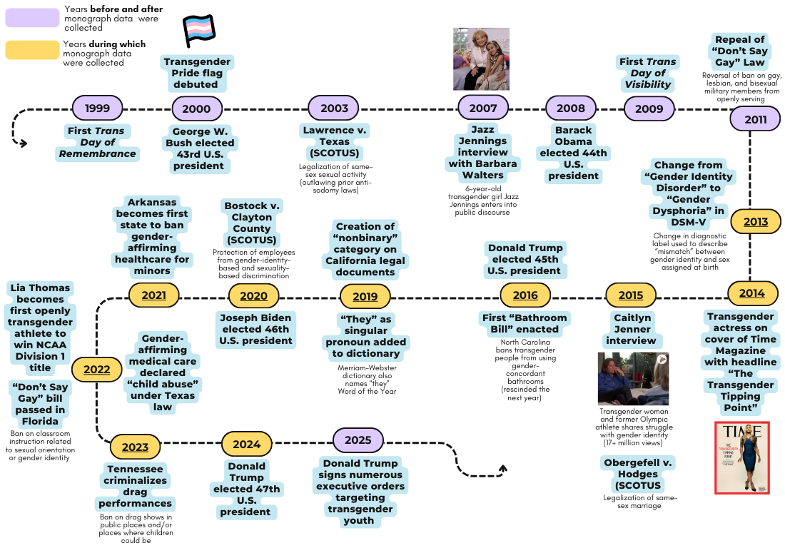
Changing Social and Political Context

Slide 7
Key Terms Throughout Monograph
Term | Definition
Assigned Sex | The sex declared at or before a child’s birth, typically on the basis of external genitalia or sex chromosomes
Gender Identity | A person’s sense of their own gender as, for example, a boy, girl, or nonbinary person
Transgender | Describes a person who identifies as a gender other than the one assumed on the basis of their birth-assigned sex; can include nonbinary identities but is used in this manuscript to refer to binary transgender men and women
Gender Diverse | Commonly used as an umbrella term referring to people who identify with a gender other than their binary, birth-assigned sex and/or show consistent gender nonconformity; in Chapters III-VII, we use “gender diverse” to refer to identities other than (transgender or cisgender) boy or girl, such as nonbinary and genderqueer
Nonbinary | A person identifying as neither a boy nor a girl, as both boy and girl, or as a combination of genders
Cisgender | Describes a person whose gender identity aligns with their birth-assigned sex
Gender Nonconforming | Describes traits, identities, behaviors, and preferences that run counter to cultural stereotypes expected of children of a certain assigned sex
Queer | Umbrella term describing people who are not heterosexual or cisgender; in this monograph we use it as a sexual orientation descriptor for people who are lesbian, gay, bisexual, pansexual, or any sexual orientation that is not straight
LGBTQ+ | Umbrella term describing people who are not heterosexual or cisgender, including people who are lesbian, gay, bisexual, pansexual, transgender, nonbinary, queer, intersex, or asexual

Slide 8
Traditional Developmental Accounts of Gender Development...
Typically focus on most common gender development trajectory
Indicate that gender identity is first recognized around 2-3 years of age (e.g., Etaugh et al., 1989, Fagot, 1985)
Generally assume that once a child recognizes their gender identity, this won’t change – and that they believe others’ gender will be stable as well (Kohlberg, 1966).
Have primarily focused on gender-conforming cisgender youth, though some studies examine, for example, tomboys (e.g., Ahlqvist et al, 2013; Martin & Dinella, 2012)
Have argued that gender identity is multidimensional (e.g., Bem, 1974, 1981; Egan & Perry, 2001), even if many people think of it as a simple binary

Slide 9
Traditional Clinical Psychiatry and Psychology Approaches to Gender Development
Older clinical case studies, dating at least as far back as the 1950’s, profiled feminine males and masculine females (e.g., Friend et al, 1954; Green & Money, 1960, 1961; Stoller, 1968)
More recent systematic studies and sometimes longitudinal studies that primarily focused on feminine males emerged in 1970s and 1980s (e.g., Green 1974, 1987; Zucker et al, 1985)
The clinically-oriented work described above, noting that these youth often struggled in mental health and peer relations, tended to view gender nonconformity as a problem to be treated (e.g., Rekers et al, 1976; Coates & Person, 1985; Green, 1987; Zucker, 2005); it was also the empirical basis for the creation of “Gender Identity Disorder” in 1980 in the Diagnostic and Statistical Manual.
Most youth in the older longitudinal studies ultimately identified as gay or bisexual, cisgender adults, not transgender adults (Green, 1987; Zucker & Bradley, 1995; Wallien & Cohen-Kettenis, 2008)

Slide 10
Past work on Sexual Orientation Change
Unlike past research on gender development, much past work on sexual orientation has focused on questions of identity change.
Several large, longitudinal studies suggest that 20% (or more) of people report changes in sexual orientation over time (e.g., Diamond, 2016; Dickson et al, 2003; Savin-Williams et al, 2012).
Change in sexual orientation is reported even amongst individuals who identify as straight at later time points (e.g., Diamond, 2003; Sandfort, 2005).
There has been less work on the sexual orientation of trans youth, though some recent studies suggest that large numbers of these youth identify as queer (Bungener et al, 2017; J. Olson et al, 2015)

Slide 11
Childhood gender nonconformity predicts gender and sexual orientation
Some research has suggested that children who show more gender nonconformity in childhood (e.g., the most feminine males at the clinic) were more likely to report being transgender in adulthood (e.g., Wallien & Cohen-Kettenis, 2008; Steensma et al, 2013; Singh et al, 2021).
Multiple studies, including many larger studies, have suggested that boys with more feminine interests and girls with more masculine interests were more likely to be cisgender queer adults (e.g., Li et al, 2017; Zucker & Bradley, 1995; Steensma et al 2012)

Slide 12
Central Research Questions
How much stability and/or change is there in gender identity and sexual orientation from childhood through adolescence?
Do aspects of childhood gender development predict change in gender identity and/or sexual orientation in early adolescence?

Slide 13
Participant Groups
All youth were 3-12 years of age at the start of and 9-22 at the end of the study
  Average age 8 yrs old at first data collection
  Average 14 years old at latest data collection
Participants were recruited:
  as Transgender
    Youth had undergone a social transition (changed pronouns, names, hairstyle, clothing) prior to beginning study
    Recruited throughout U.S. (98%) and Canada (2%) from conferences, camps, clinical settings, and via word of mouth
  as Siblings
    Siblings of transgender youth, raised in similar environments and with knowledge of trans youth.
  as Cisgender
    Matched to transgender youth on age and gender and raised at the same historical time
    Primarily living in greater Seattle area (where research team was based)
Parents of each group also participated in this study.

Slide 14
 | Recruited as* Transgender | Recruited as* Siblings | Recruited as* Cisgender
Sample size | 317 | 218 | 377
Average number of visits in the study (range) | 5.8 (1-9) | 4.6 (1-9) | 4.6 (1-9)
% boys /% girls (at start of study) | 34% / 66% | 57% / 43% | 66% / 34%
% White, non-Hispanic / % multiracial, non-Hispanic / Other race | 69% / 13% / 18% | 69% / 11% / 20% | 68% / 19% / 13%
% with household income >$75,000/yr | 66% | 68% | 82%
% with college+ level of education | 81% | 83% | 85%
*Note: The "Recruited as" label before each group is used to emphasize that the designations of Transgender or Cisgender were true for all children in that group at recruitment, but not necessarily each subsequent point.

Slide 15
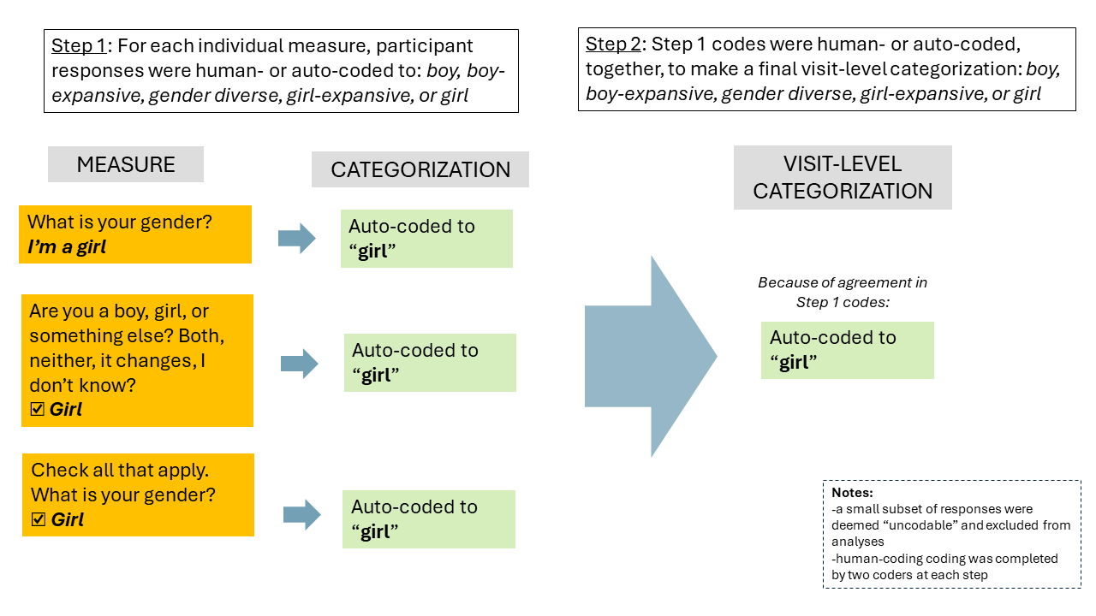
Coding of Gender Identity at Each Visit
Coding: 2,992 youth visits + 4,565 parent visits
Notes:
**do you have the original of this, Benny? If so, I think we should not use one with expansive since I think we can sidestep that in this presentation?

Slide 16
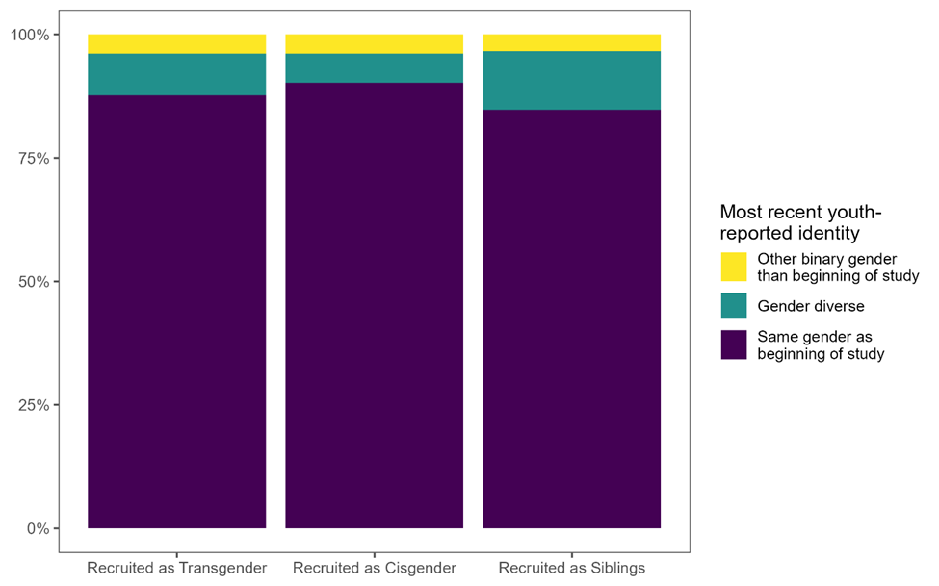
Results: Most Recent Identity
(according to self-report)
Most common pattern in all groups was stability of identity from start to end of study.
Rates of identity change over course of study did not differ by group.
Most common change was to ‘gender diverse’ (e.g., nonbinary) in all groups.
Very similar results when looking at parent-report.
Notes:
**benny – if you have the actual file, it would be good to make font on axes and legend larger for slide purposes.

Slide 17
Results: Childhood predictors of later gender change
Among boys at the end of the study,
  Those who were still living as boys had reported more masculine childhood identities than those who are today living as girls.
  And had more masculine toy, clothing, and peer preferences, than those who are today living as girls or gender diverse.
Among girls at the end of the study:
  Those who are still living as girls had more feminine toy, clothing, and peer preferences, than those who are today living as boys or gender diverse.

Slide 18
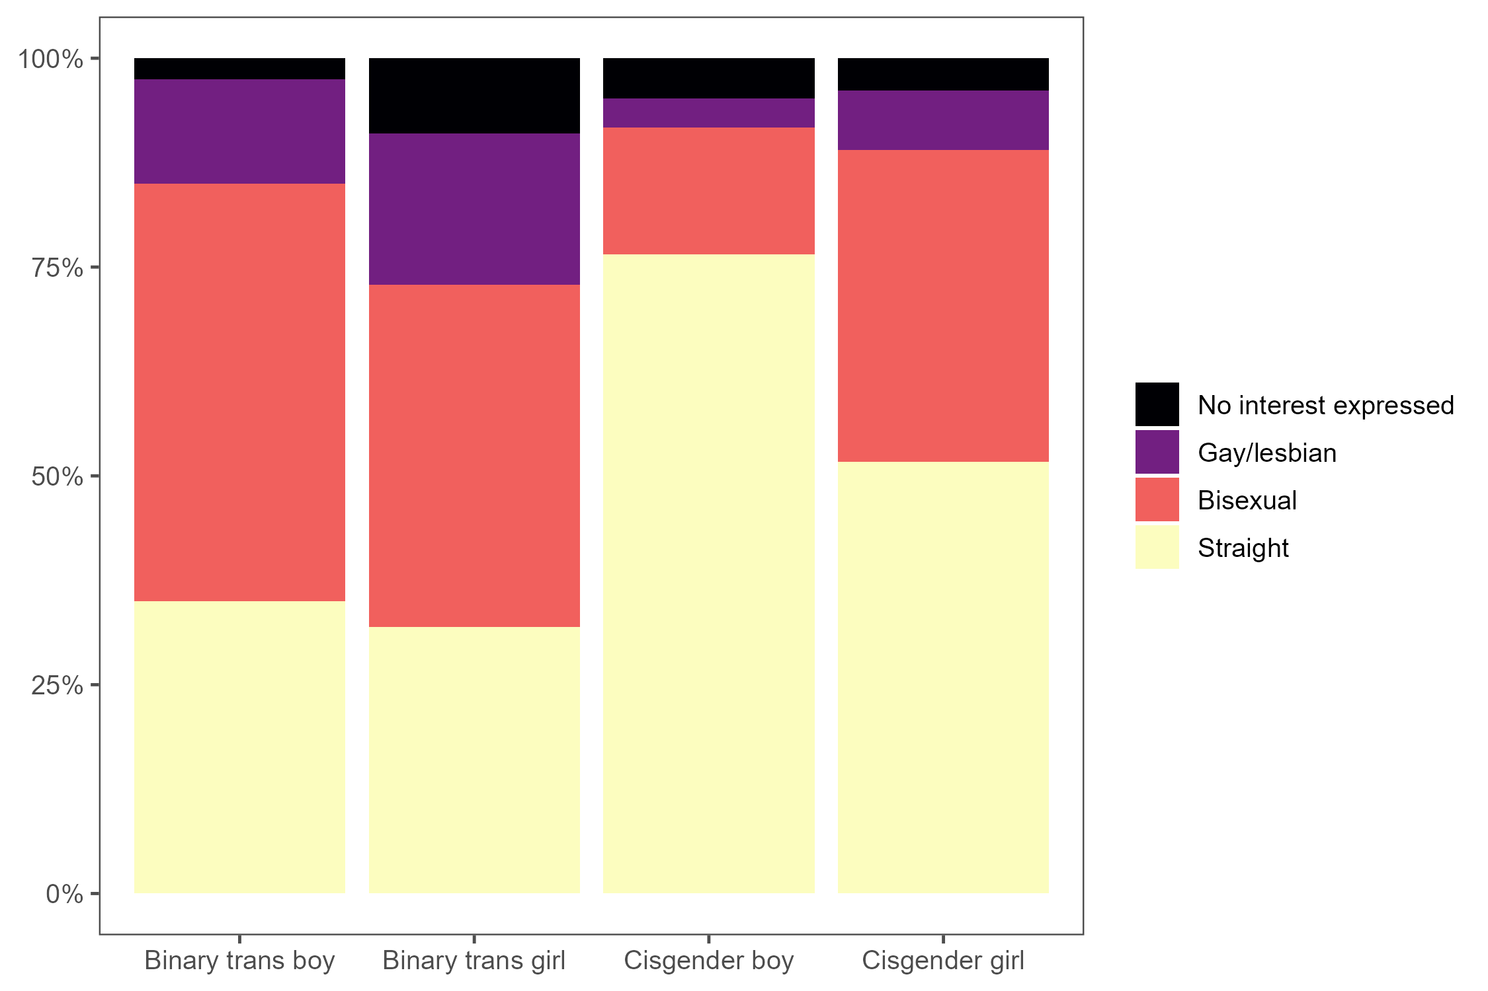
Results: Romantic Attraction at latest visit
Overall, roughly a third (33%) of cisgender and most (60%) of transgender adolescents identified as queer (any orientation other than straight).
These statistics are quite different from past figures, but they are in the ballpark of more contemporary estimates.
For all youth (transgender, cisgender, boys, and girls) bisexual was more common than gay/lesbian.
Girls (vs. boys) and transgender (vs. cisgender) participants were more likely to identify as queer.
Among cisgender youth, there was a large gender difference in whether they identified as straight or not (girls were less likely to be straight).
*Most (60%) gender diverse/nonbinary youth, identified as bisexual (not shown in figure to the left).

Slide 19
Results: Childhood predictors of later sexuality
Among boys, straight boys had
  more masculine early gender identities than queer boys.
  more masculine toy, clothing, and peer preferences than queer boys.
  parents who reported that they were more masculine in childhood than queer boys.
Among girls, straight girls had
  more feminine early gender identities than queer girls.
  more feminine toy, clothing, and peer preferences than queer girls.
  parents wo reported that they were more feminine in childhood than queer girls.

Slide 20
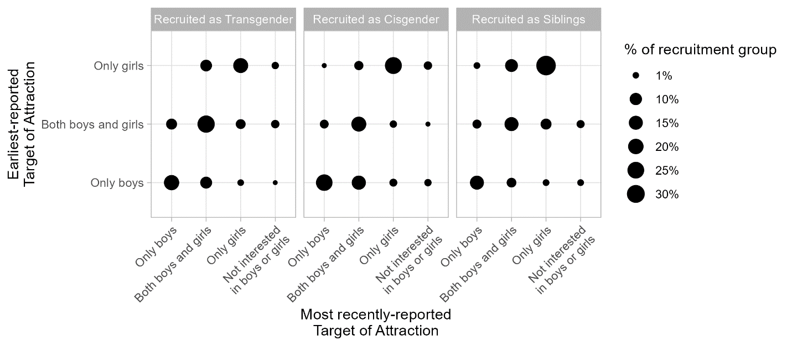
Results: Changes in Sexual Orientation Over Time
The most common pattern in all groups was stability in sexual orientation across the study.
However, change was reported very often (over 35% of youth) and at a similar rate across all participant groups.
When change was reported, it often involved shifting to/from an interest in both boys and girls and an interest in only one gender group.
Few youth shifted from only interested in boys to only interested in girls (or vice versa).

Slide 21
Summary of Key Findings
Most youth show stability in gender identity and sexual orientation from early childhood to early adolescence.
Levels of stability did not differ by initial recruitment group (transgender, sibling, cisgender)
In line with recent studies, we found much higher rates of reported shifts in gender identity and queer identification in this cohort than in past studies.
We found significant but small associations between reported gender identity and preferences in early childhood and gender and sexuality in early adolescence.

Slide 22
Strengths & Novelty of the Present Study
This is the first longitudinal study of socially-transitioned children
Large sample size given relative rarity of population
Inclusion of comparison groups of cisgender youth, enabling us to interpret results as cohort effects vs. effects of being transgender
Inclusion of parents’ and youths’ perspectives
Very high retention rate
Participation throughout development (rather than only once in childhood with a single follow-up in adolescence/early adulthood, as in some past research)

Slide 23
Limitations of the Present Study
Not a representative sample; includes higher percentages of White and multiracial youth than the general population, and participants come from high income families with highly educated parents who are very supportive.
  Youth who come from lower income households, youth of color, and youth with more conservative and less formally educated parents were underrepresented study
  youths who identified as transgender but were not allowed to socially transition in childhood or whose parents did not approve of their identities were also not included
Parents of Recruited as Cisgender group are slightly more politically conservative and higher income than Parents of Trans/Siblings, meaning that that groups are not directly comparable

Slide 24
General Implications
Our results suggest that most early-identifying transgender children will show stability in gender identity across childhood and adolescence, meaning they are likely not confused or going through a temporary phase (though some do change to live as nonbinary or, more rarely, cisgender)
However, contrary to predictions from classic developmental literature, we found that over 10% of initially cisgender children reported gender change – suggesting that this sample thinks about gender more flexibly than those from earlier generations, and that gender is likely not a static social category for everyone (as often assumed)
Early-identifying and socially transitioned transgender youth show stability in their identities in contrast to the trajectories of youth studied in medical clinics (1950 – 2010)

Slide 25
Implications for Parents
Gender identity is flexible: Parents of all children—regardless of how they identify—should recognize that gender identity can evolve over time. The fact that over 10% of initially cisgender children reported a gender change highlights the importance of fostering open, nonjudgmental conversations about gender in the home.
Caution against outdated assumptions: Parents may be relying on outdated beliefs about gender as fixed and binary. Our findings suggest a need to re-evaluate those views in light of today’s children's sense of identity, who may understand and explore gender more flexibly than previous generations.
Support your children across development: Because some youth who initially identified as transgender later identify as nonbinary or cisgender, parents should support gender development as an ongoing process, not a one-time declaration—remaining open, supportive, and responsive to their child’s evolving self-understanding.

Slide 26
Implications for Researchers
Need for Longitudinal, Inclusive Studies: These findings underscore the value of longitudinal research that includes socially transitioned transgender youth, a group historically excluded from developmental studies. There is an urgent need to understand these processes among youth who may not always be supported by their families and who experience other social risks including poverty, racism, and discrimination for other reasons (religion, immigration status).
Rethinking Developmental Models: The evidence that some cisgender-identified children later change their gender identity challenges long-standing theories that conceptualize gender identity as stable from early childhood. Researchers must revisit and revise developmental models to account for greater fluidity and cultural change.
Sample Context Matters: The stability observed in early-identifying transgender youth contrasts sharply with earlier clinic-based samples. This highlights the importance of considering the social, medical, and family contexts in which youth are studied when interpreting developmental outcomes.
Expanding Definitions of Gender: The results call for more nuanced measurement tools and theoretical frameworks that go beyond binary categories and acknowledge gender as a dynamic and socially situated identity.

Slide 27
Sources of support
NSF SMA-1837857/SMA-2041463
NSF BCS-1523632
NSF GRFP
NIH HD092347
NIH MH135634
The content of this paper and presentation is solely the responsibility of the authors and does not represent the official views of NSF or NIH.

Slide 28





























Thank you
Daniel Alonso
Maddy DeMeules
Annie Fast
Jessica Glazier
Kayla Lewis
Tabea Hässler
Rachel Horton
Dominic Gibson
Stats Atwood
Lily Durwood
Nandana Rao
Riley Lowe
Charlie Blotner
Natalie Wittlin
Elizabeth Enright
Tori Varlack
Jennifer Rubin
Shira Kahn-Samuelson
Deja Edwards
Selin Gülgöz
James Rae
Gabrielle Lindquist
Chase Garvey
Grey Raber
Courts Parry
Gabriela Ji
Ashley Jordan
Zoe Mermin
Leila Eisner

Slide 29
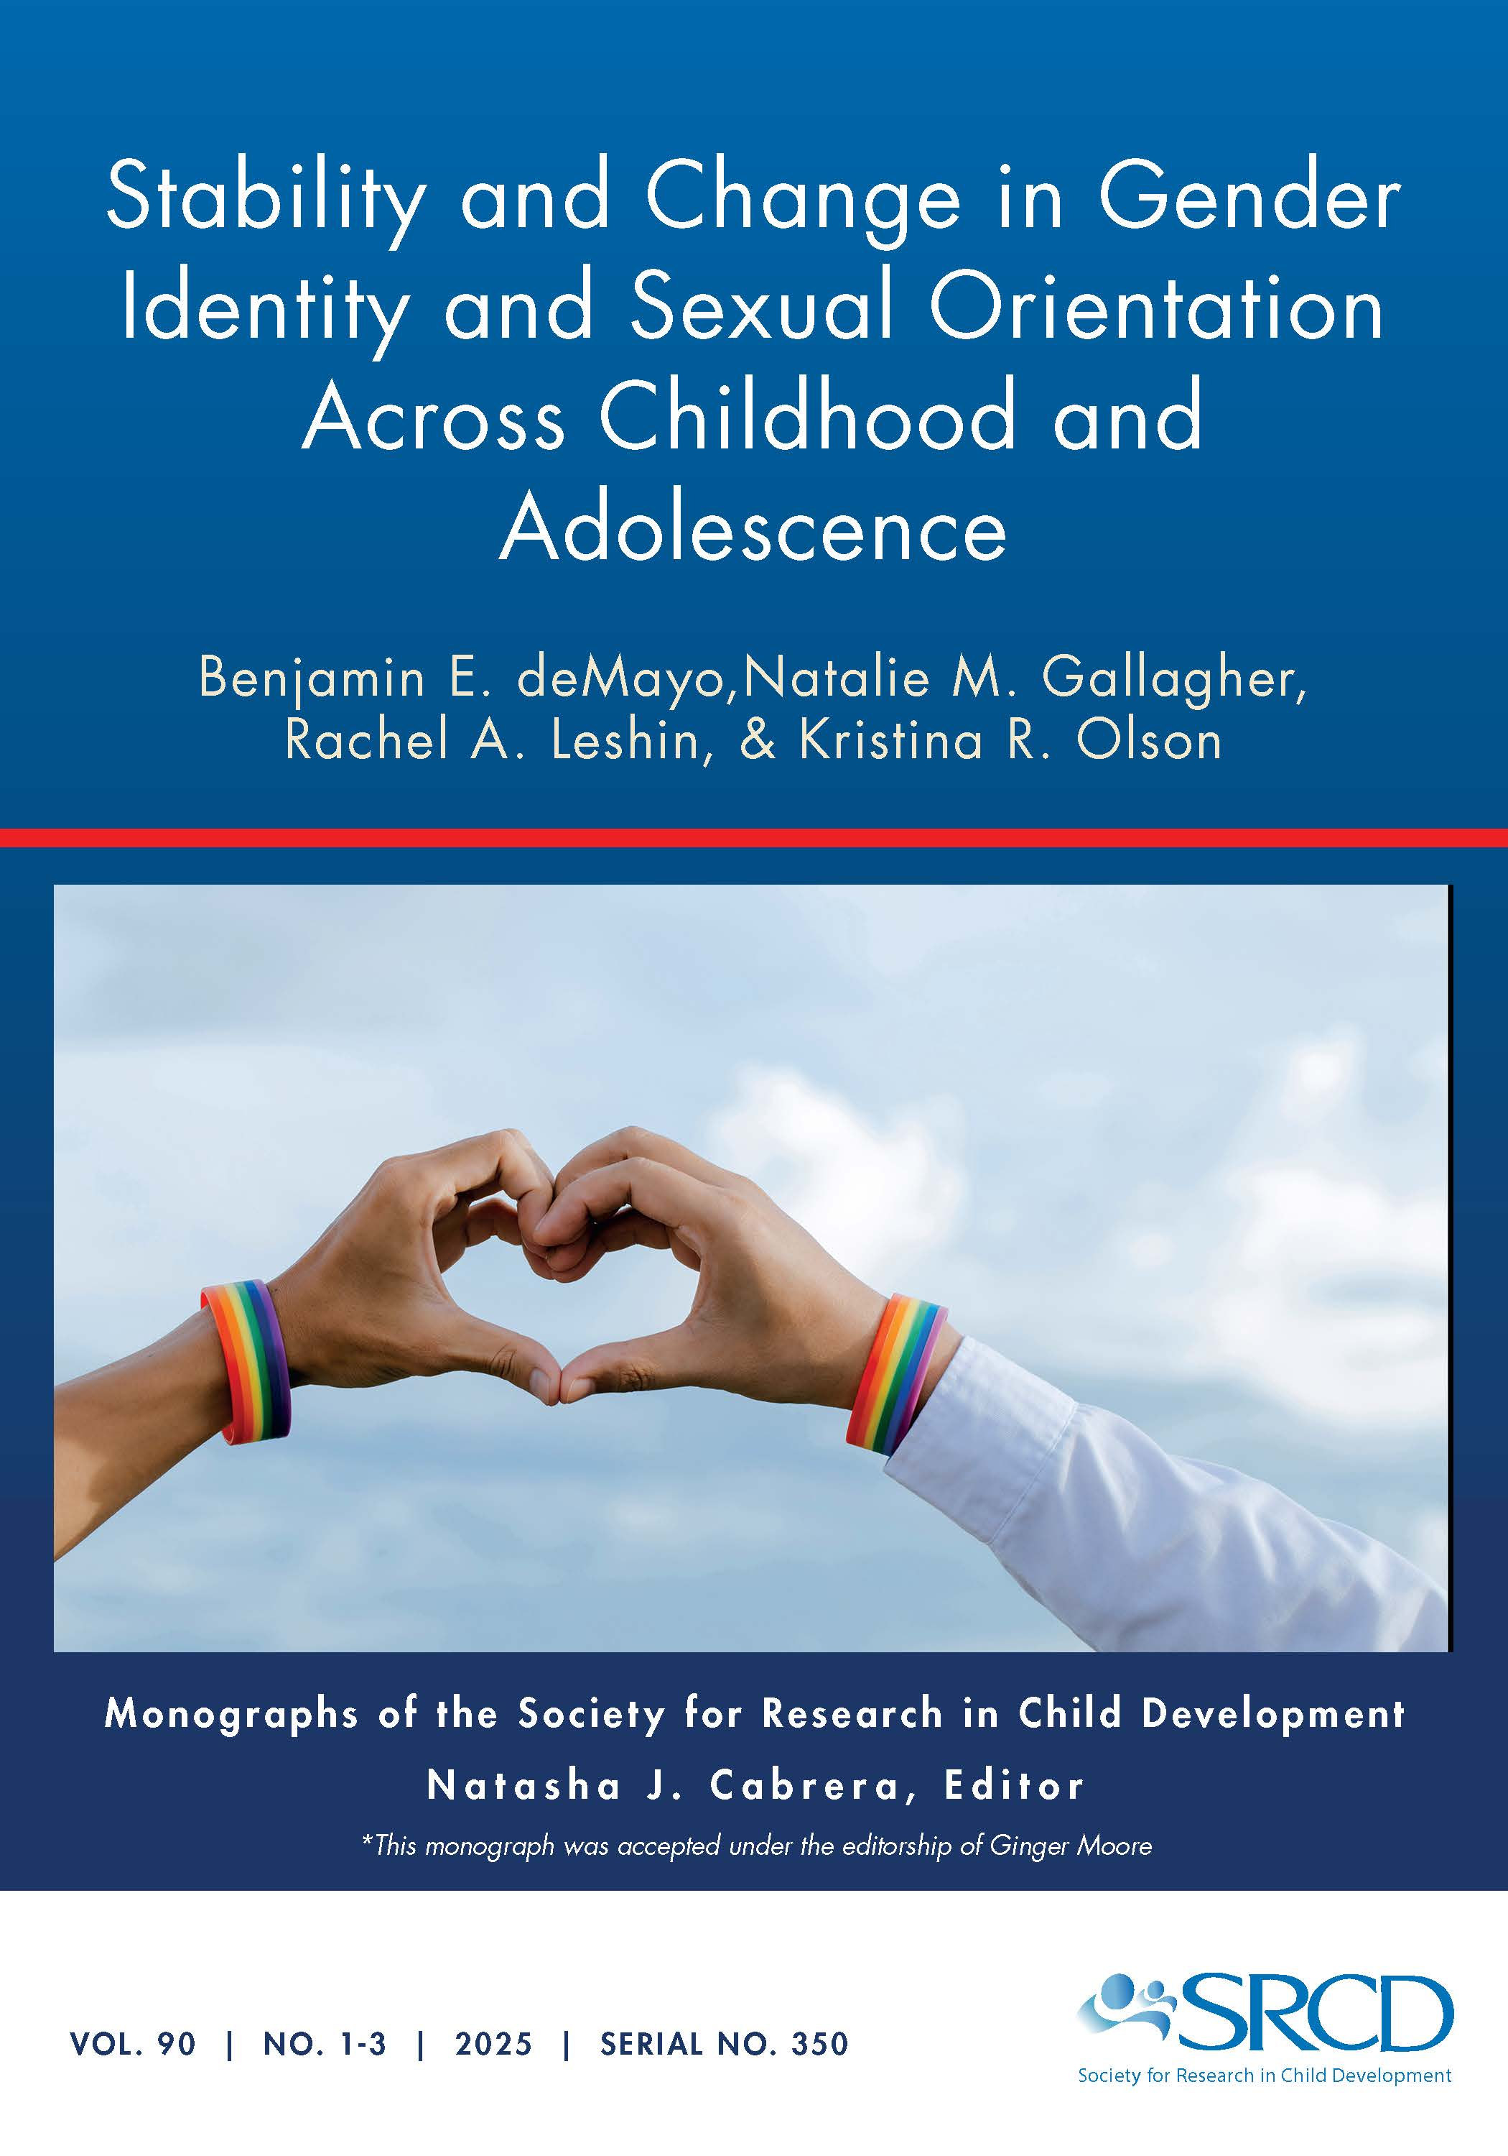
For this issue, visit
https://doi.org/10.1111/mono.12479
For videos, commentaries, and teaching materials,
visit monographmatters.srcd.org

Slide 30
Corresponding author
Benjamin deMayo
bdemayo@princeton.edu
Editorial inquiries
Natasha J. Cabrera
ncabrera@umd.edu
Citation
deMayo, B. E., Gallagher, N. M., Leshin, R. A., and Olson, K. R. (2025). Stability and Change in Gender Identity and Sexual Orientation Across Childhood and Adolescence. Monographs of the Society for Research in Child Development, 90.1-3. https://doi.org/10.1111/mono.12479

