Slide 1

A guided tour of the dynamic field theory of executive function development
Alexis McCraw, M.A.
Jacqueline Sullivan, M.A.
Kara Lowery, Ph.D.
Rachel Eddings, M.A.
Hollis R. Heim
Aaron T. Buss, Ph.D.
Scholars from the University of Tennessee, Knoxville
Notes:
Hello, this is Aaron Buss, the PI of the attention, brain and cognition lab at the university of Tennessee. In this powerpoint presentation I am going to give a more in-depth overview of the dynamic field theory of executive function that we have been developing and describe how we tested predictions of this model in the study reported in the monograph.

Slide 2
Dynamic Field Theory (www.dynamicfieldtheory.org)
Dynamic field theory (DFT) is a class of dynamical systems models.
In a dynamical systems approach, the goal is to explain a phenomenon of interest through interacting components of system.
In the psychological sciences, the dynamical systems approach can be traced to the pioneering work of Esther Thelen and Linda Smith in the domains of motor development and infant cognitive development (Thelen & Smith 1994: A dynamic systems approach to the development of cognition and action. MIT Press).
Notes:
To begin, I just want to refer interested readers to a website where more information, including published papers, lectures, tutorials, and code are available. That’s the website shown here, www.dynamicfield theory.org.
To begin, dynamic field theory is a class of dynamical systems models. Dynamic systems theory initially grew out of the study of complex systems. We can consider weather as one example of a dynamical system and is in fact one of the areas in which these concepts and mathematical formulations were first applied. We can consider weather as a dynamical system that involves interacting variables such as humidity, pressure, and temperature that are all changing over time and influencing other variables of the system. The weather patterns that we experience are a result of the interactions of the these variables over time. Thus, a key insight provided by dynamical systems approaches is that how a system organizes to produce behavior, be it behavior of a weather system or behavior of a person, does not need to be built in but can result from the interactions occurring in the system. Moreover, dyanamical systems theory provides the mathematical tools needed to model these interactions and organization over time.
In the context of psychological and developmental sciences, the application and development of the dynamical systems can be traced to Esther Thelen and Linda Smith pioneering work in the domains of motor control and infant cognitive development. The book I cite here provides the history context and influences that lead to their formalization of ideas.

Slide 3
Dynamic Field Theory
Dynamic field models are constructed with simulated populations of neurons.
Local excitation and lateral inhibition interactions produce stable neural states that correspond to cognitive representations and drive behaviors.
Neurons are ‘tuned’ to perceptual and motor information.
Notes:
Dynamic field theory is a class of dynamical systems theory in which the goal is to ground cognition and behavior in neural dynamics.
There are inherent challenges to ground cognition and behavior in neural processes because there is no principled or a priori way that these two things should be related. The stance offered by dynamic field theory is that behavior and cognition arise from neural states. Neural states are stabilized and destabilized via excitatory and inhibitory interactions within and between populations of neurons.
Activation within populations of neurons have cognitive and behavioral relevance because these populations are tuned to dimensions of perceptual and motor information.
As we’ll see, although neural populations are defined in term of perception/action dimensions, dynamic field models can build representations that combine dimensions to give rise to new types of more abstracted representations.

Slide 4
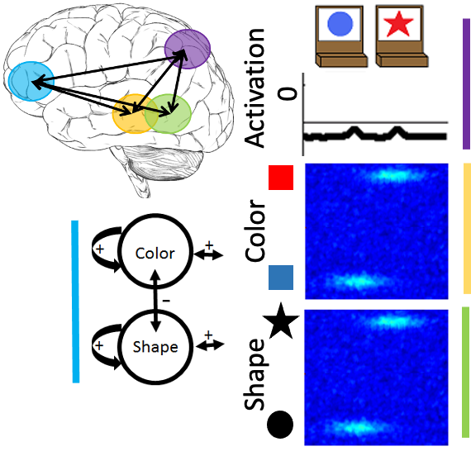
Simulating the DCCS task
The object representation system:
  Neural population that is tuned to spatial dimension (top). Activation in this field corresponds to decisions for action, that is, where a card should be sorted.
Notes:
Here we are showing the basic architecture of the dynamic neural field model we used to simulate the DCCS task.
In the upper most right part of the image, we are showing stimuli that are representative of the basic task structure. Below are three neural populations that together make up an object representation system. Inputs to this system correspond to the information present in the stimuli at top.
Below the sorting trays is a spatially tuned population of neurons. Activation in this field corresponds to decisions for actions. In this case, where a test card should be sorted.

Slide 5
Simulating the DCCS task
The object representation system:
  One neural population is tuned to color and space (middle). A second neural population is tuned to shape and space (bottom).
  Together, the spatial and feature-space fields correspond to the dorsal and ventral visual pathways.
Notes:
Next are two neural populations that are sensitive to a combination of spatial and featural information. One neural population in the middle is tuned to a combination of color and space dimensions. A second is sensitive to a combination of shape and space information.
In the color-space field, there are inputs corresponding to the blue object on the left and the red object on the right. In the shape-space field, there are inputs corresponding to a circle-shaped object on the left and a star-shaped object on the right.
Together, these three fields implement neural processes corresponding to the dorsal and ventral visual pathways.

Slide 6
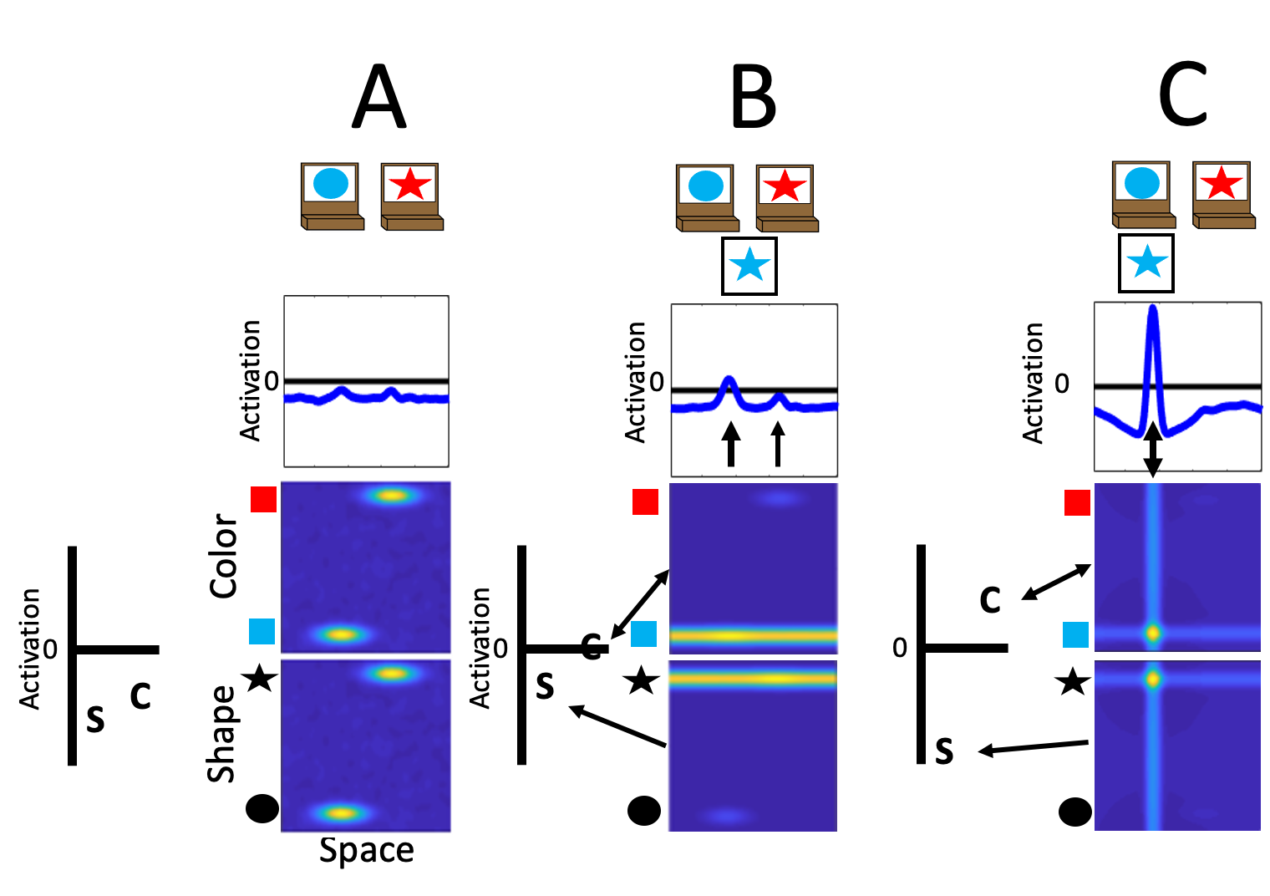
Simulating the DCCS task
Dimensional labels:
  Activation in the object representation system is coupled to a label system.
  ‘Color’ (C) label reciprocally connected to color-space field.
  ‘Shape’ (S) label reciprocally connected to shape-space field.
Instruction to sort by ”Color” reflected by boosted activation
Notes:
A final component of the model architecture is added to the current illustration on the left. This component corresponds to representations of labels for the feature dimensions involved in the DCCS task, a ”color” label marked by the C and a “shape” label marked by the S.
Activation of the object representation system is reciprocally coupled to activation of the label system.
A key developmental hypothesis generated by the model is that the ability to attend to task-relevant information is a function of the strength of association between dimensional labels and feature dimensions. As children learn what the labels “color” and “shape” mean, they form stronger associations between labels and visual dimensions. Thus, learning labels is not just learning what things are, but learning how to think about things.
In this illustration, the label representation for ”color” marked by the C is at a higher level of activation due to the instructions to sort by color in the pre-switch phase of the DCCS task.

Slide 7
Simulating the DCCS task
Test cards presented without spatial localization.
  Ridge for blue input overlaps with task input at the left.
  Ridge for star input overlaps with task input on the right.
  Feature-space fields send input to the dimensional labels and spatial field.
Feature inputs are not spatially localized
Notes:
In this illustration, we are showing the model after a test card has been presented, but before a decision has been made.
First, I’ll draw your attention to the horizontal ridges going across the color-space and shape-space fields. The feature inputs of the test cards are not spatially localized. However, the ridge for the blue feature overlaps with the input from the target cards at the leftward location because the blue circle target card is at the leftward sorting location. The ridge input for the star-shaped feature overlaps with the input from the target cards at the rightward location because the red star target card is at the rightward location. In this example, the leftward location would be the correct response if sorting by color.
Thus, the test card itself is ambiguous as to which location it should be sorted. This ambiguity is reflected by activation the spatial field above the feature-space fields. Here, activation at both the leftward and rightward locations are reaching the activation threshold. At this point, however, we can see a slight advantage at the leftward location which would be the correct location if sorting by color. This advantage is emerging due to an influence I will draw your attention to next.
Next, we will consider activation in the label system. Both the shape and color labels are boosted in activation due to input being received from the object representation system. The color label is still at a higher level of activation due to the instruction to sort by color. In fact, the color label representation is breaching threshold and beginning to increase activation within the color-space field, which will enhance output from this specific population. In this case, the enhanced output from this system is at the leftward location.

Slide 8
Simulating the DCCS task
Dimensional attention via dimensional labels.
  The ”Color” label becomes activated--> “Shape” label is suppressed via inhibitory coupling and the color-space field is boosted.
  Peak is built at the leftward location as the blue and star feature are bound to this sorting location.
Notes:
In this illustration, the model is shown after having made a decision for the blue star test card.
In the spatial field, a stable peak of activation has formed reflecting a decision to sort to the leftward location. Across the object representation system, a coherent representation of the blue star object is present. This is reflected by peaks of activation both for the blue feature and the star-shaped feature at the leftward location.
I’ll draw your attention to the vertical ridge of activation now present in both the color-space and shape-space fields. This ridge is the input from the spatial field which serves to bind visual features together, a processes necessary for coherent object representations to form across neural populations.
The label system also reflects the intended goal of attention to focus on color information. Due to local-excitation and lateral inhibition which is present throughout the model, the color label representation has build stabilized activation which also serves to inhibit activation of the other label representation.

Slide 9
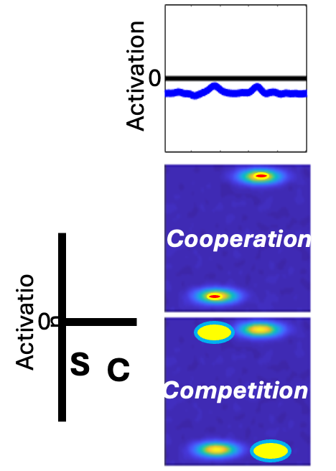
Simulating the DCCS task
The impact of learning during pre-switch phase.
  The model builds memory traces associated with responses made during the task.
  Memory traces cooperate with task structure within pre-switch relevant dimension.
  Memory traces conflict with task structure within post-switch relevant dimension.
Notes:
This next illustration shows the consequences of Hebbian learning accumulating across the pre-switch trials. Hebbian learning serves as another source of input that increases activation for neurons in proportion to their activation over the course of a task.
In the example we have been following so far, the pre-switch rules were to sort by color. Thus, blue test cards were sorted to the left and red test cards were sorted to the right. This creates cooperation between the task structure and memory traces within the color-space field. That is, there is both an input and a memory trace for blue at the left. Similarly, there is also an input and a memory trace for star at the right.
There is quite a different configuration in the shape-space field. Due to the nature of the test cards, the shape features were sorted to opposite locations of the task structure. Specifically, there is an input for circle at the left, but a memory trace for circle at the right. Similarly, there is an input for star at the right, but a memory trace for star at the left.
Together, this creates a bottom-up bias to continue binding the combination of features on the test in a way that is consistent with the rules to sort by color. A stronger influence from the dimensional label system is required to redirect decision and follow the rules to sort by shape during the post-switch phase.

Slide 10
Simulating the DCCS task
Large body of work has demonstrated that the model can successfully explain and predict behavioral and neural data
  Variations in the strength of label-feature coupling produces patterns of model behavior that replicates 3- to 5-year-olds and predicts behavior of 3-year-olds in new DCCS versions (Buss & Spencer, 2014 SRCD Monographs)
  Performance on the DCCS task is associated with performance on tasks that require attention to dimensions but which do not explicitly involved labels as predicted by the model (Buss & Kerr-German, 2019 Cognition)
Notes:
Although we only stepped through the most basic illustration of the model, hopefully this provides a richer understanding of the key processes implemented by the model.
A large body of work has accumulated over the last 10 years that illustrates the explanatory power of the dynamic field model.
Variations in the strength of label-feature coupling produces patterns of model behavior that replicates behavior of 3- to 5-year-olds across more than a dozen of variations in the DCCS task. The model has also predicted behavior of 3-year-olds in new versions of the DCCS task.
Other work shows that performance on the DCCS task is associated with performance on tasks that require attention to shape and color dimensions but which don’t explicitly involved labels. These results suggest that children’s neurocognitive system draws on whatever information it has to confront the demands of a task, and the influence of label representations is evident even if labels are not given in the task.

Slide 11
Simulating the DCCS task
Large body of work has demonstrated that the model can successfully explain and predict behavioral and neural data
  Children who show weak frontal cortex activation when failing the standard task will show strong frontal cortex activation when correctly switching in an easier version of the task as predicted by the model (Buss & Spencer, 2018)
  Performance of 3-year-olds can be improved when given prior exposure to the post-switch dimension as predicted by the model (Perone et al. 2015 & 2019 Child Development)
Notes:
The model has also been used to better understand the brain-behavior relationship over development.
Foundational work initially showed that children who perseverate in the DCCS task show weaker activation in frontal cortex compared to children who switch rules. These results were interpreted to suggest that maturation of frontal cortex is a key factor driving improvements in performance.
However, children who fail the standard DCCS task, and show weak frontal cortex activity when doing so, nonetheless show strong frontal cortex activity when switching rules in an easier version of the task. The model predicted this result due to the reciprocal coupling between object representation process and label representation processes. In this case, the easy version provided a bottom up signal to guide the label representation system toward the task-relevant post-switch information.
In anoher line of work, the model successfully predicted that exposing children to the post-switch dimension prior to completing the DCCS would lead to improved performance on the DCCS task. This results is a consequence of prior exposure building up memory traces which support attention to the post-swtich dimension.

Slide 12
Simulating the DCCS task
Large body of work has demonstrated that the model can successfully explain and predict behavioral and neural data
  An expanded version of a model that implements a more detailed label learning simulates the association between comprehension, production, and DCCS performance and explains the influence of manipulations to the labels used during instructions (Spencer et al., in press Developmental Review)
  Measures of neural activation from left frontal cortex during dimensional label production at 33 months of age predicts performance on the DCCS task at 45 months of age (Lowery et al. 2022 Scientific Reports)
Notes:
More recent work has began to more carefully consider the details of dimensional label learning in the context of the DCCS task.
In a forthcoming paper, we show that an expanded model architecture that implements a more detailed label learning system replicates patterns of performance across the production, comprehension, and DCCS tasks. Further, this expanded model is also able to explain the influence of manipulations to the labels and instructions used in the DCCS task that were previously beyond the scope of what the model could address in a principled way.
Other work provided the first examination of the neural processes supporting dimensional label learning. These results, replicated in the data presented in the current monograph, showed that activation in left frontal cortex during label production at age 2 predicted performance on the DCCS task at age 3.

Slide 13
Situating the current results
The current study was unique because we more comprehensively assessed neurocognitive function during early childhood to test whether other measures might predict future performance on the DCCS task.
We found results consistent with those of Lowery et al. (2022): neural activation in left frontal cortex during label production at 30 months of age was the best predictor of DCCS performance at 54 months of age.
Notes:
To wrap up, we will situation the current results in the context of this larger body of work.
The current study addressed shortcomings in previous work by more comprehensively assessing neurocognitive function in early development. It could be that earlier measures of executive function predict later executive function better than dimensional label production. However, our results here supported our predictions and previous data. Across all measures of neurocognitive function, the best predictor of DCCS performance in activation in left frontal cortex during label production at age 2.

Slide 14
Future prospects
We have identified a learning mechanism that can be targeted to improve executive function.
Our results suggest that measures of executive function depend on what children know about the content of the task itself and the language used to instruct a task.
How do learning processes defined in culturally specific experiences of children conspire to create cognitive control skills?
Notes:
The unique perspective presented here motivates several new prospects for research.
The model points to a learning mechanisms as a means for developing EF skills. Previous work was limited by focusing on maturation as a key aspect of EF development. From this perspective, the best way to improve EF was by practicing EF itself. Such intervention research has notoriously yielded little evidence of transfer beyond the trained task.
Future work can target label learning to determine the benefits that such training can confer to this aspect of neurocognitive function.
More generally, these results highlight that measures of EF depend on what children know about the content of the task and the language used to instruct such tasks.
A key question for future research is how learning process which are defined in culturally specific experiences conspire to create cognitive control skills.

Slide 15
Corresponding author
Alexis McCraw
amccraw@vols.utk.edu
Editorial inquiries
Ginger A. Moore
ginger.moore@psu.edu
Citation
McCraw, A., Sullivan, J., Lowery, K., Eddings, R., Heim, H. R., & Buss, A. T. (2024). Dynamic field theory of executive function: Identifying early neurocognitive markers. Monographs of the Society for Research in Child Development, 89(3).

