Slide 1
Developing Research Partnerships: Fostering Prosociality in Refugee Children:
Tara Callaghan

Slide 2


Slide 3
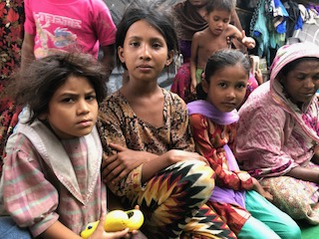

Fostering Prosociality in Refugee Children:
An Intervention with Rohingya Refugee Children
Photo by Tara Callaghan

Slide 4


Slide 5
THE ROHINGYA

Slide 6
THE ROHINGYA CRISIS
AUGUST 2017

Slide 7
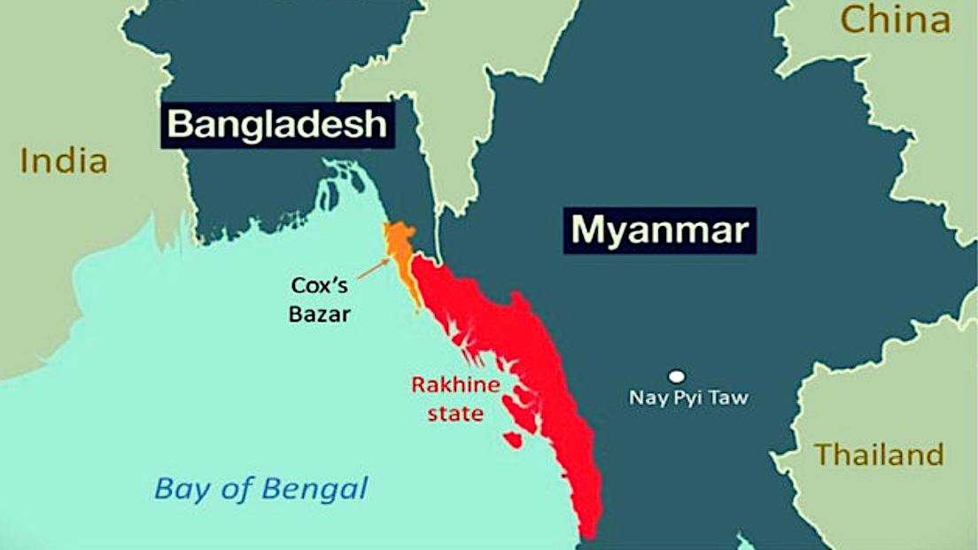

Slide 8
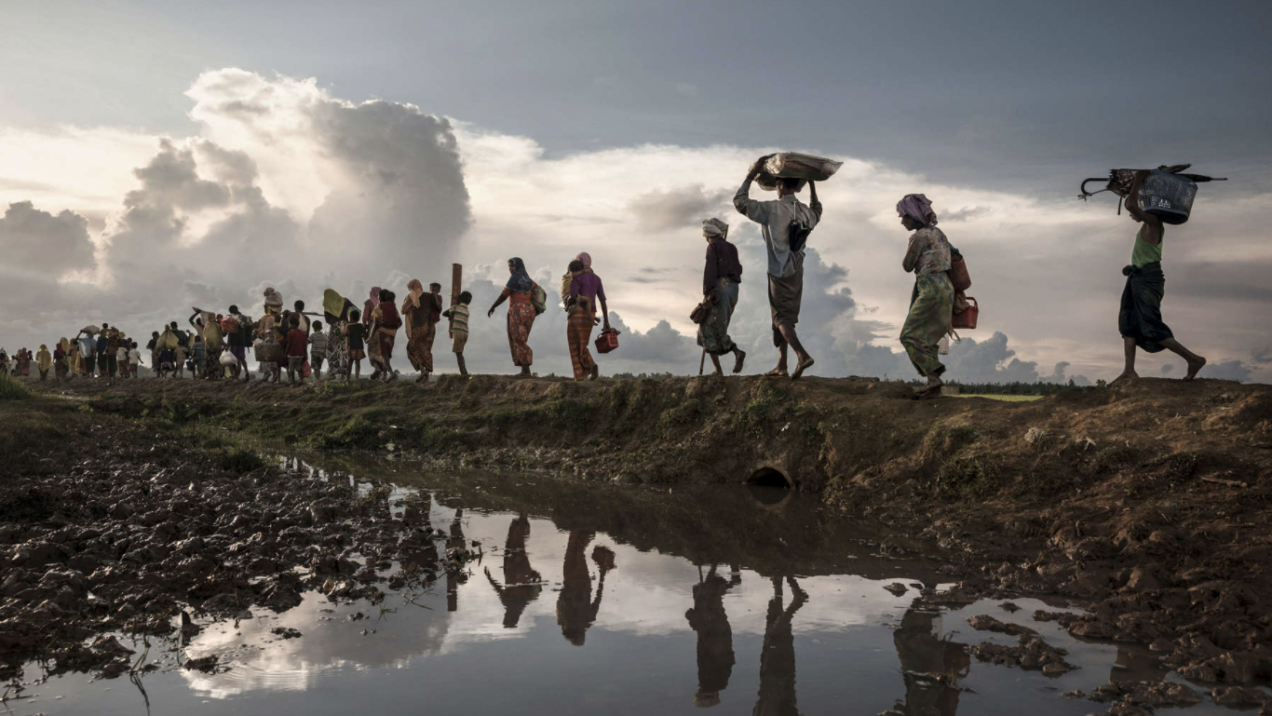
© Paula Bronstein (paulaphoto.com)

Slide 9
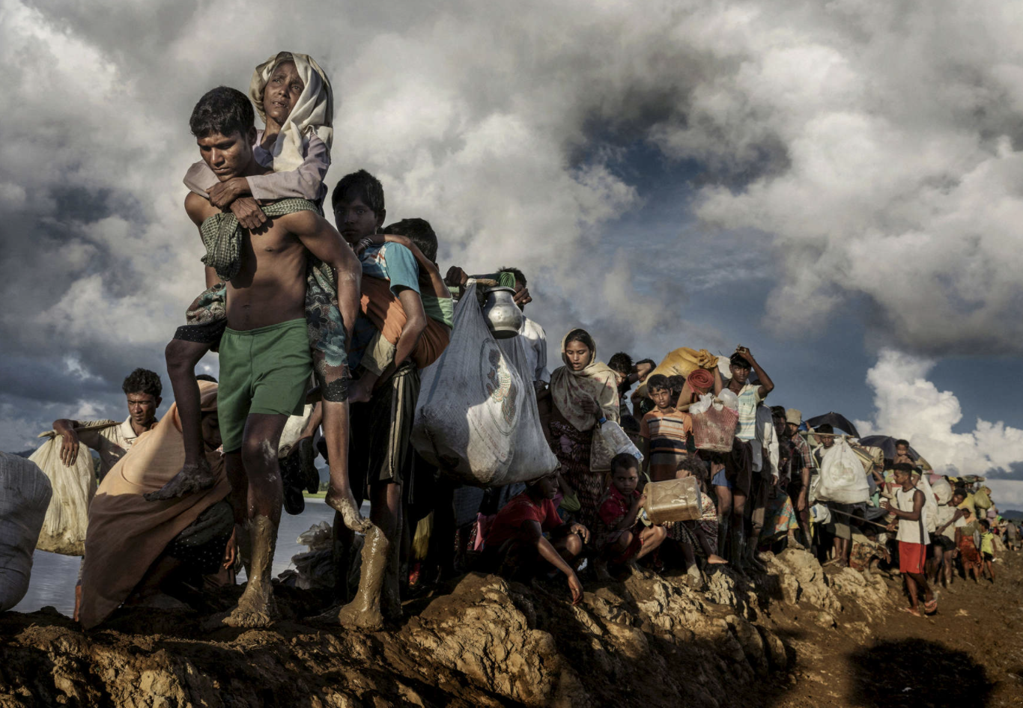
© Paula Bronstein (paulaphoto.com)

Slide 10
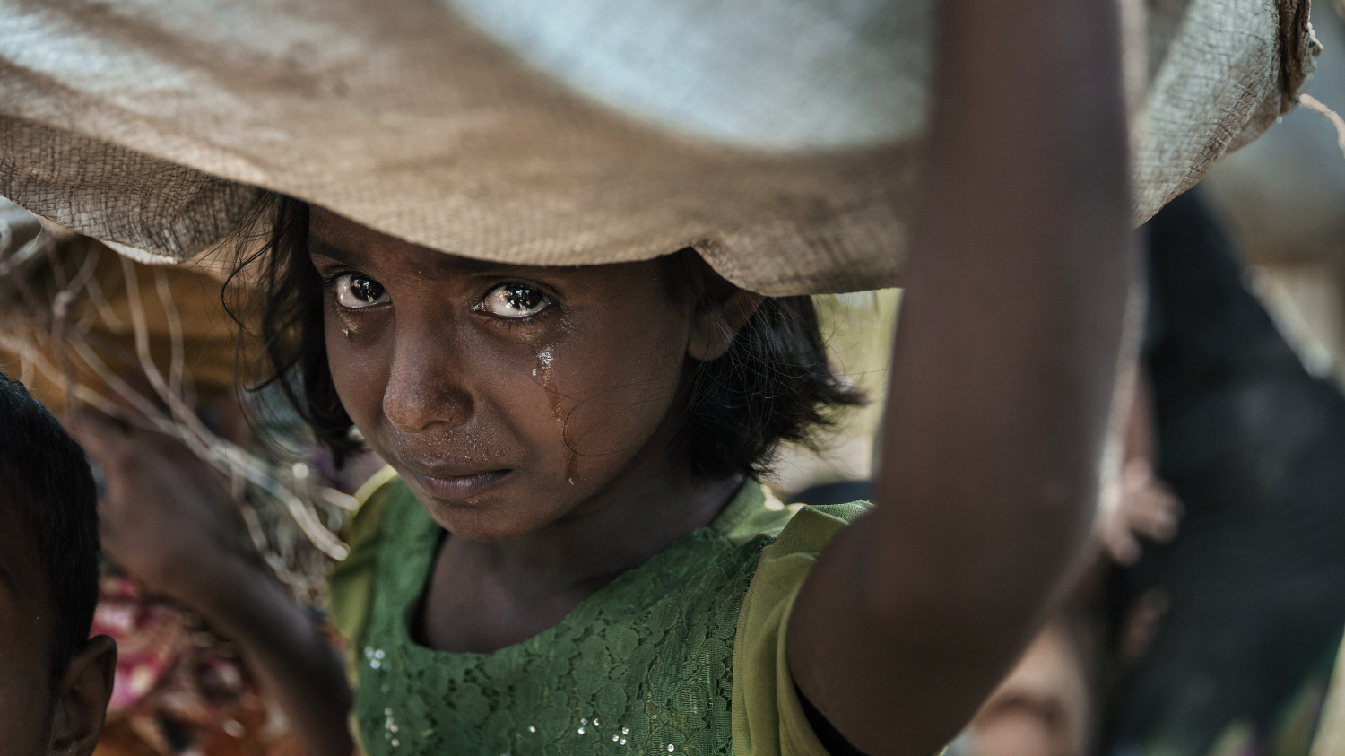
© Paula Bronstein (paulaphoto.com)

Slide 11
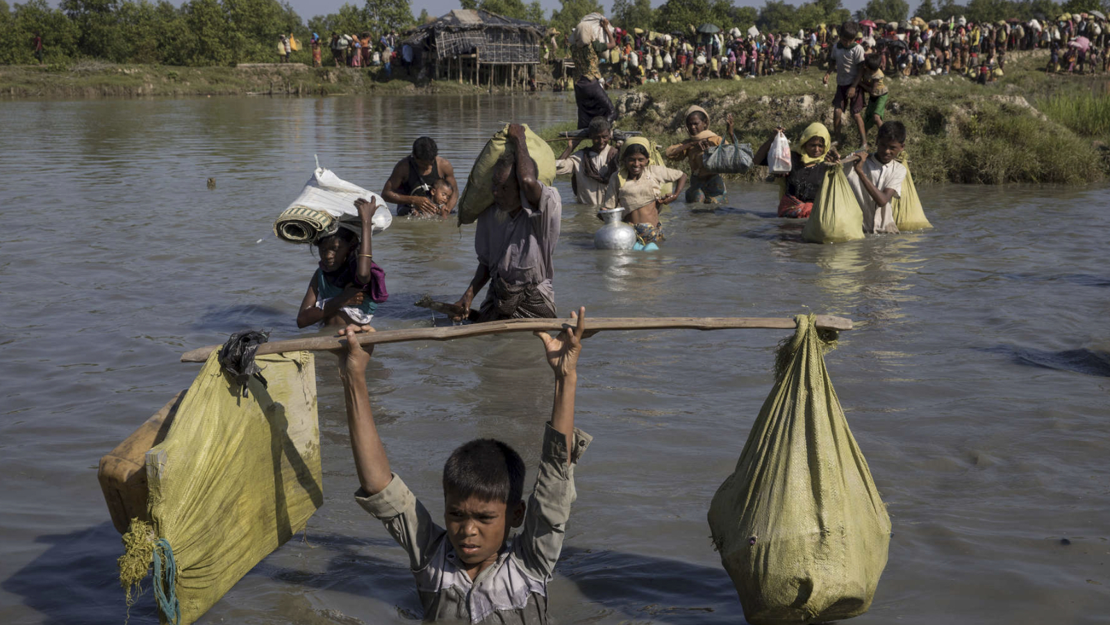
© Paula Bronstein (paulaphoto.com)

Slide 12
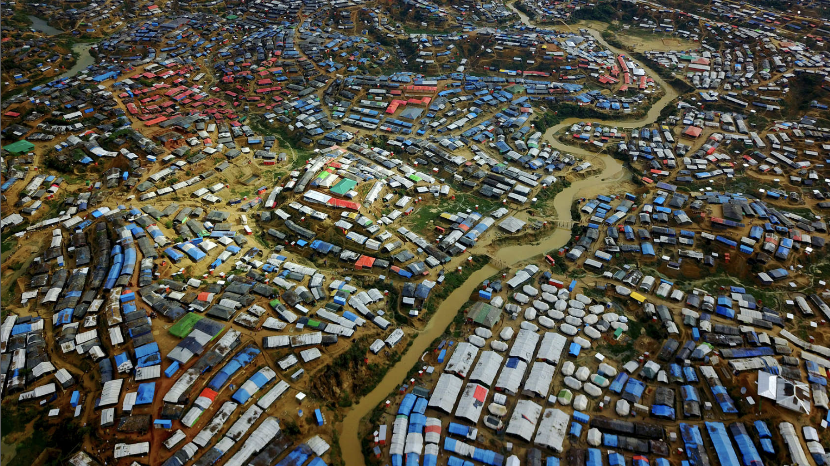
© Paula Bronstein (paulaphoto.com)

Slide 13
The Rohingya Crisis:
A Tragic Context for a Natural Experiment
Can the human predisposition toward prosociality survive in the context of genocide, forced migration and life in the largest refugee camp in the world?

Slide 14



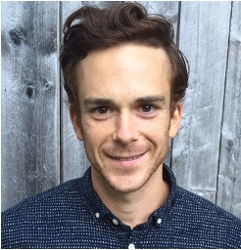



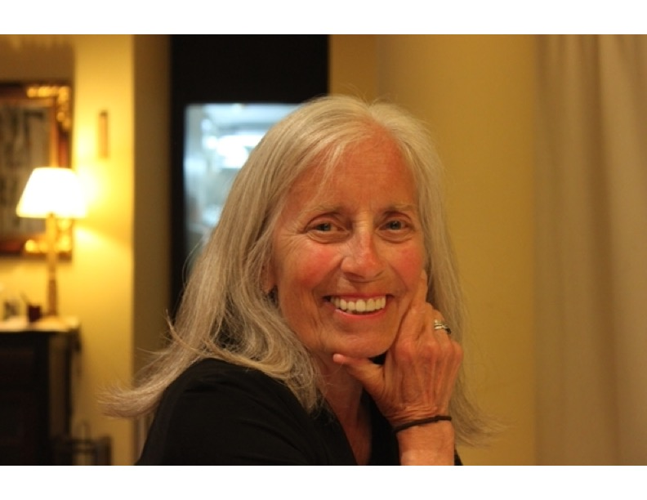


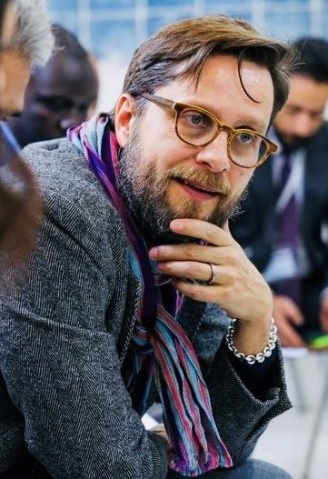




Slide 15
What Do we Know?
Most research focuses on mental health & uses self-report measures
  PTSD, increased aggression, decreased emotional distress (desensitization)
The handful of studies examining conflict and prosocial behavior also use self report (SDQ, Goodman, 20021)
  Taylor et al (2018) – 6yr longitudinal study in Belfast, prosociality score on SDQ decreased with age and degree of exposure to violence
We recently conducted a study that measured Rohingya children’s prosocial helping, sharing and compassionate behavior to assess the efficacy of conducting behavioral research in refugee camp contexts
  Brief intervention based on either collaboration or emotion perspective taking showed interesting pattern depending on birthplace as a proxy for level of trauma experienced (Corbit et al., 2023)

Slide 16
Knowledge Gaps
Is prosociality intact in children who have endured genocide, forced migration and the adverse environment of refugee camps?
Can we intervene to provide supports to help refugee children retain and grow their prosocial nature against all odds?
Are initial levels of prosociality and intervention-related change differentially affected
  depending on children’s age?
  depending on the level of trauma children have experienced?

Slide 17
Research Strategy
Design an intervention based on evidence of factors that foster prosociality
  Peer collaboration, emotion perspective taking, EF skills
Identify the prosocial measures to assess whether the intervention fostered prosociality (pre/post comparison)
  Helping, sharing, empathic responding, EF skill
Implement the intervention and assess pre/post change
  Daily over 10 days

Slide 18
Study Design
Virtual training of a 12-person Rohingya researcher team
3 Waves data collection
Total N= 152
2 Age groups (5-8, 9-12)
Assessments of helping, sharing, empathic responses to story scenarios, executive functioning (over 2 days pre- and post-intervention)
3-hour intervention sessions with a collaborative foundation plus emotion perspective and executive functioning skills training
3 researchers and 8 children in 4 classrooms with AM and PM sessions

Slide 19
Intervention Activities
Foundation of Collaboration
Puzzles, Pattern Building, Coop Board Games, Emotion Perspective Stories,
EF Skills Building Video Games

Slide 20
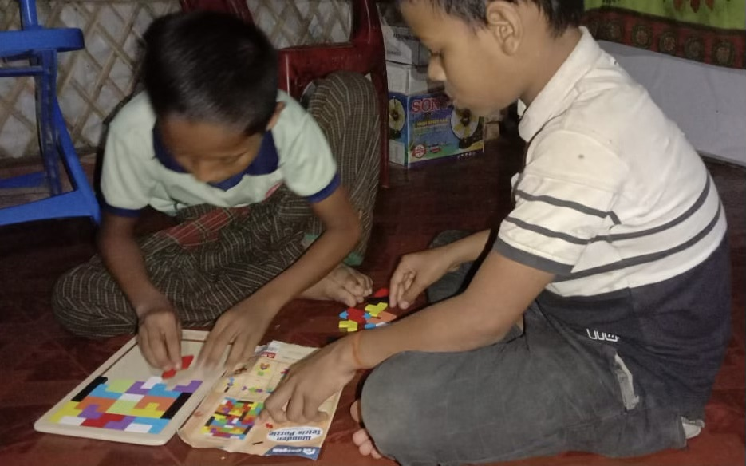
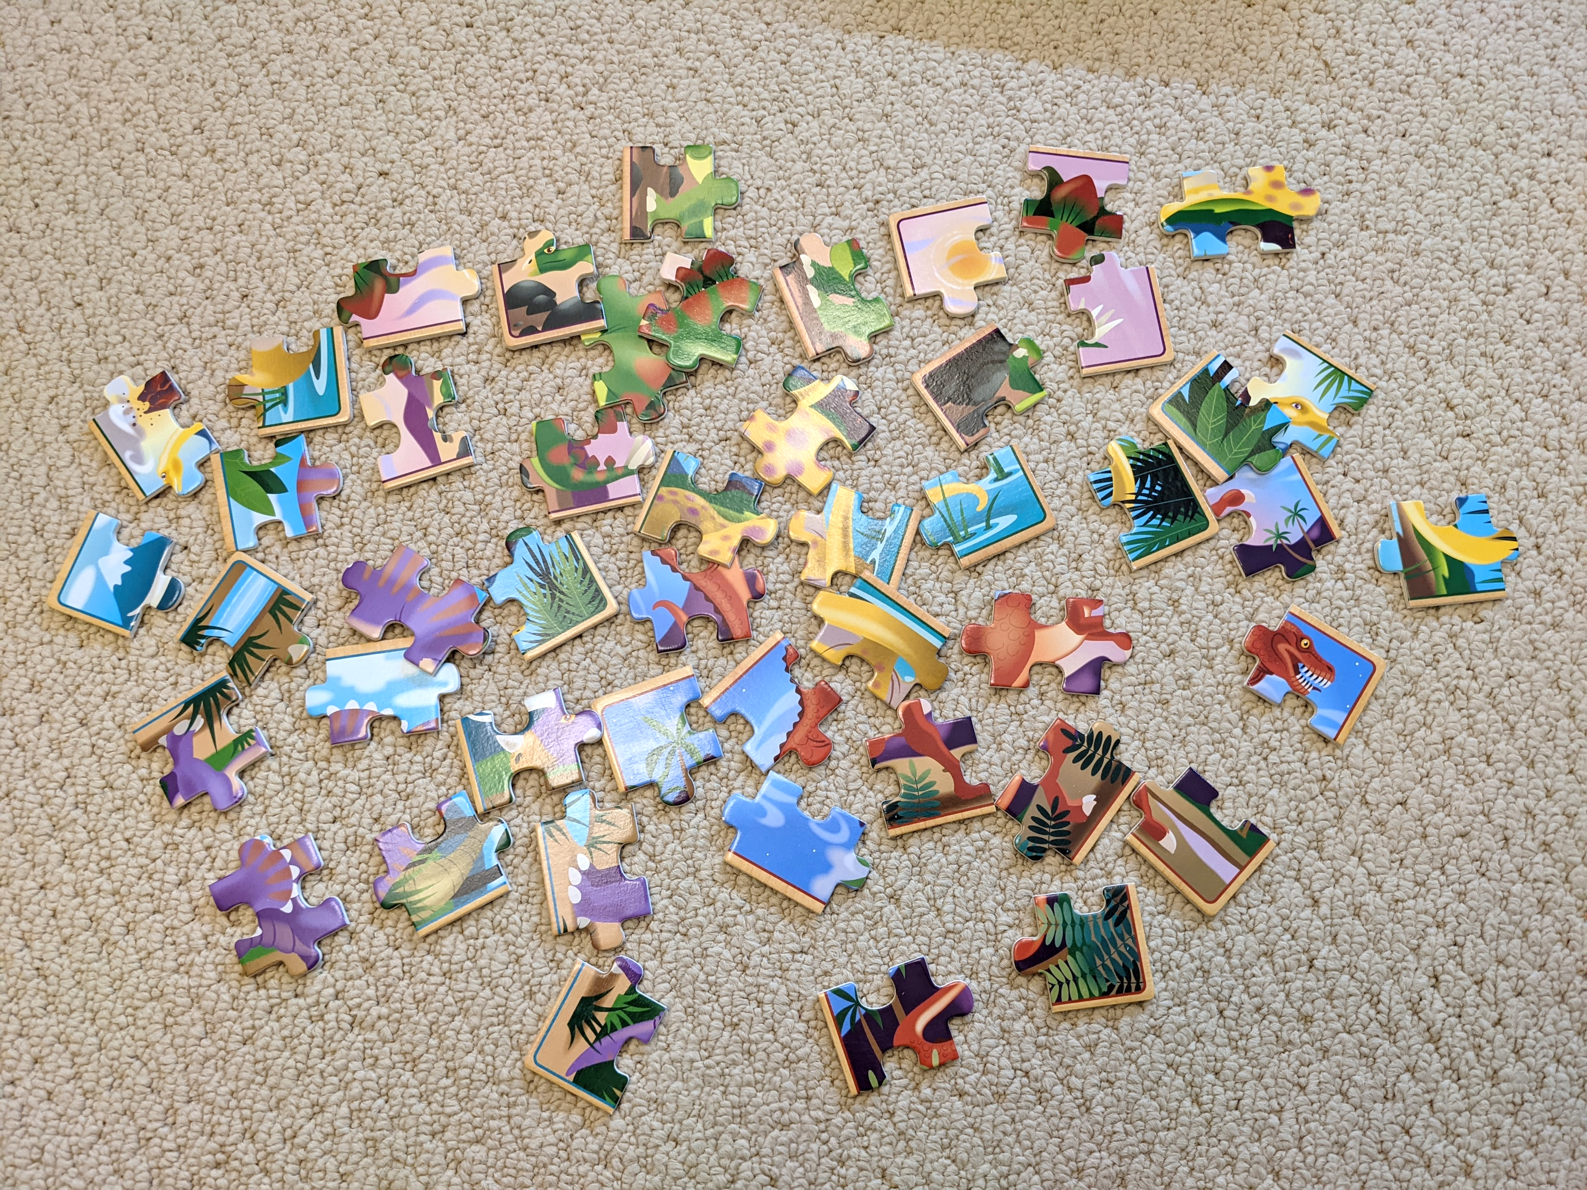
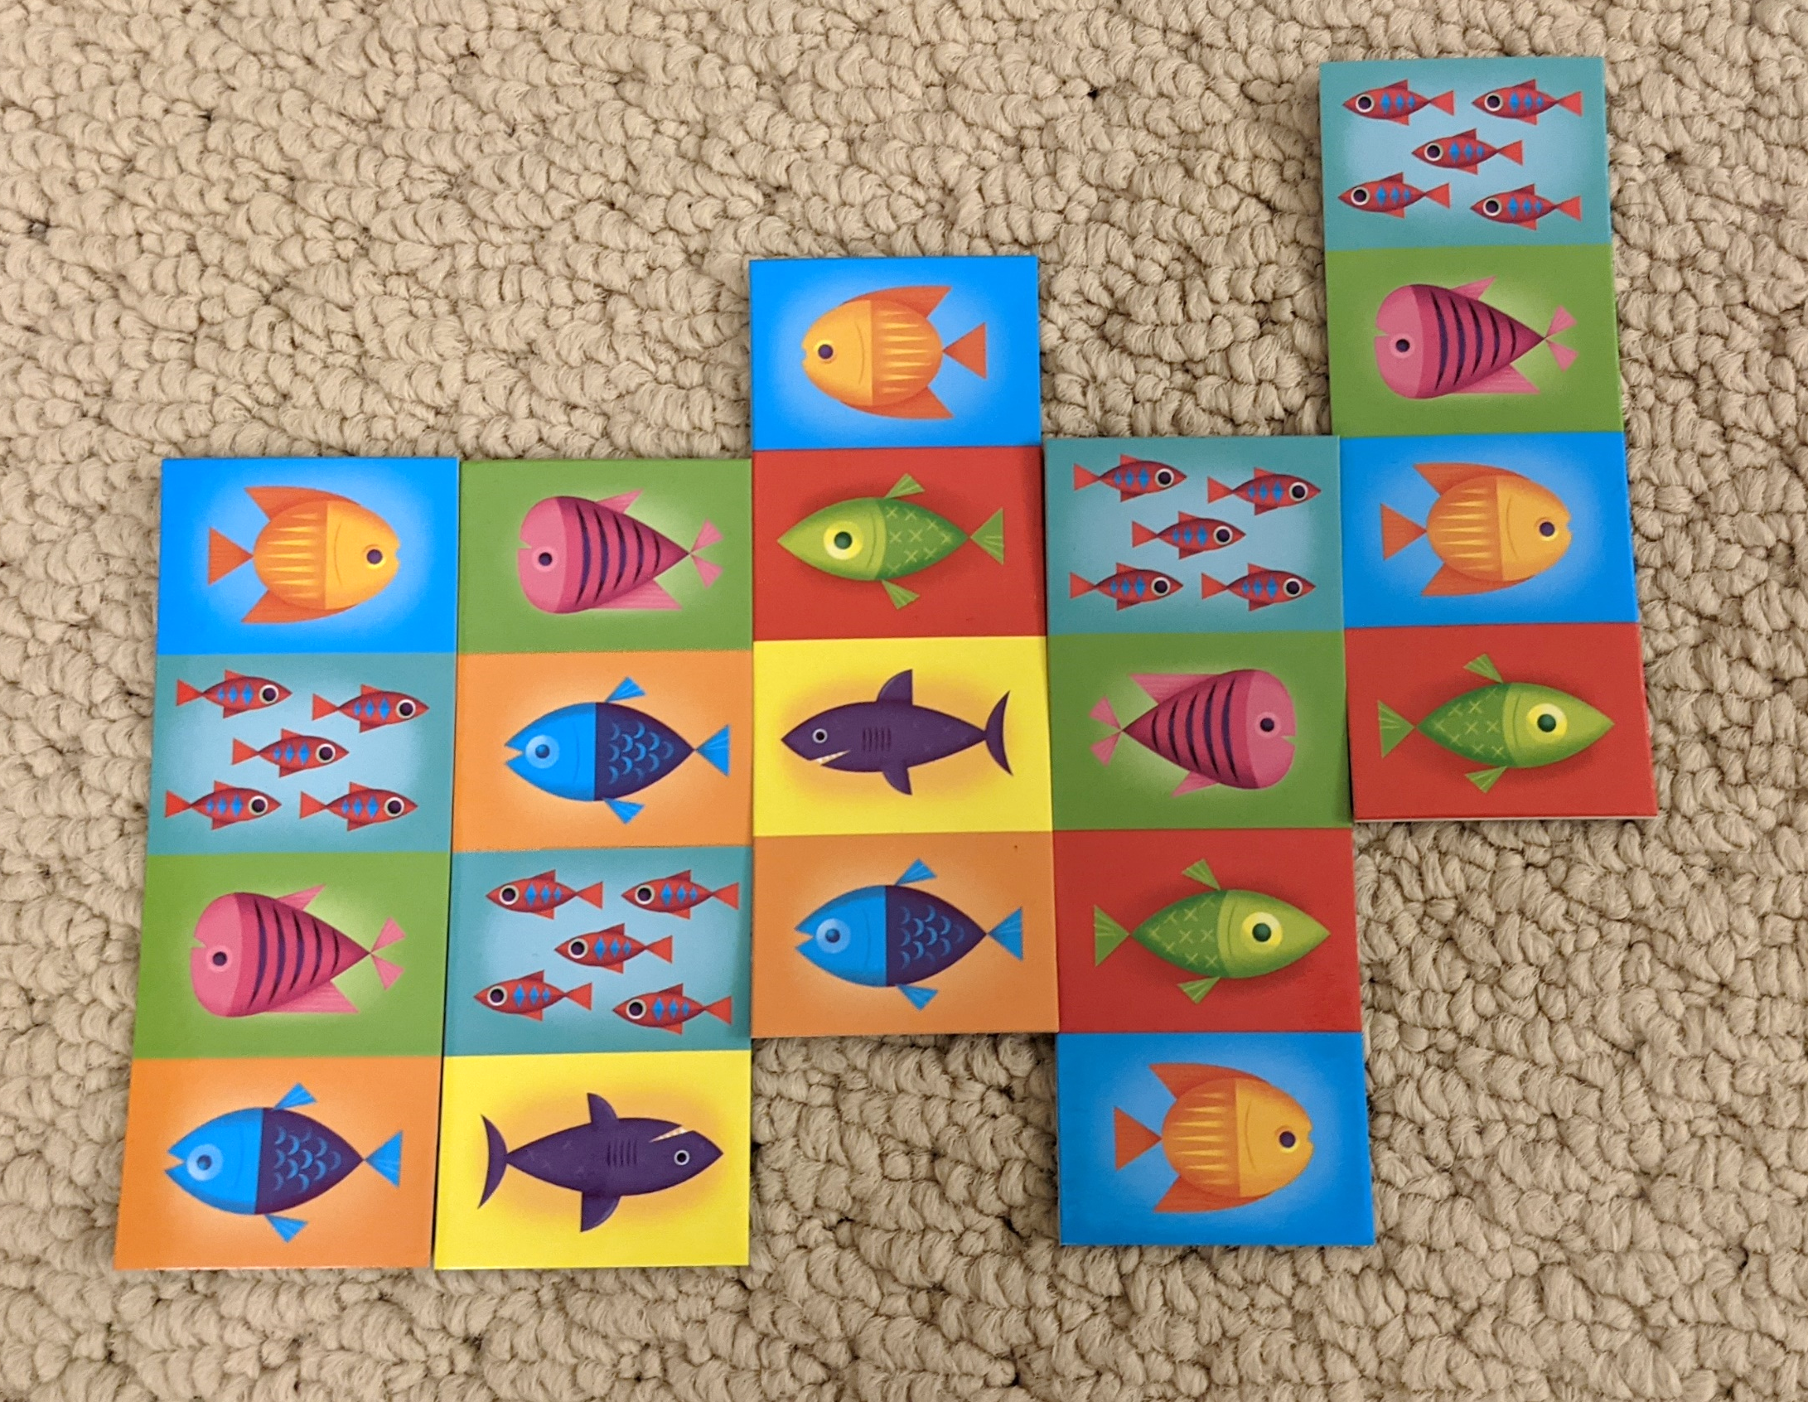
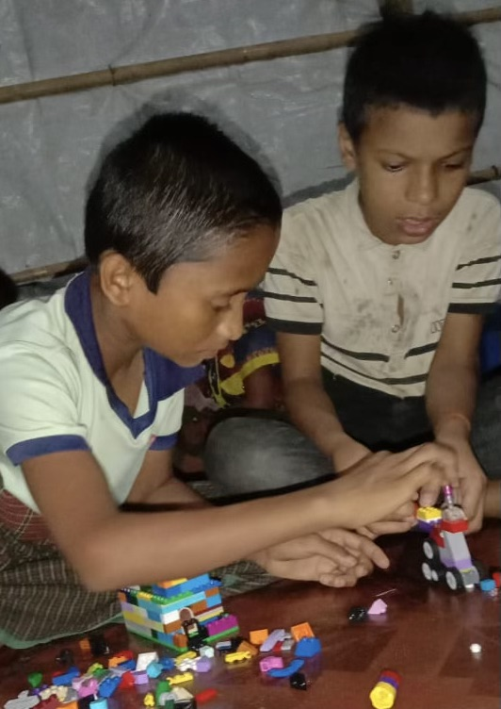
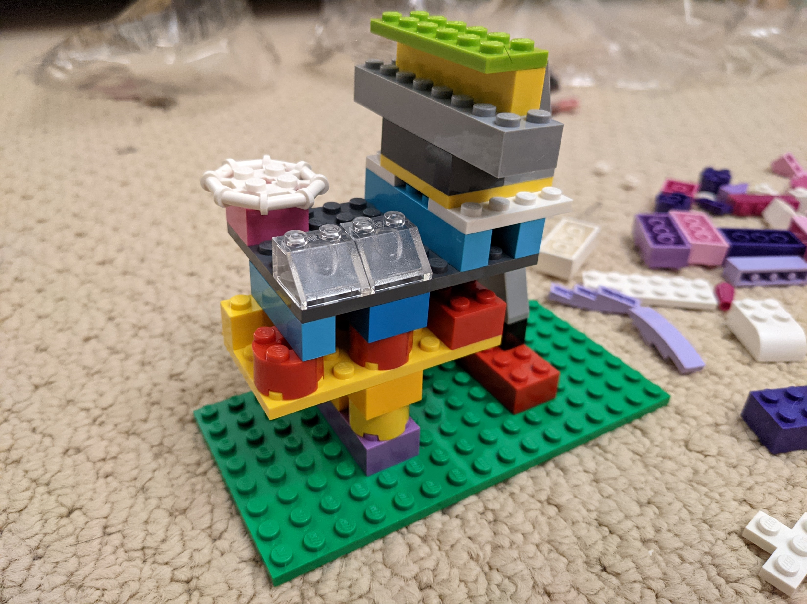
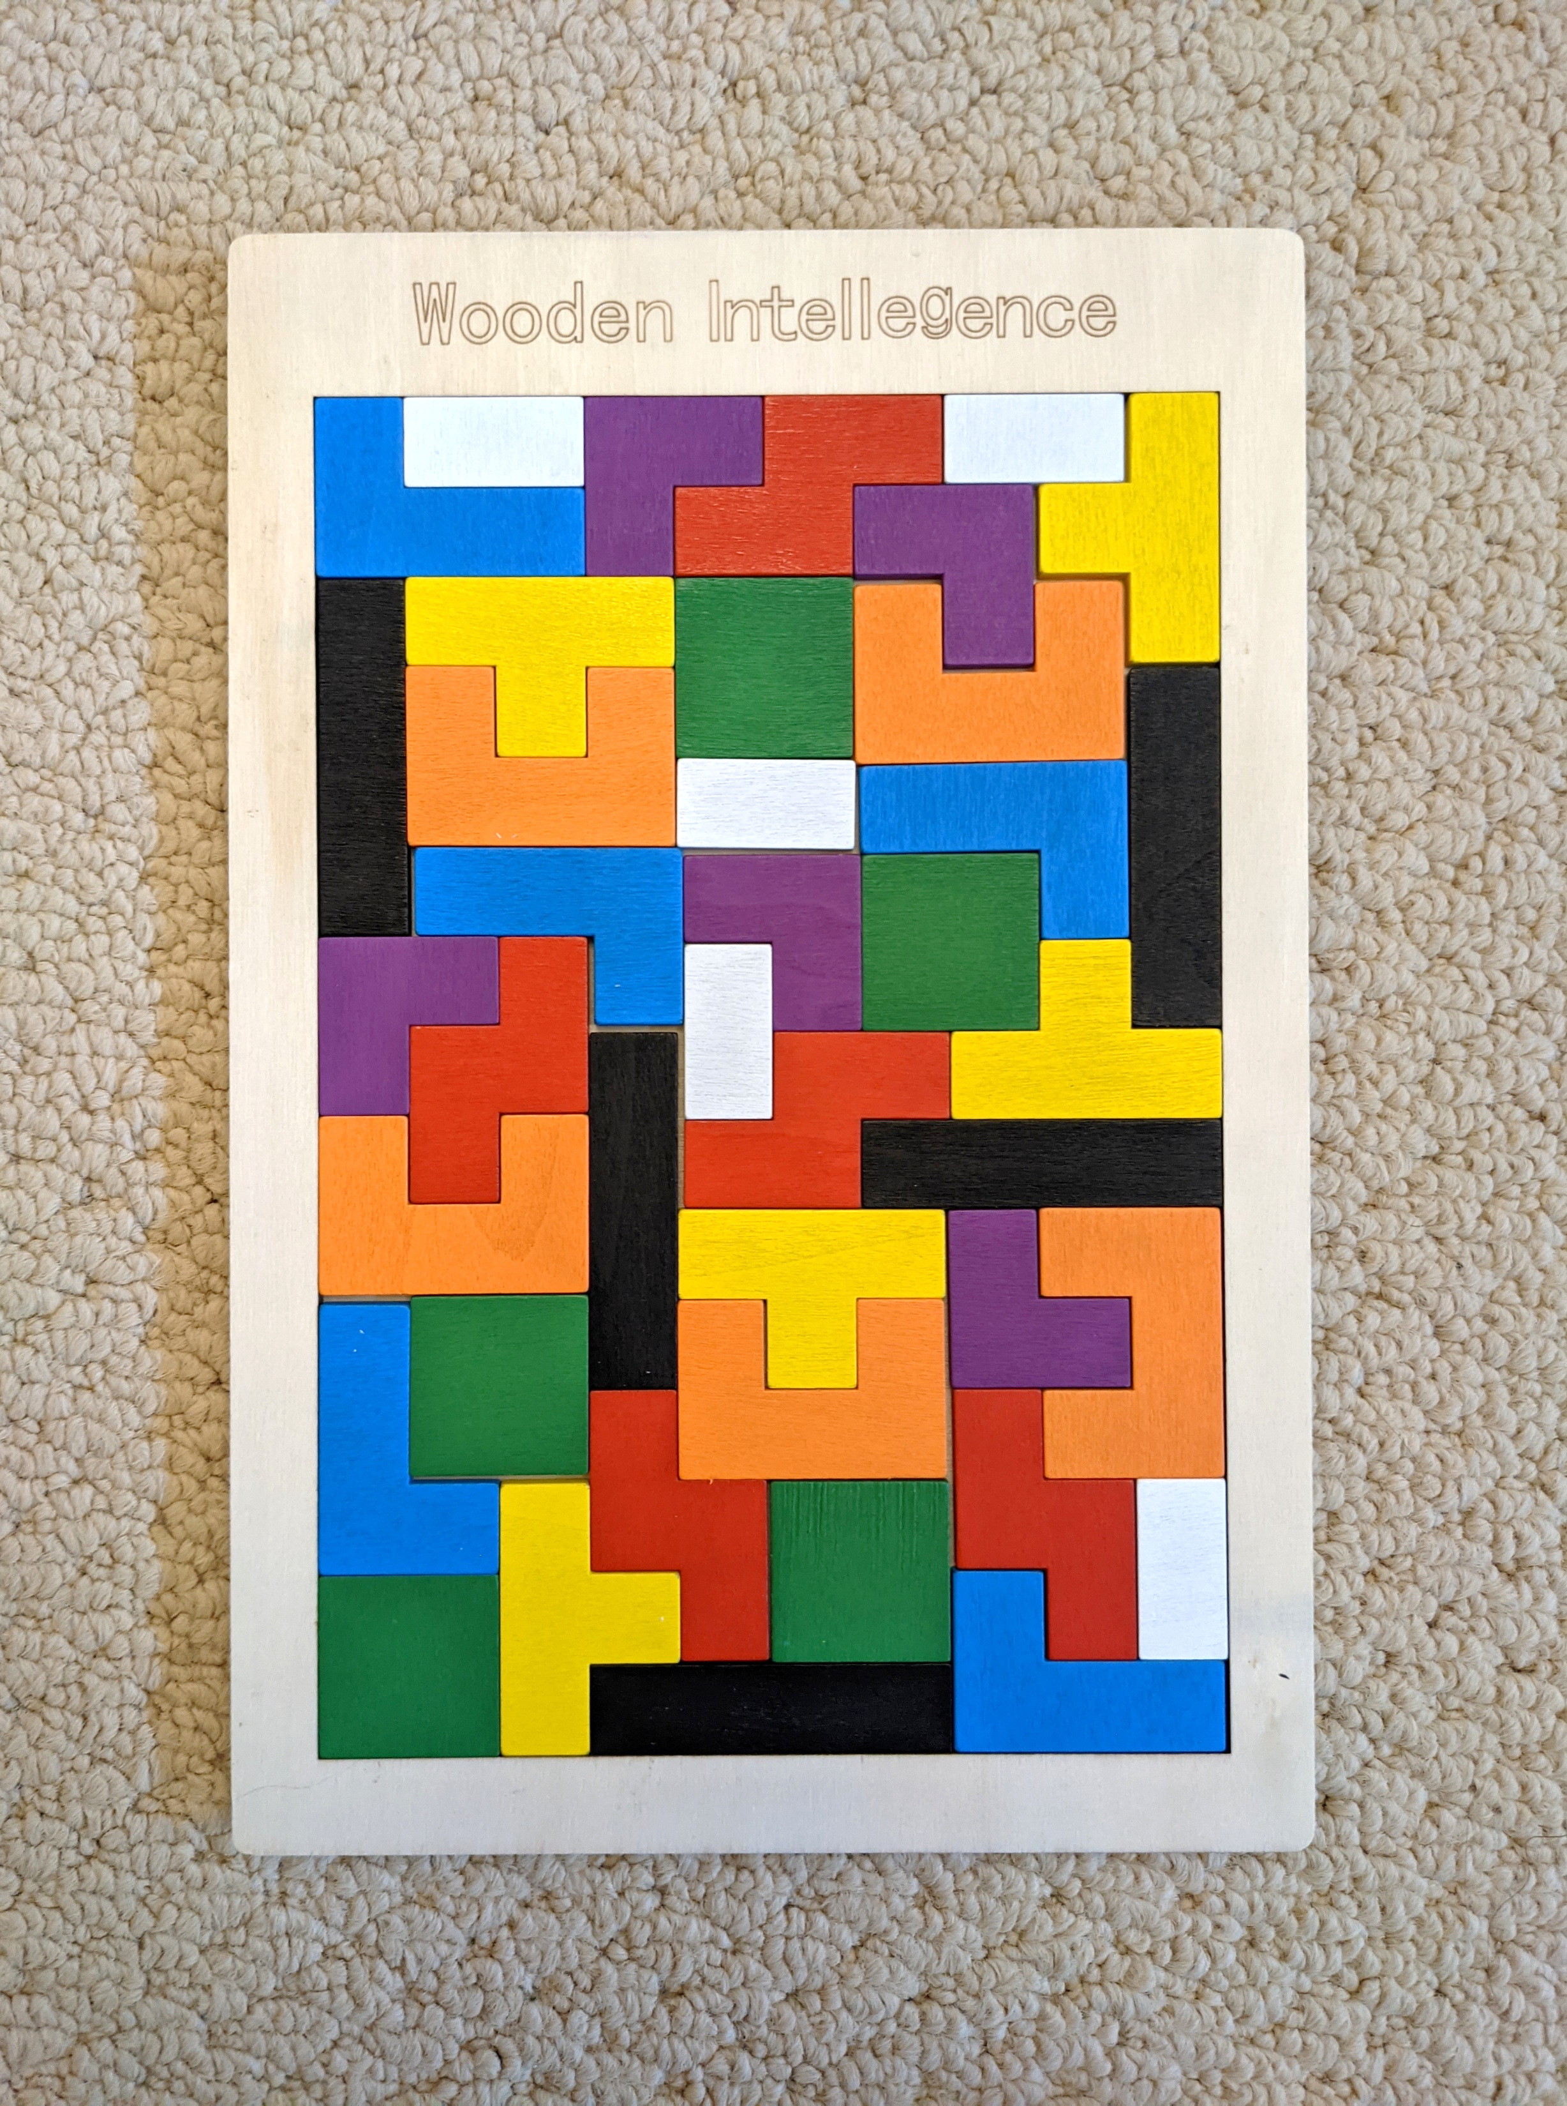
Cooperating with Puzzles and Pattern Building
Young Children (5-8 years)
Older Children (9-12 years)
Notes:
Intervention: puzzles and patterns 5-8

Slide 21
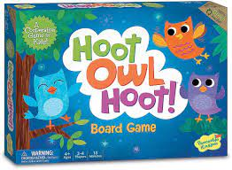
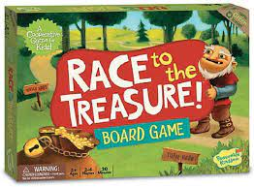
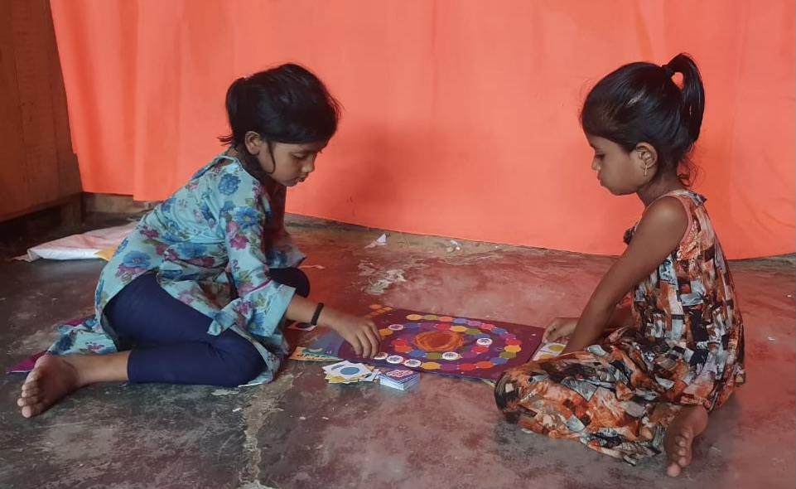
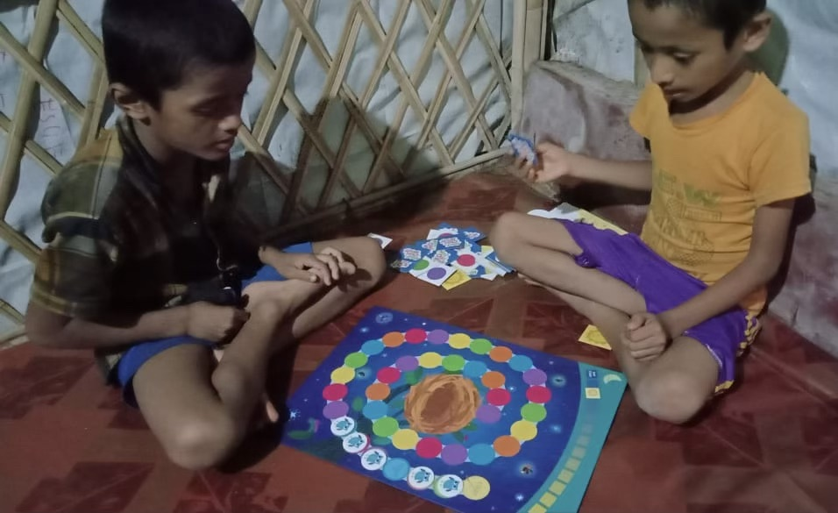
Cooperative Board Games

Slide 22
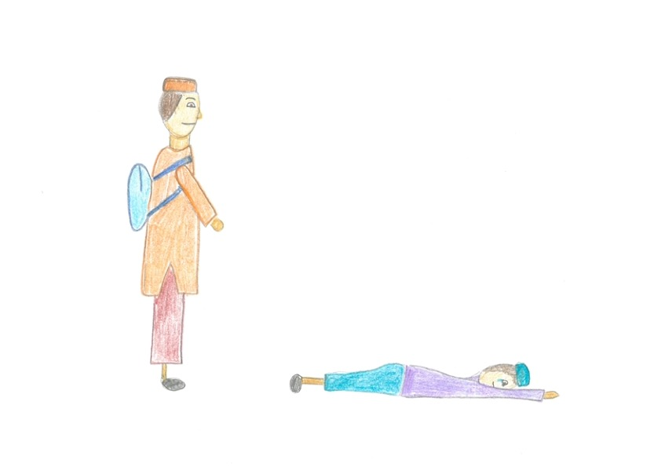
Cooperative Emotion Perspective Taking
Rahim was walking to school when he saw a small child who had fallen over. Rahim stopped and asked the child whether he was okay. The child was crying so Rahim stopped and put his arm around the little child until he stopped crying. How did the small child feel when Rahim put his arm around him? Did he/he feel happy, sad, or just ok?

Slide 23

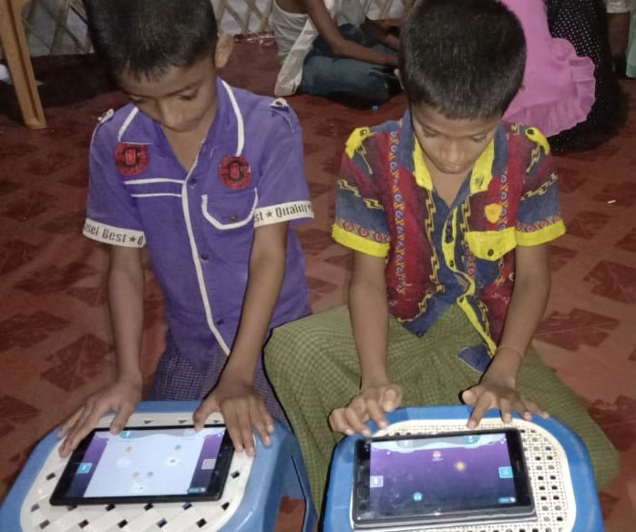

EF Skills Training: Switching and Inhibition

Slide 24
Pre- and Post-Intervention Measures
Helping, Sharing, Empathic Responding, EF

Slide 25
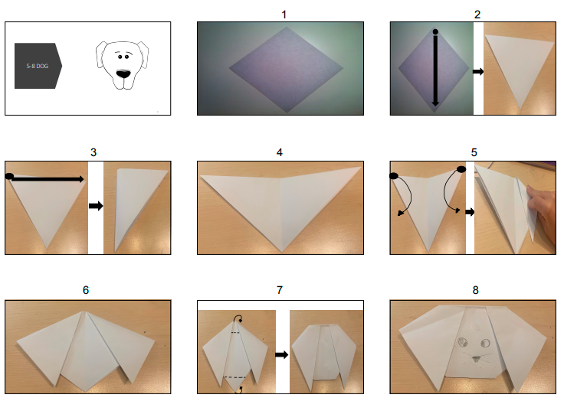
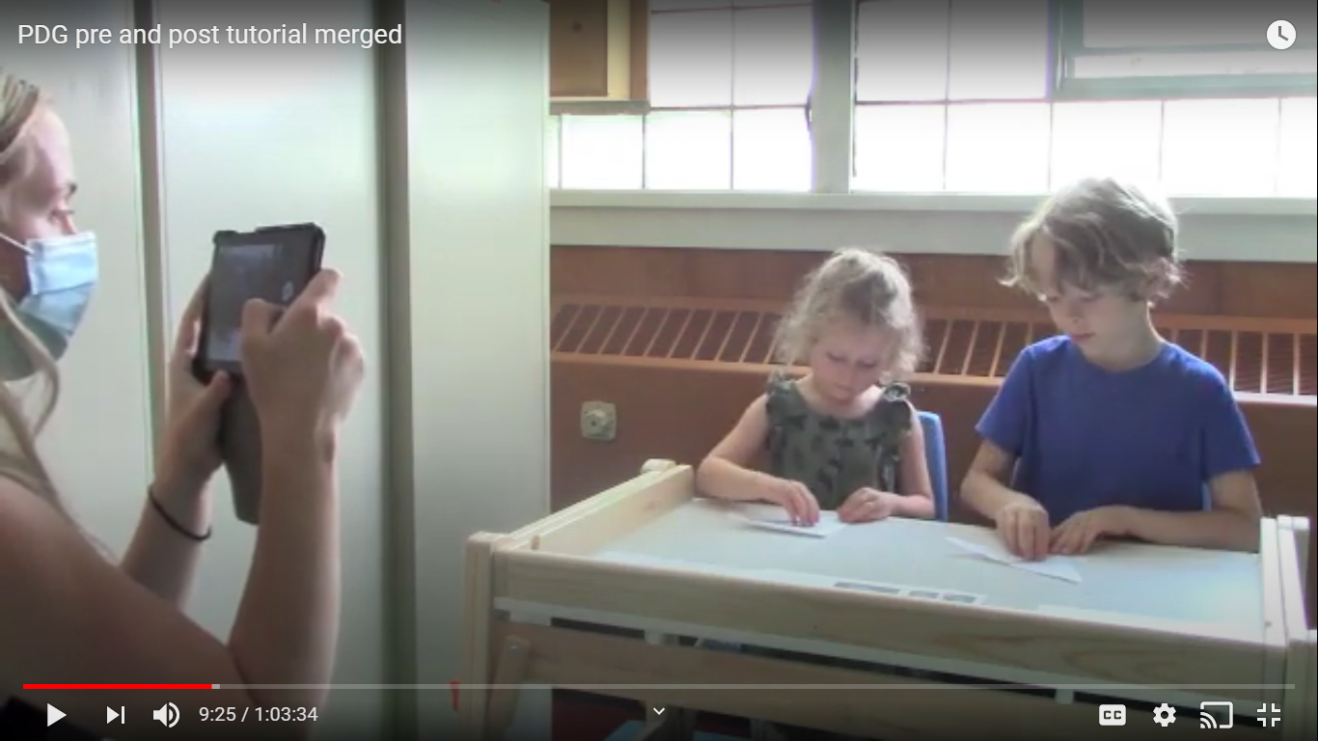
Helping Make an Origami Shape

Slide 26
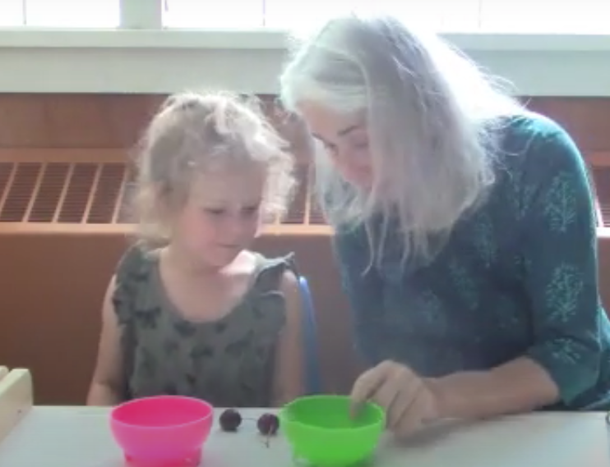
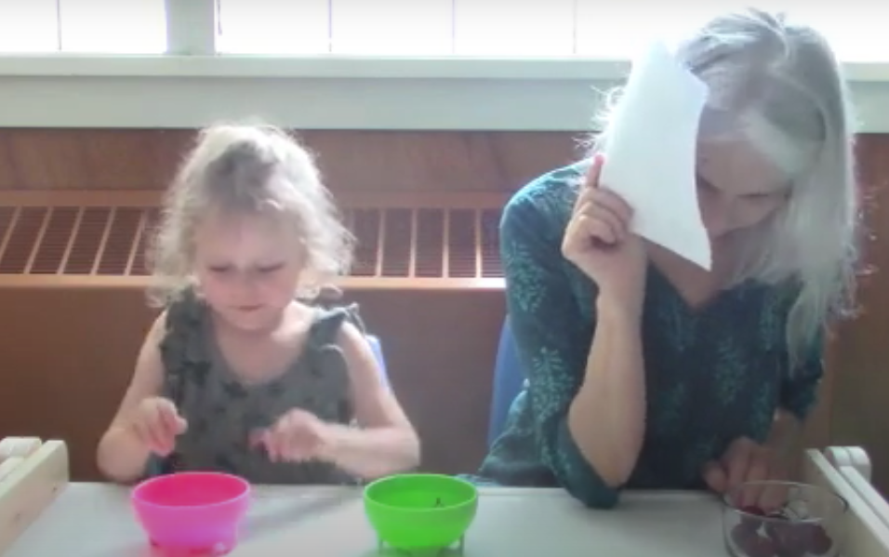
Dictator Game

Slide 27



Forced
Choice
Sharing
Task

Slide 28
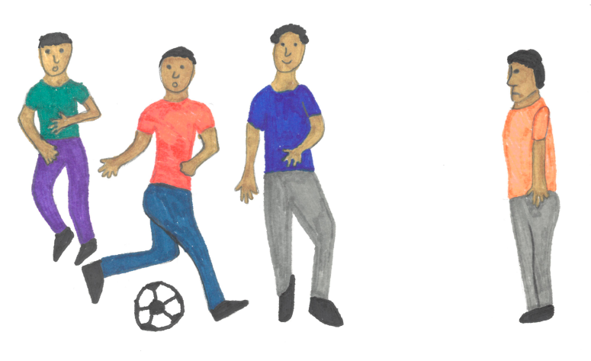
Imagine Task: Empathic Responses to Story Scenarios
Imagine you were passing by the field where a group of boys were playing soccer. You saw that there was one boy who was watching but was nervous to ask to join the soccer game. How would you feel if you saw that the nervous boy wanted to join the soccer game? Would you try to do something? What would you do?

Slide 29
Research questions and analytic approach
Research Question 1
  Do children’s initial baseline levels vary by Birthplace and Age?
Research Question 2
  Does children’s intervention-related change in levels (pre-post) vary by Birthplace and Age?
Analytic approach
  latent difference score modeling to predict the outcomes’ initial levels (intercept model) and intervention-related changes (slope model).

Slide 30
Helping behavior

Slide 31
Results for Helping
Initial Levels
Age
  older children showed a higher initial level in overtaking compared to younger children
Birthplace
  camp-born children showed higher monitoring and helping behavior relative to Myanmar-born children who showed higher overtaking
Intervention Related change
Age
  older children showed greater intervention-related increases in overtaking than the younger children.
Birthplace
  Myanmar-born children had higher intervention-related increases in overtaking than camp-born BUT were less likely to show improvements in helping behavior and monitoring

Slide 32
Fairness concerns (Sharing)

Slide 33
Results for DG Sharing
Initial Sharing Levels (DG)
Intervention Related change (DG)
Birthplace
  Greater increase in sharing in the DG for Myanmar born compared to camp born children.
Age
  Older children shared less than younger children in the initial assessment
Birthplace
  Children born in Myanmar had higher initial levels of sharing compared to those born in Camp.

Slide 34
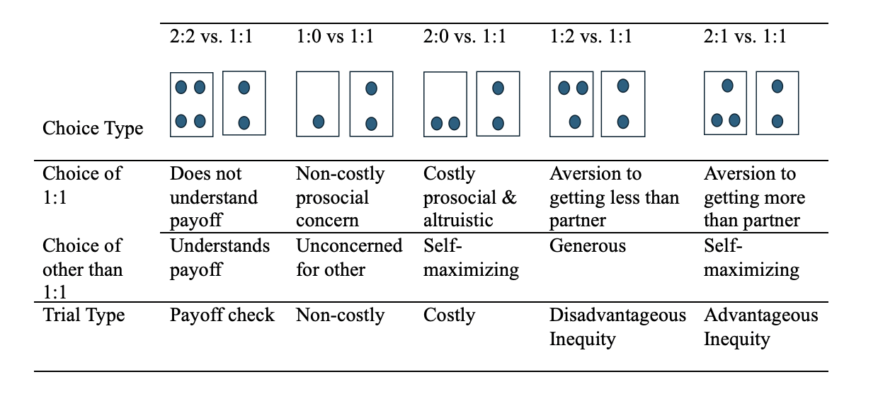
Forced choice trials

Slide 35
Results for Forced Choice Sharing
Initial Sharing Levels (FC)
Intervention Related change (FC)
Age
  Older children showed greater intervention-related improvement on all forced-choice-trial types
Birthplace
  Myanmar born children showed greater intervention-related change on non-costly sharing, costly sharing, and Advantageous trials, but NOT on Disadvantageous trials (where partner would get less).
Age
  Older children were more likely to choose equality on Costly sharing and Disadvantageous trials, no age effect was observed for non-Costly sharing or advantageous trials.
Birthplace
  Greater equality choice for Myanmar on Non-costly, Costly and Advantageous
  Lower on Disadvantageous

Slide 36
Empathic responding (Imagine task)

Slide 37
Results for Empathic Responding
Initial Levels
Intervention Related change
Birthplace
  Myanmar-born children showed a greater increase in empathy, sympathy responses compared to camp-born
Age
  Older children more likely than younger children to report empathy, sympathy and imagine appropriate remedial actions
Birthplace
  Myanmar-born more likely than camp-born children to report empathy, sympathy when asked how they would feel but less likely to imagine behavioral solutions when asked what they would do.

Slide 38
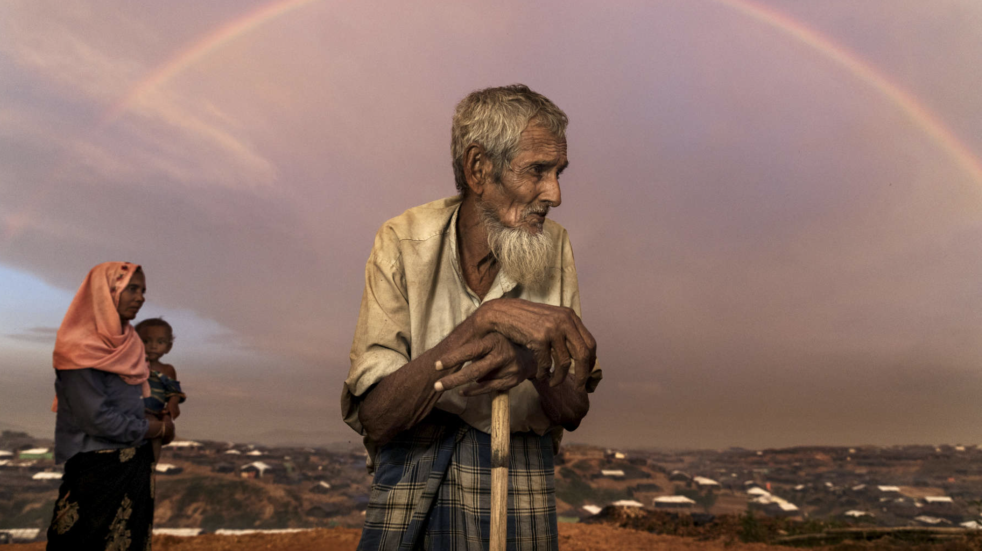
© Paula Bronstein (paulaphoto.com)

Slide 39


Slide 40
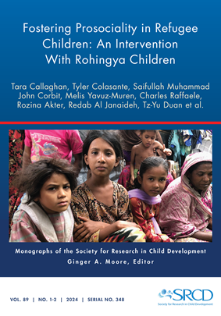
For this issue, visit
doi.org/10.1111/mono.12477
For videos, commentaries, and teaching materials,
visit monographmatters.srcd.org

Slide 41
Corresponding author
Tara Callaghan
St. Francis Xavier University
Editorial inquiries
monographs@srcd.org
Citation
Callaghan, T., et al., (2024). Fostering Prosociality in Refugee Children: An Intervention with Rohingya Children. Monographs of the Society for Research in Child Development, 89(1-2). https://doi.org/10.1111/mono.12477

