Slide 1
The Art of Mayyu Khan: Rohingya Artist and Poet
Mayyu Khan

Slide 2
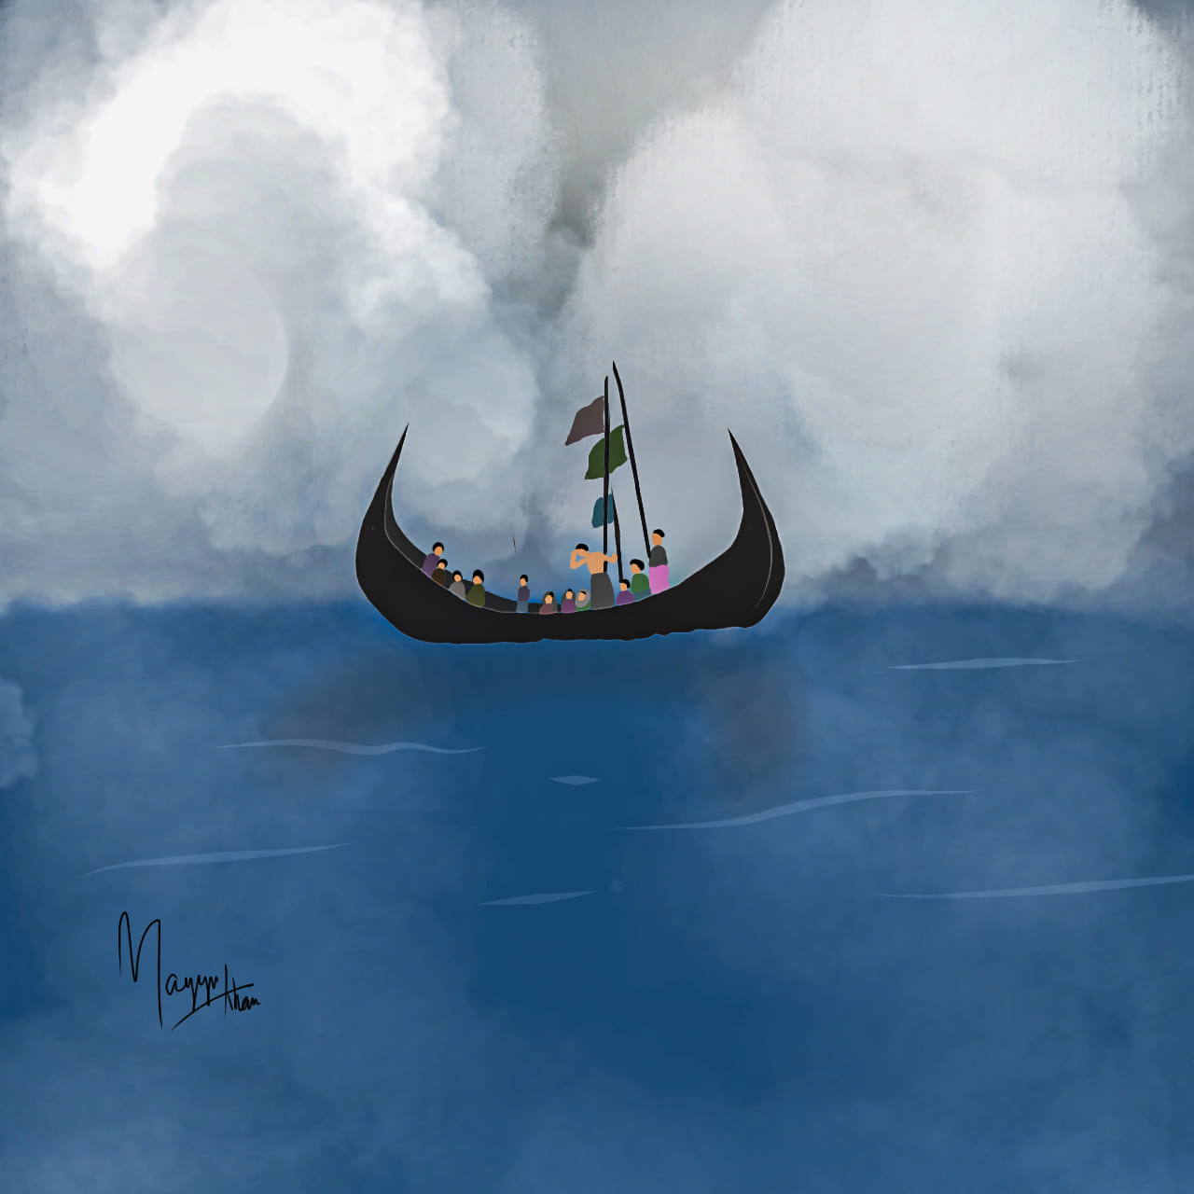
The Art of Mayyu Khan
Rohingya Artist and Poet

Slide 3
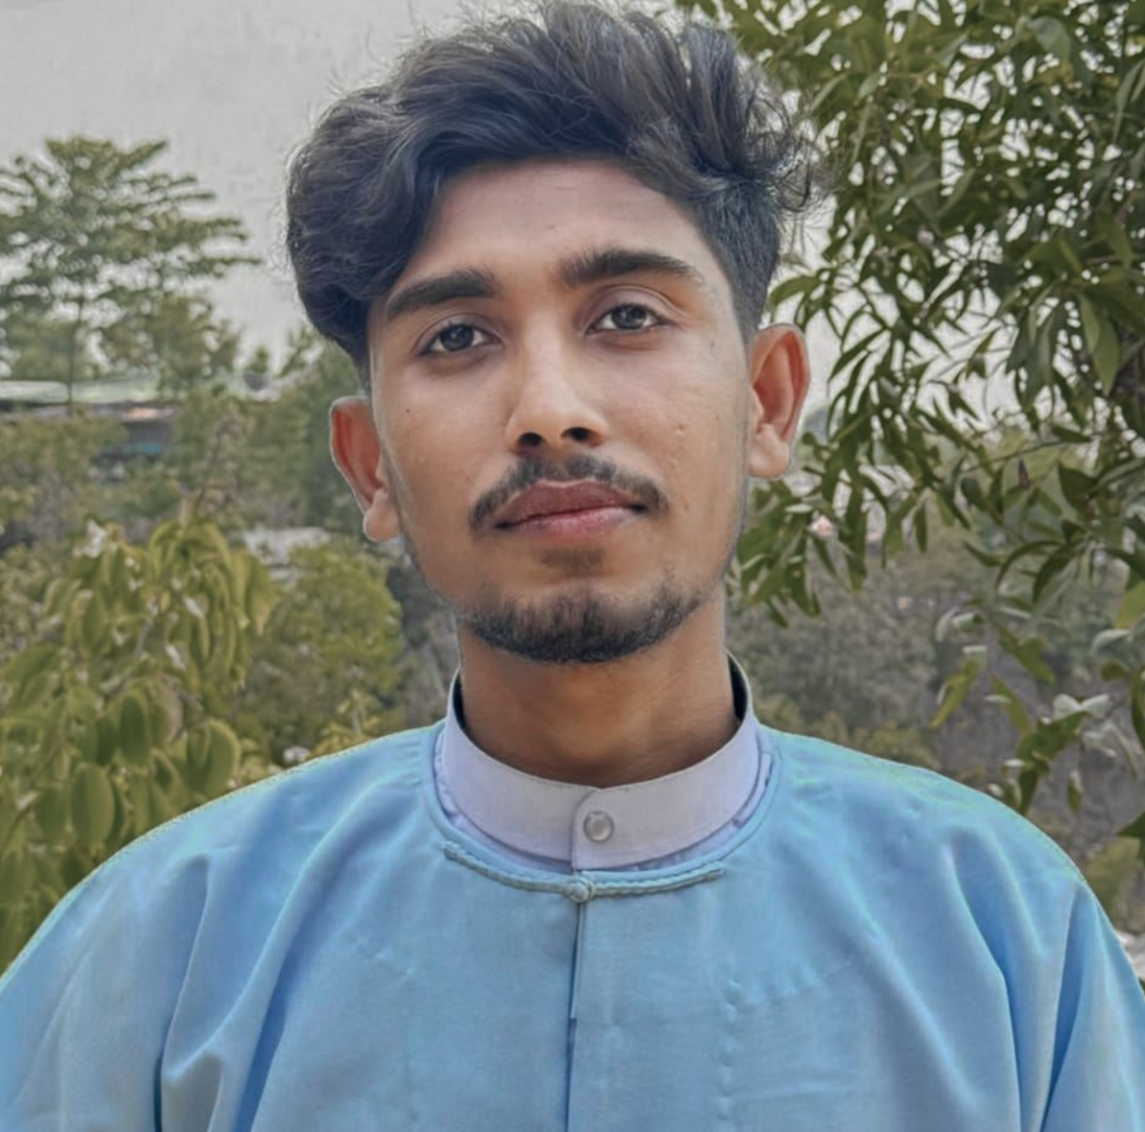
Artist’s Statement
My name is Mayyu Khan, I'm 24 years old. I have been living in the Bangladesh refugee camp for a long time but in June 2024 I resettled in New Zealand. My hometown in Myanmar is Rathedaung in Northern Rakhine state.
I have been practicing creative activities from a very young age. Photography, film making, poetry writing, painting, music and many more. Due to discouragement and lack of a suitable environment, I could not continue these creative activities. But since I became an adult, I have created my own environment. I voluntarily do the above various activities which can contribute to my peace of mind and my ethnic or social work.
Through these works, I try to bring myself, others and my oppressed Rohingya nation to the world. Besides my art, I work in various ways to reform or preserve our almost extinct Rohingya culture and language. My artworks and photographs carry memory, testimony and life for decades and eras. I use these works mainly as powerful languages for ​​that which I am unable to verbalize.

Slide 4
Drawings by Mayyu Khan

Slide 5
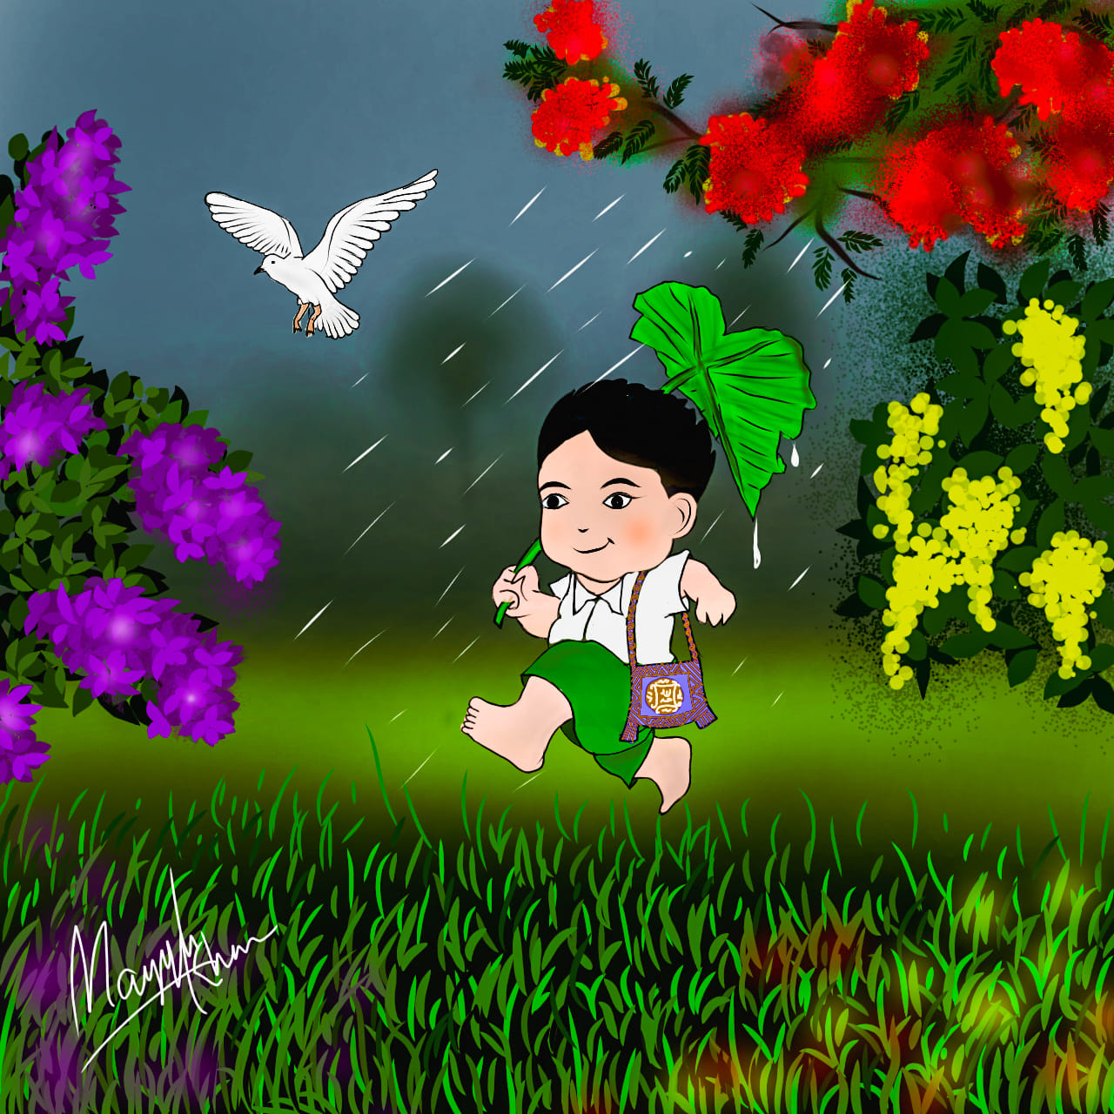

Slide 6
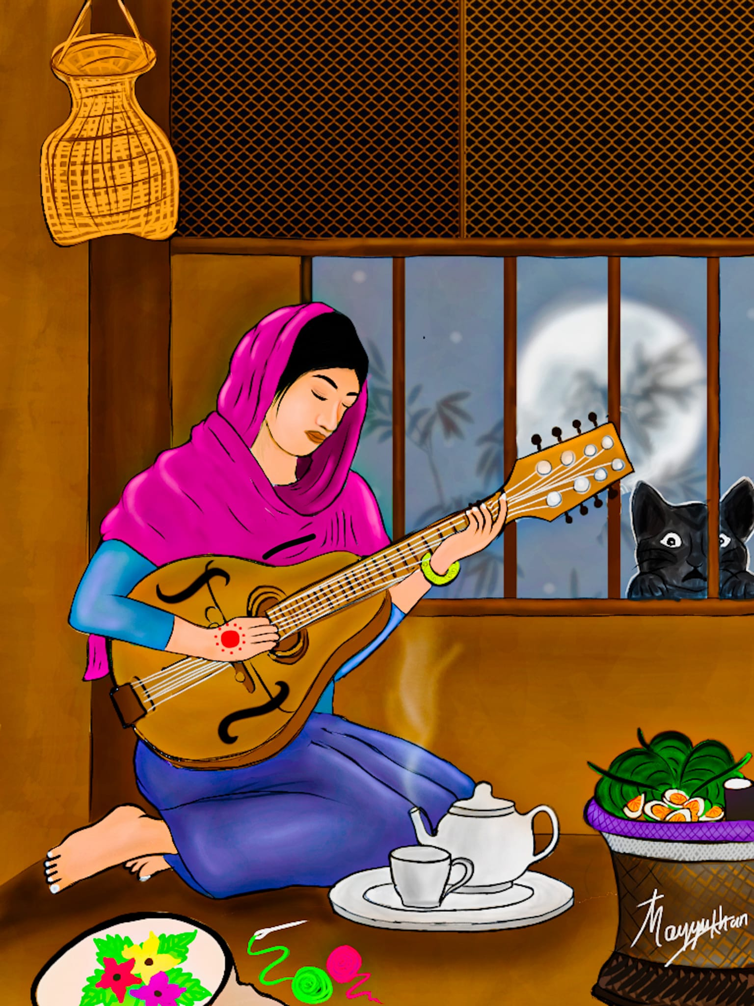

Slide 7
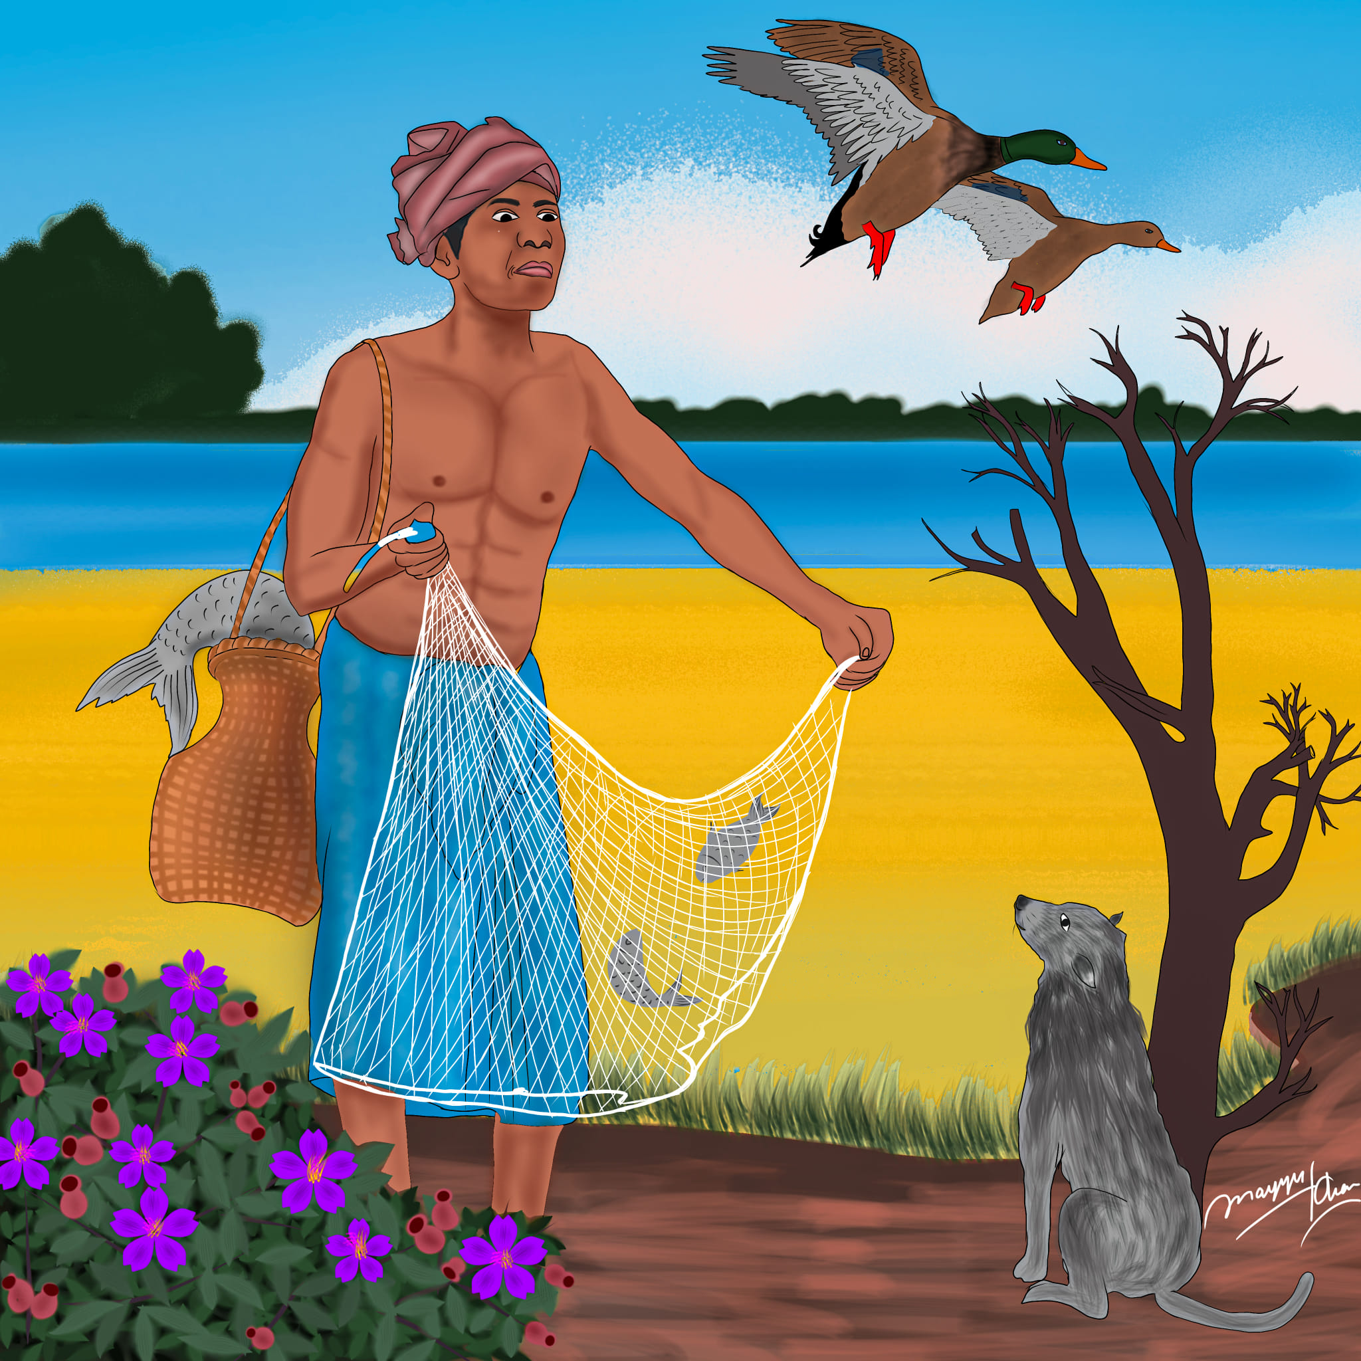

Slide 8
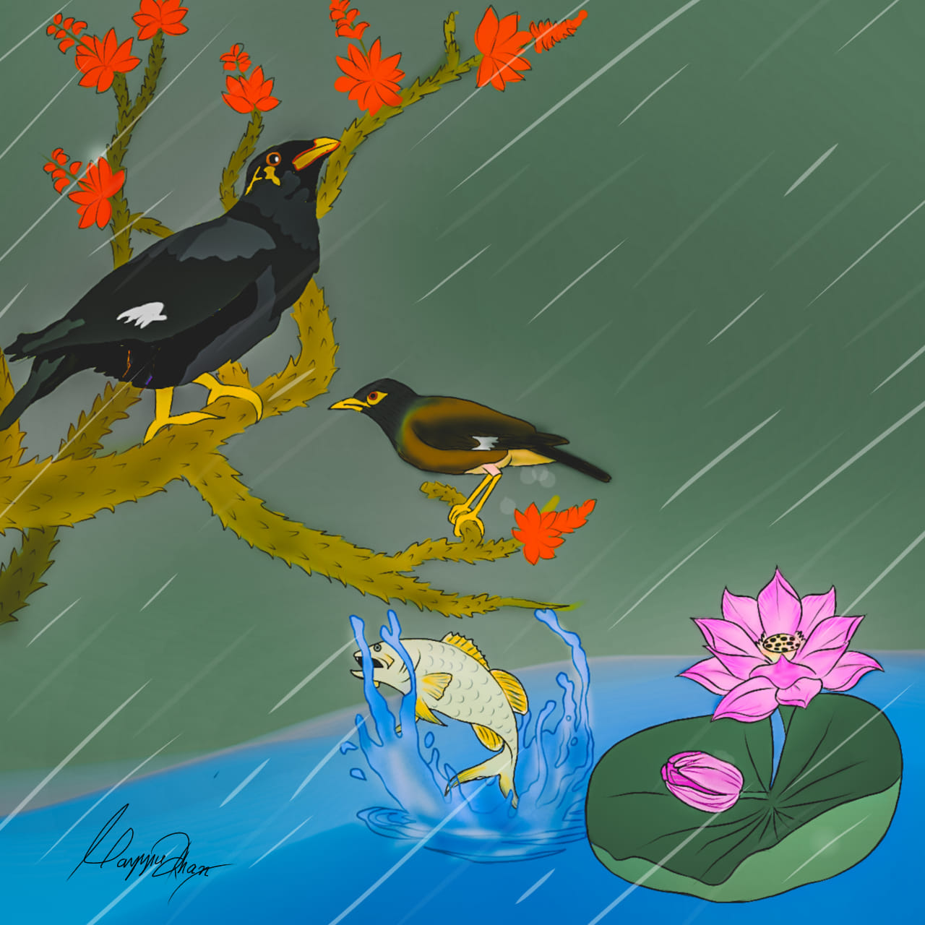

Slide 9
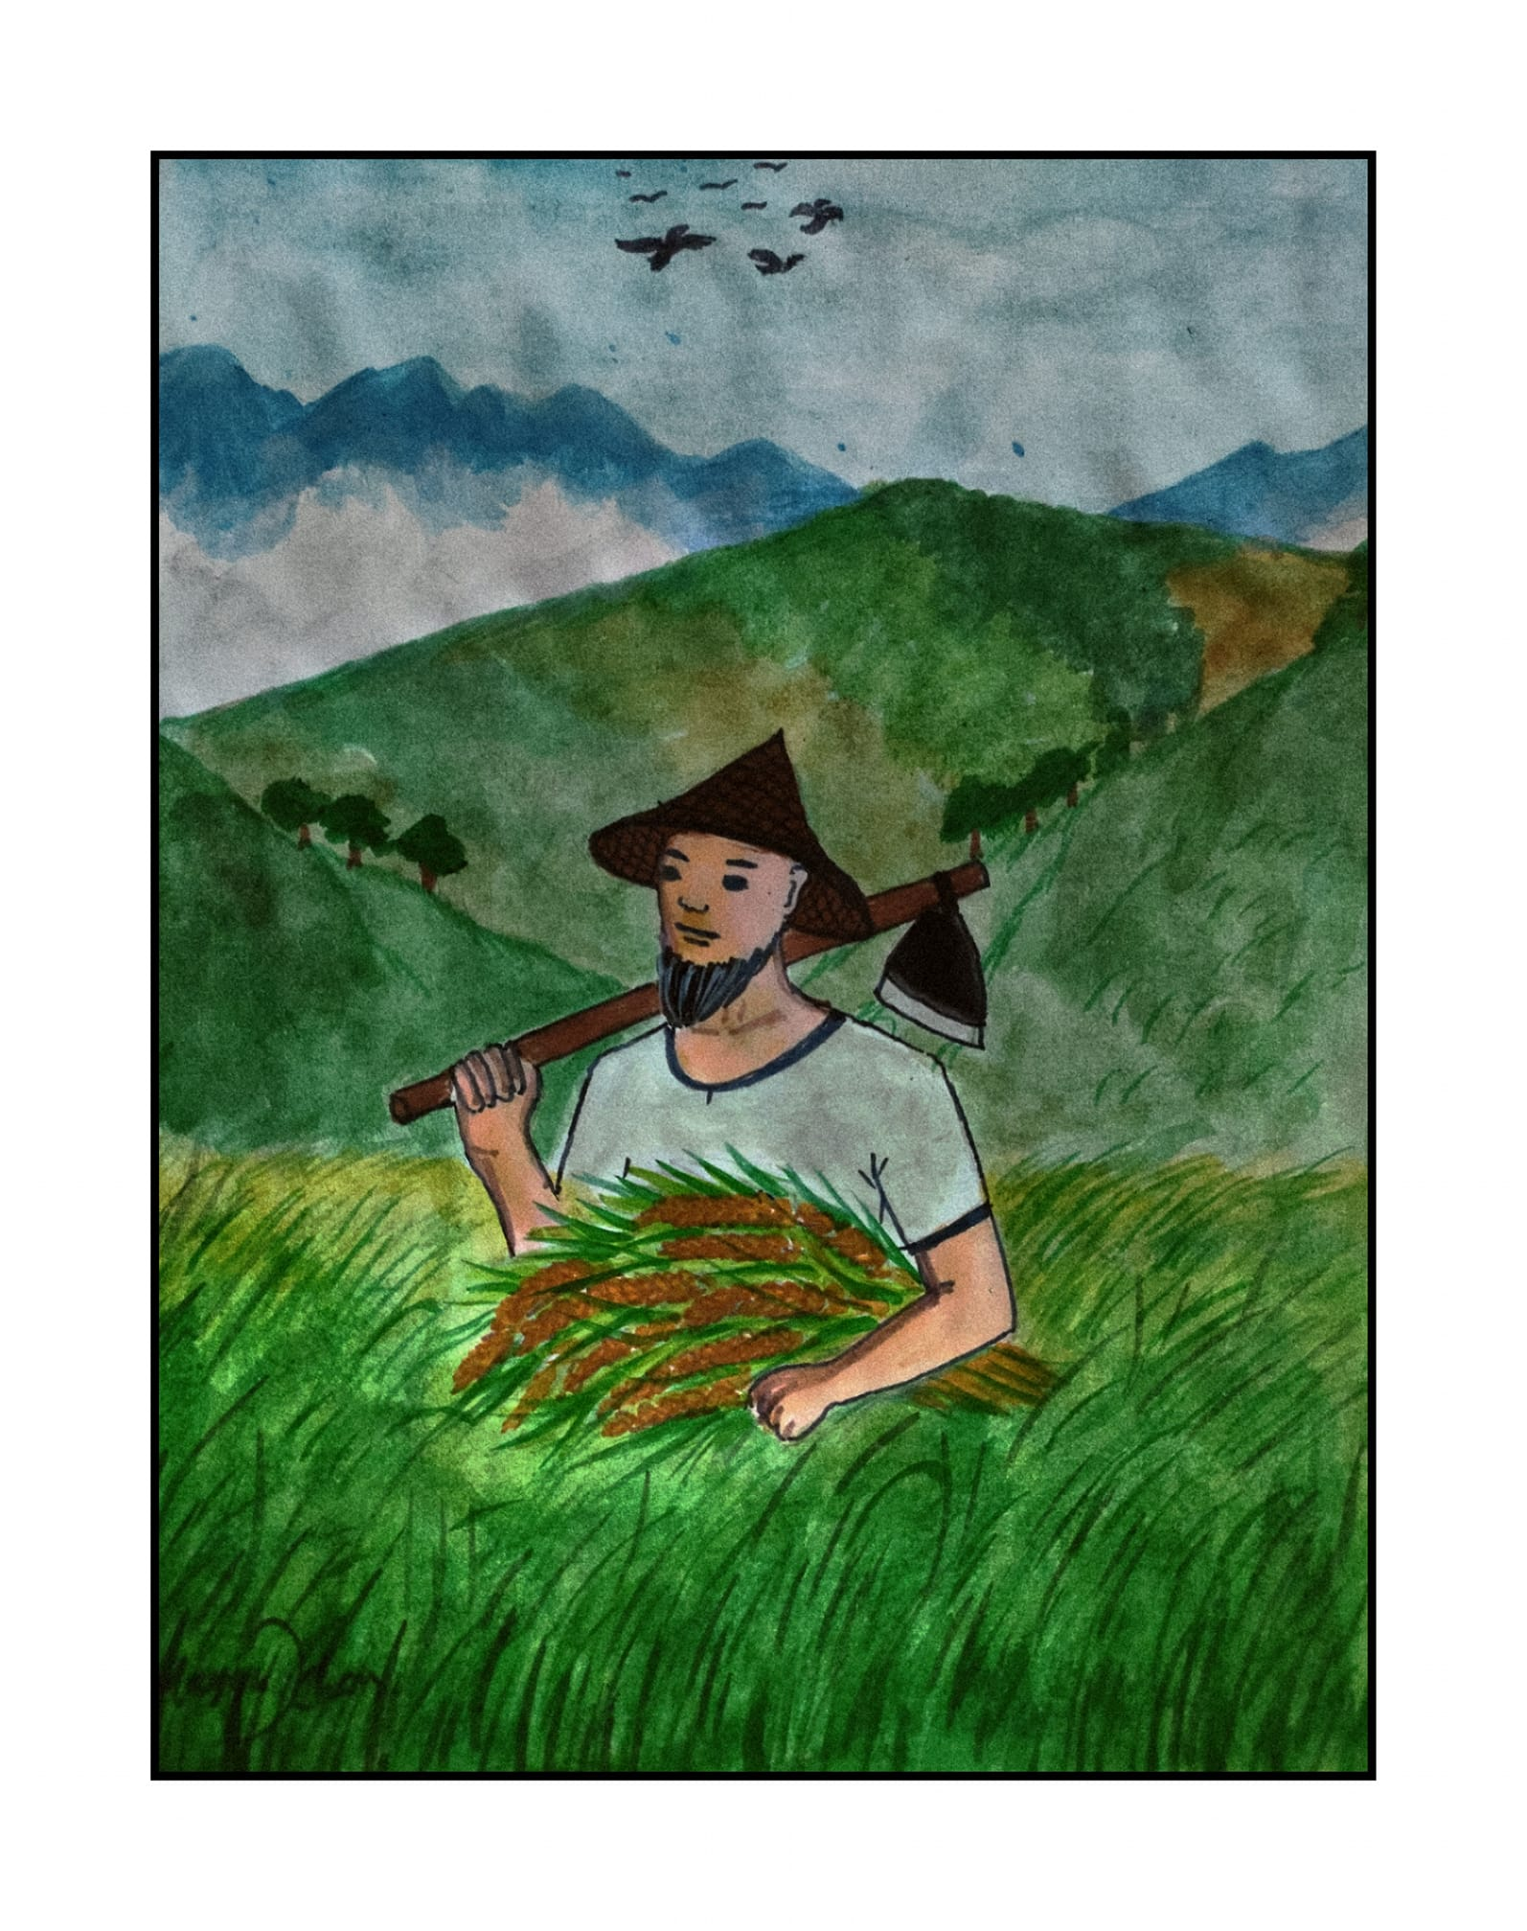

Slide 10
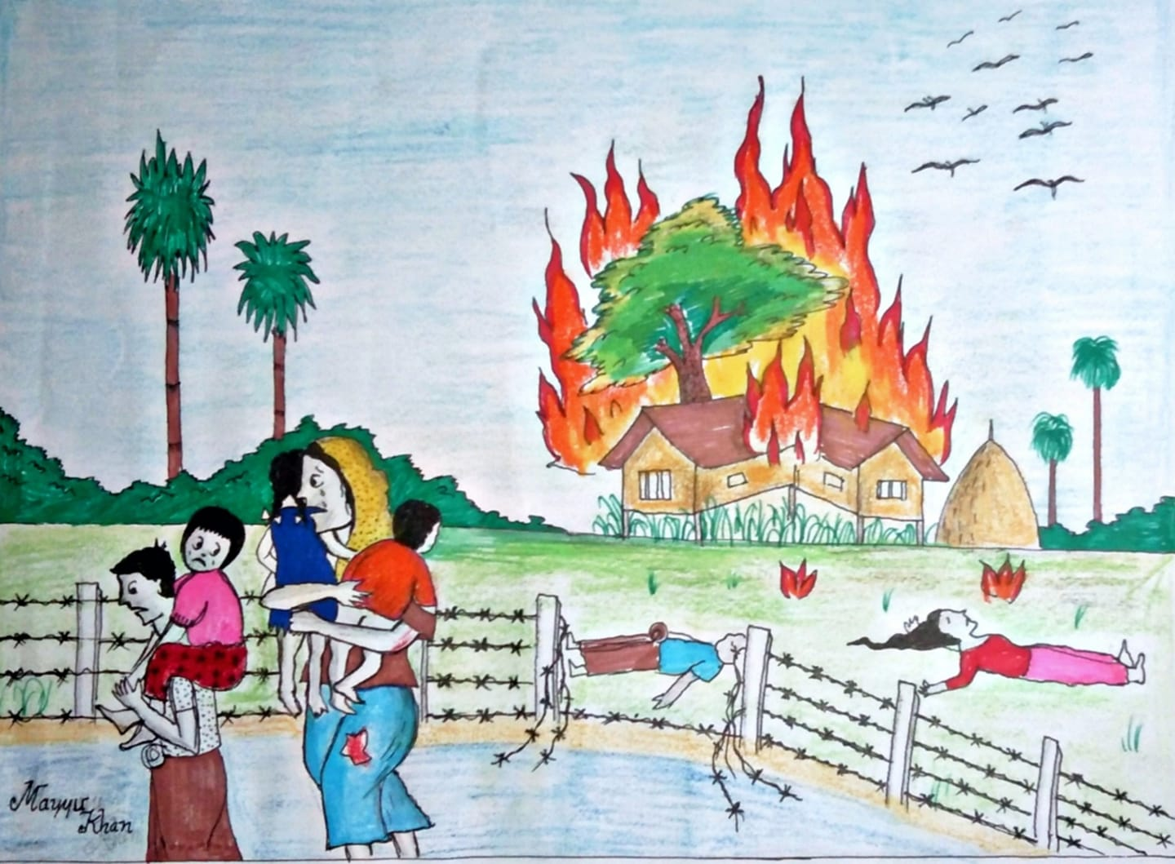

Slide 11
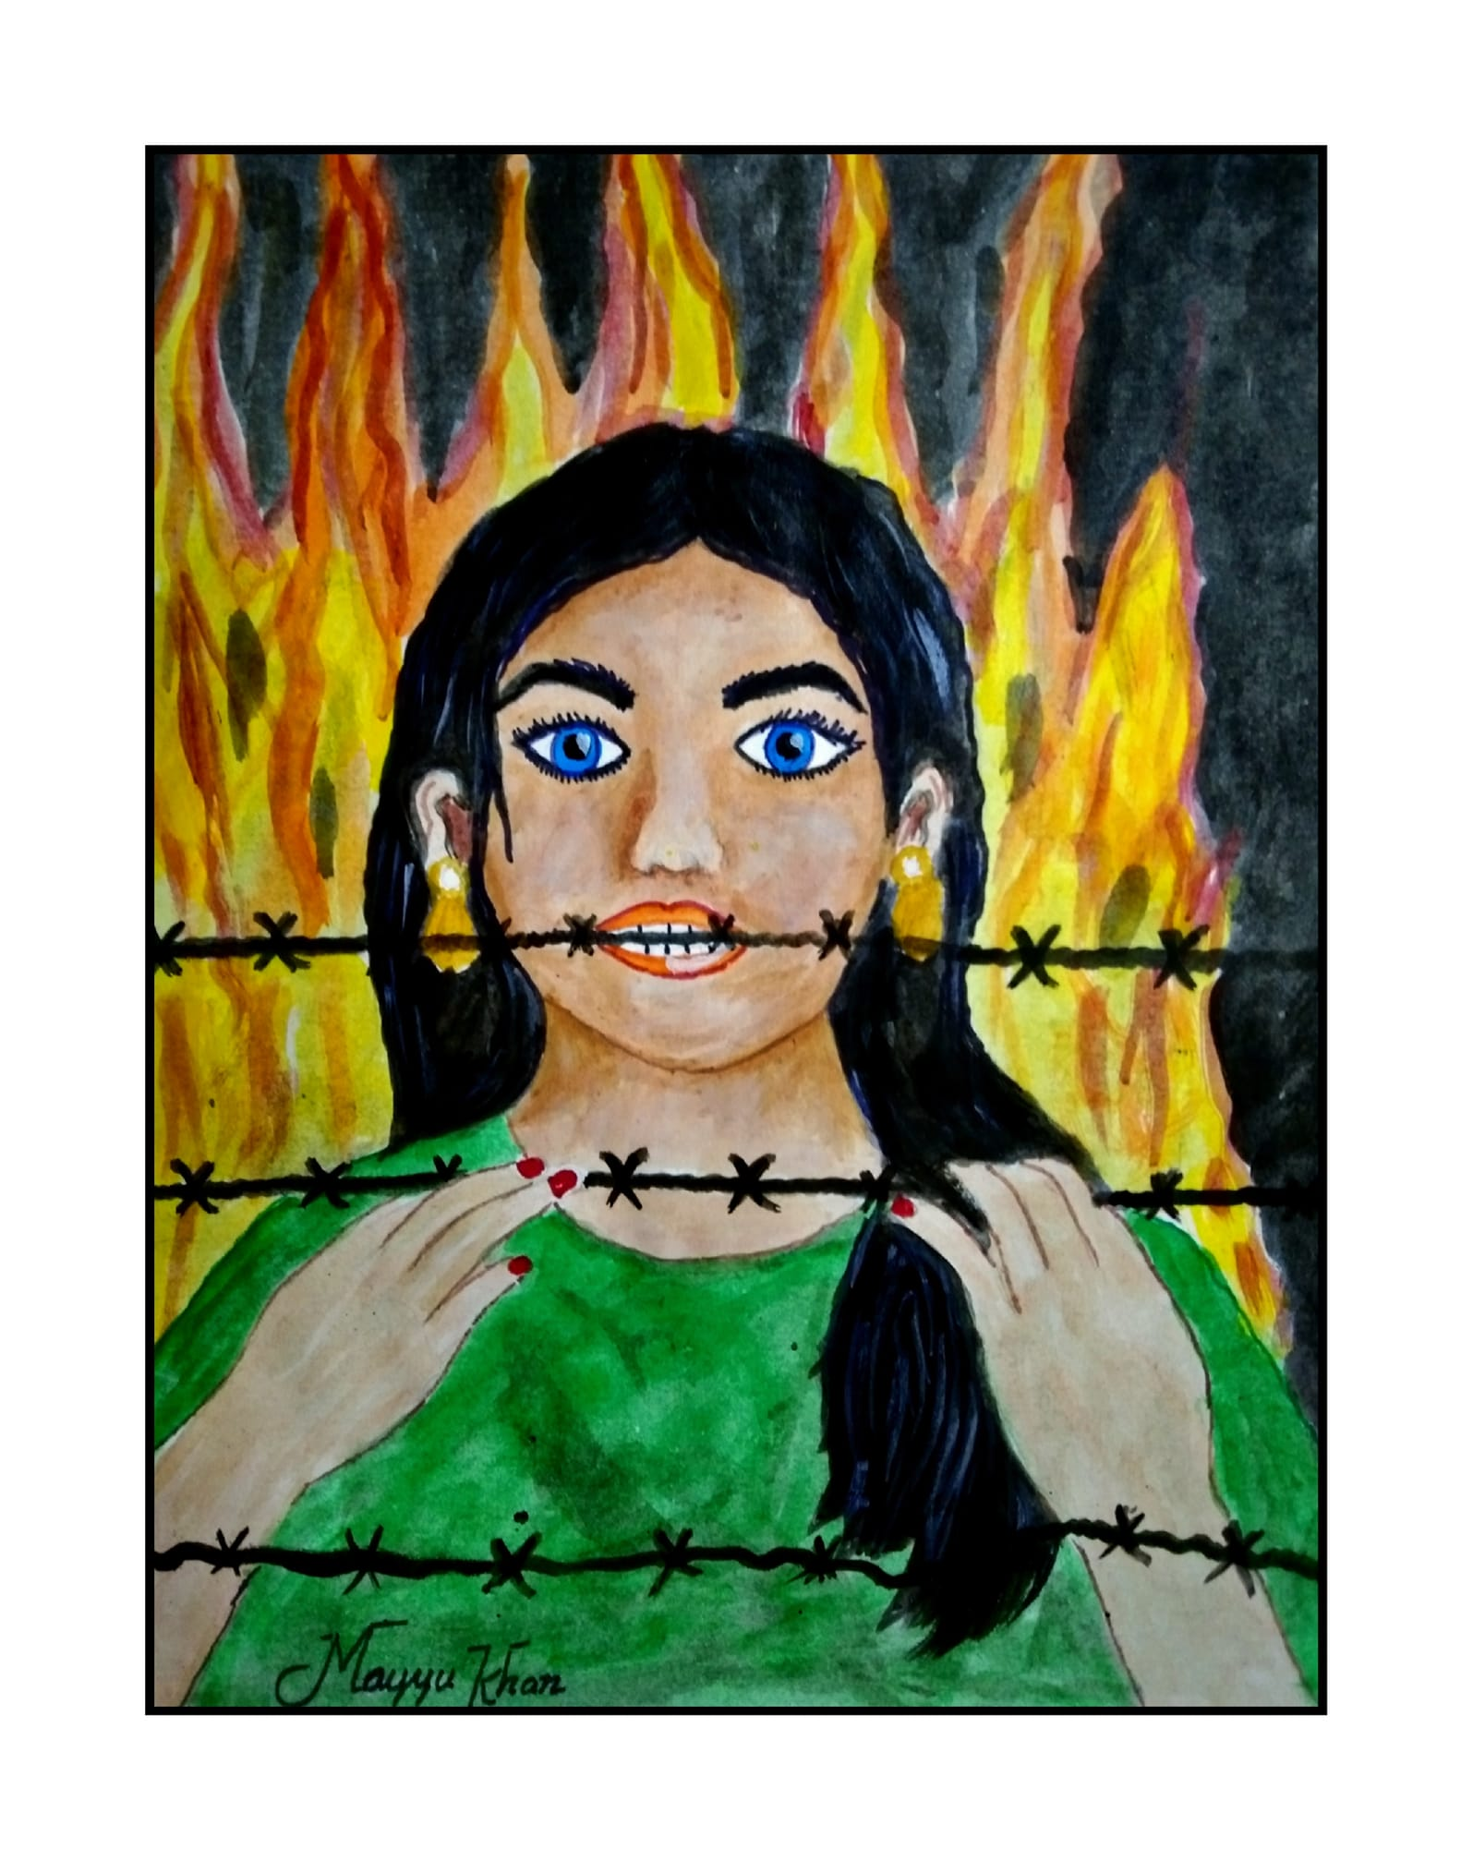

Slide 12
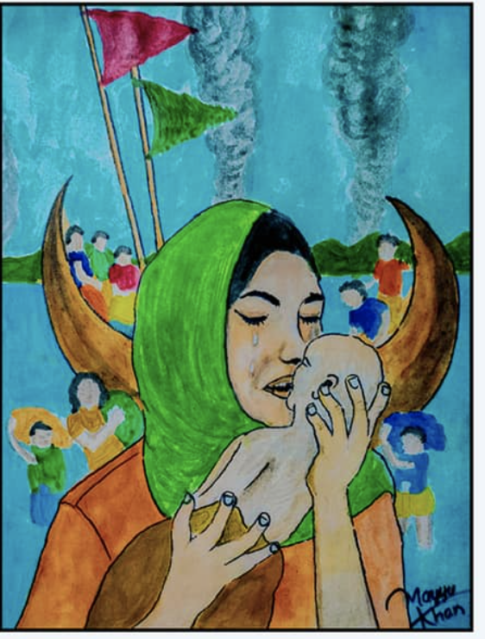

Slide 13
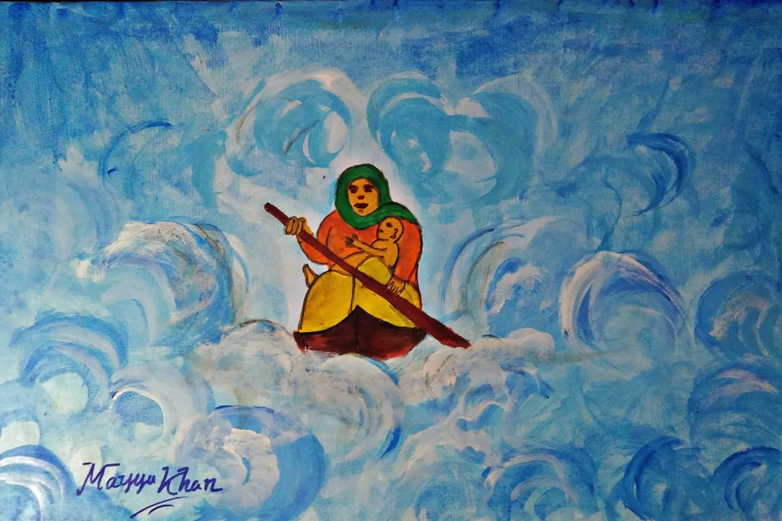

Slide 14
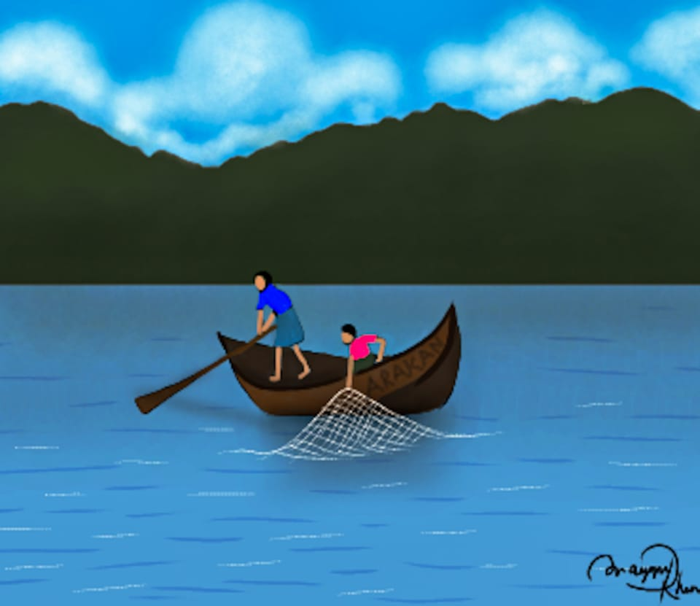

Slide 16
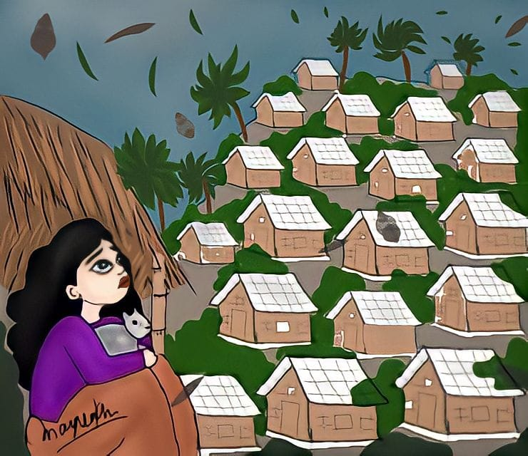

Slide 17
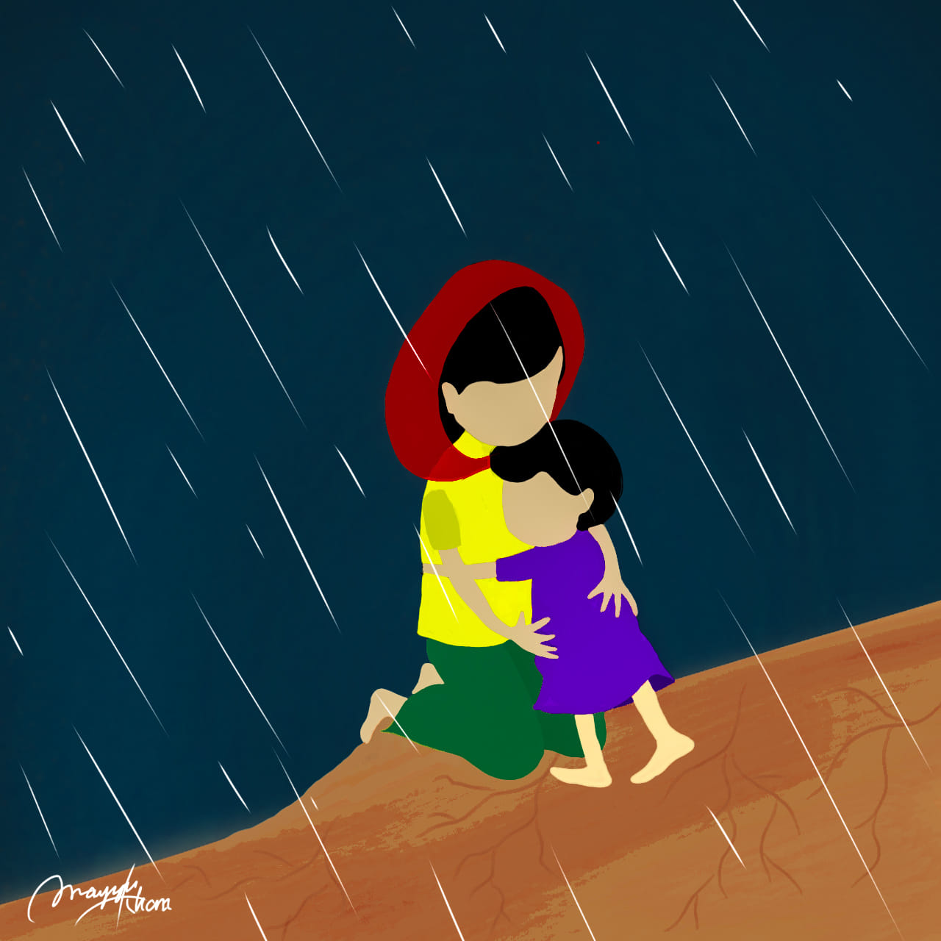

Slide 18
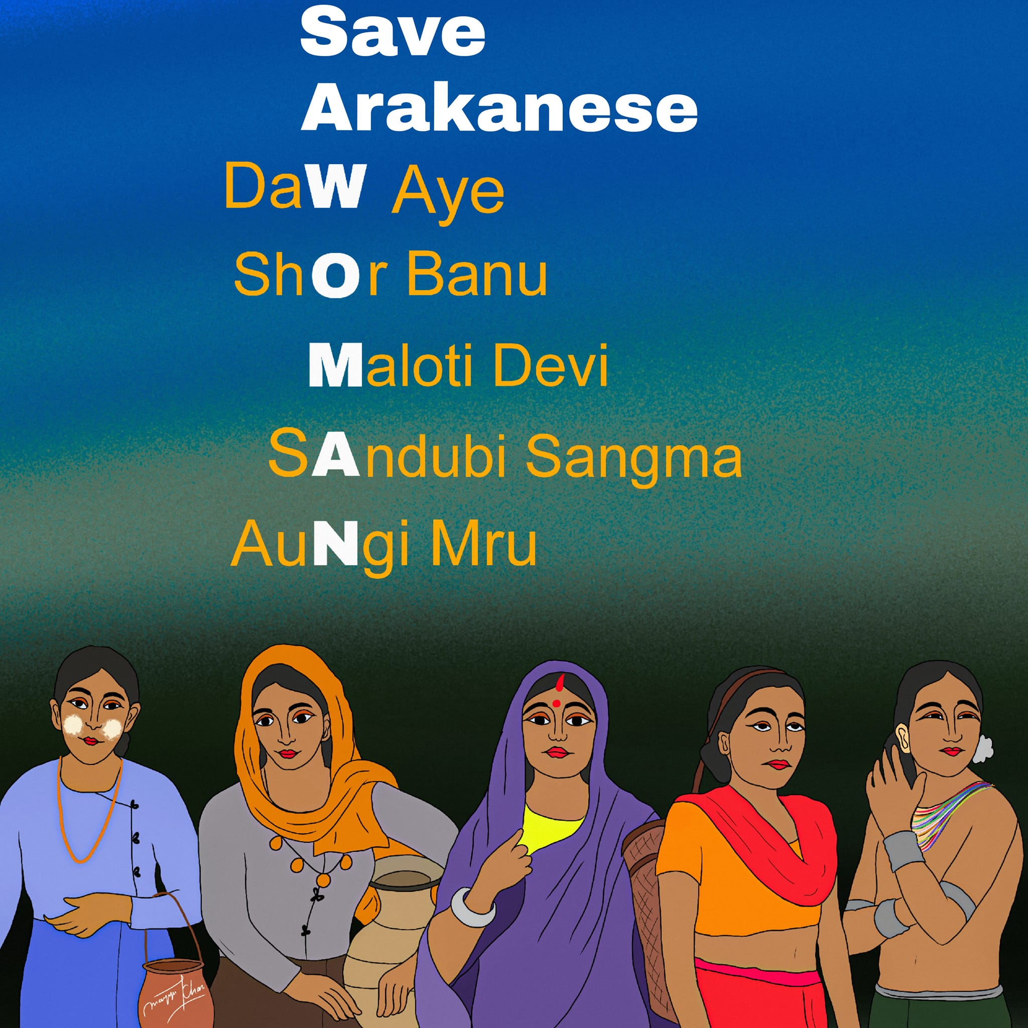

Slide 19
Poems by Mayyu Khan

Slide 20
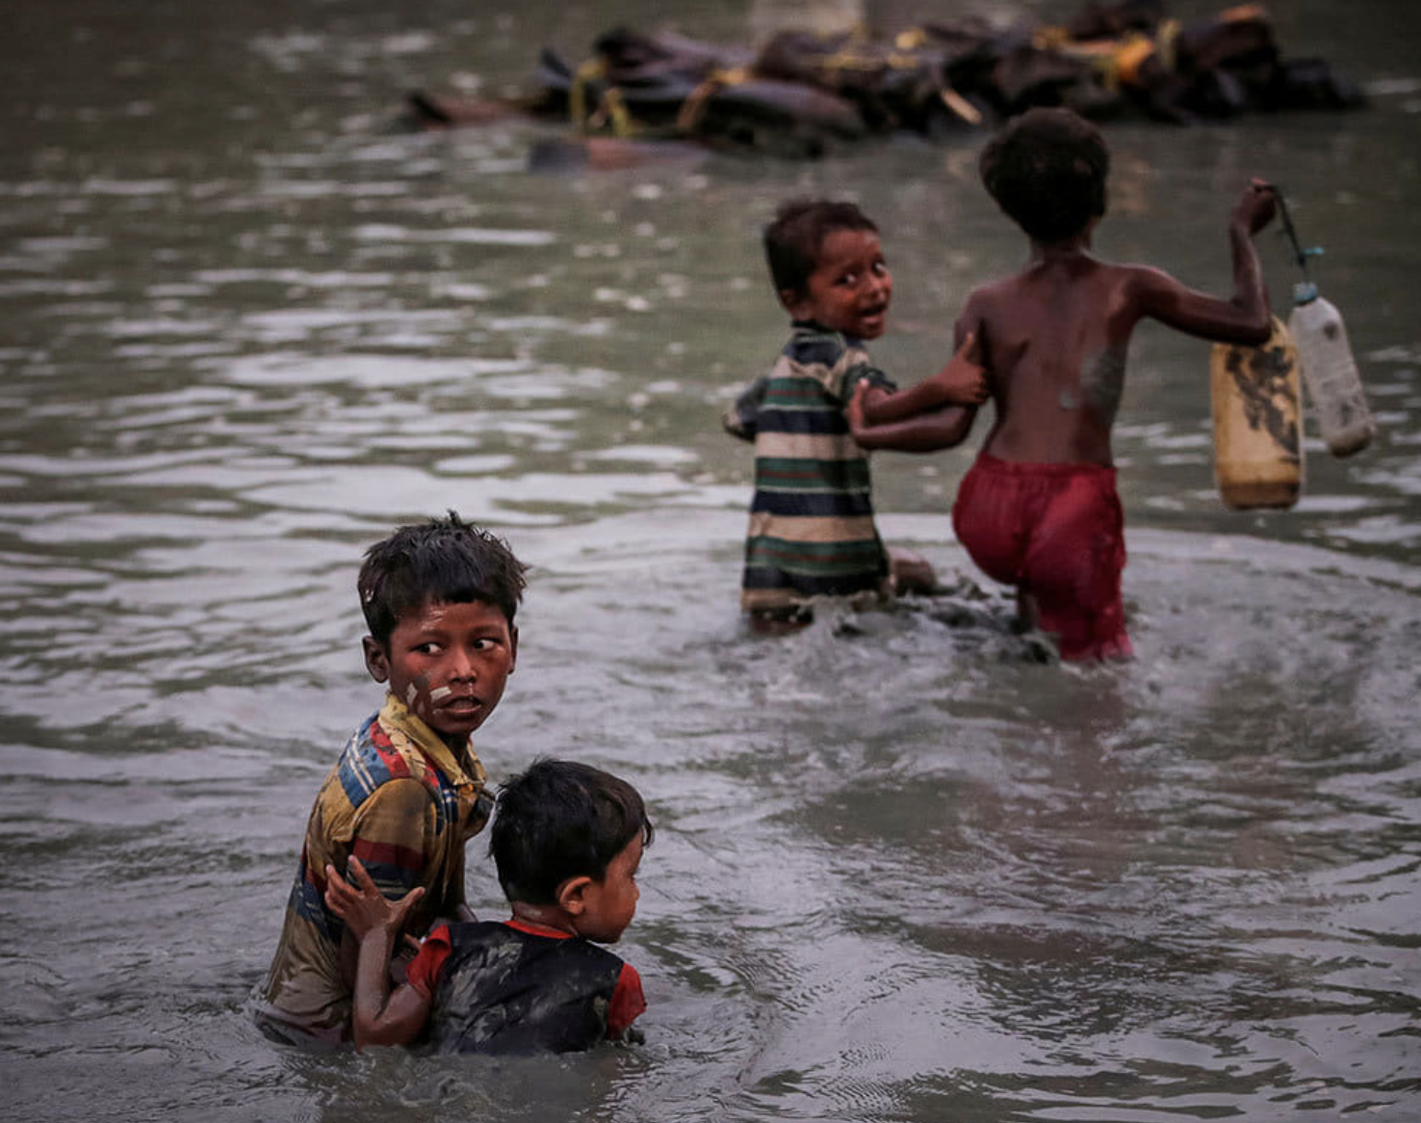
Oh baby pebbles how did you cross the sea?
You have lost all your home and your parents.
Who will help you in the foreign country?
If you don't get Justice the world will fall apart.
-Mayyu Khan
(05-03-2021)

Slide 21
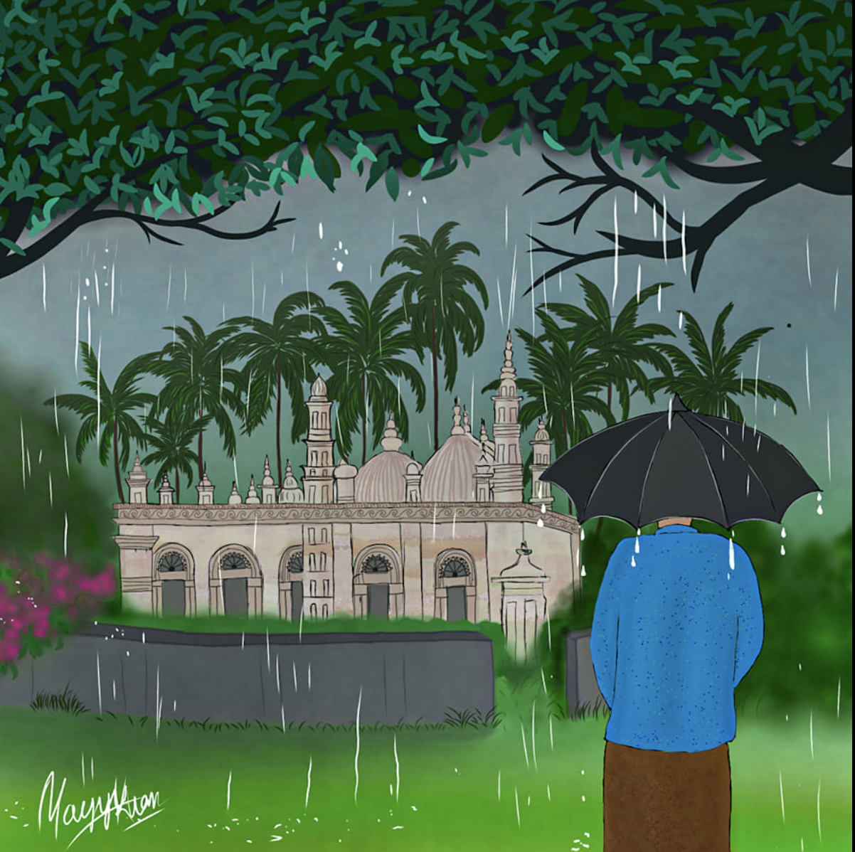
One day the melodious adhan will start from the Akyab Jama Mosque (Sittwe) at dawn and the weather will be mild on that day.
The birds will be free and will return to their nest.
- Mayyu Khan

Slide 22
https://fb.watch/tevls0nwvw/

Slide 23
https://fb.watch/tevCW7-RJ2/

Slide 24
Follow Mayyu Khan at
https://www.facebook.com/mayyukhanofficial

Slide 25
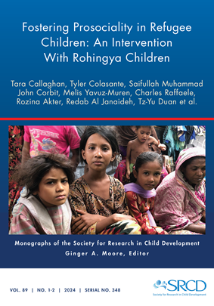
For this issue, visit
doi.org/10.1111/mono.12477
For videos, commentaries, and teaching materials,
visit monographmatters.srcd.org

Slide 26
Corresponding author
Tara Callaghan
St. Francis Xavier University
Editorial inquiries
monographs@srcd.org
Citation
Callaghan, T., et al., (2024). Fostering Prosociality in Refugee Children: An Intervention with Rohingya Children. Monographs of the Society for Research in Child Development, 89(1-2). https://doi.org/10.1111/mono.12477

