Slide 1
Place Based Developmental Research: Conceptual and Methodological Advances in Study Youth Development in Context
Dawn P. Witherspoon, The Pennsylvania State University
Mayra Y. Bámaca, University of California, Merced
Tamara G. J. Leech, Andrew Carnegie Fellow
Stephen A. Matthews, The Pennsylvania State University
Amanda L. Roy, University of Chicago, Illinois
Rebecca M. B. White, Arizona State University
Christopher R. Browning, The Ohio State University
Tama Leventhal, Tufts University
Nicolo Pinchak, The Ohio State University
Naomi Sugie, University of California, Irvine
Erin N. Winkler, University of Wisconsin-Milwaukee

Slide 2
Conceptual, Methodological, and Empirical Advances in the Study of Development in Context
Chapter 1

Slide 3
Context Matters
Scientists acknowledge that “context matters” for development
Bronfenbrenner’s Process, Person, Context, Time (PPCT)
Neighborhood effects scholarship situates development within residential neighborhoods
Notes:
Developmental scientists have, for some time, recognized that development unfolds in numerous settings, such as schools, extracurricular activities, hang-outs (i.e., places individuals may engage for recreation and pleasure, often unstructured environments), and residential neighborhoods. Indeed, Bronfenbrenner’s Process, Person, Context, Time (PPCT) model of human development, one of the more commonly used developmental theories for studying development in context, recognizes that contextual exposures (e.g., in neighborhoods) intersect with different aspects of person characteristics, social processes, and time to influence human development. Since the turn of the 20th century, neighborhood effects researchers have been situating development within neighborhood contexts and working to identify how neighborhoods matter for a range of developmental outcomes (see Leventhal & Brooks-Gunn, 2000; Leventhal, Dupéré, 2019; Leventhal et al., 2009 for reviews).

Slide 4
Tensions Exist in Research on Development in Context
Selection confounds
Exposure mechanism
Developmental colorblindness
Notes:
Selection, the idea that families have some degree of choice when selecting their neighborhoods, as well as variables that predict families’ choices (e.g., family income), represents a major confound (Leventhal et al., 2009). Similar confounds exist with regards to selection as it relates to other developmental contexts, such as schools, extracurricular settings, daycare centers, and hang-outs. Selection can offer an alternative explanation for any setting-level effect. To the degree that individuals select into settings (or not), then any setting effects may actually be person- or family-level effects.
Second, many development in context research designs assume that residents in neighborhoods or participants in other settings experience equivalent exposures to the setting environment (Browning & Soller, 2014; Kwan, 2009, 2012; Kwan et al., 2019), resulting in both the over- and under-estimation of setting effects on development (Basta et al., 2010; Spielman & Yoo, 2009).
Third, Although researchers studying neighborhood contexts have historically recognized that race, ethnicity, and culture matter for neighborhood environments (Sampson et al., 1997), the body of developmental scholarship has ignored how race, ethnicity, and culture matter for individual developmental demands, affordances, exposures, experiences, and outcomes (Jackson et al., 2016).

Slide 5
Monograph Objectives
Integrate mainstream neighborhood effects frameworks with cultural-developmental and activity space frameworks to support research capable of advancing a better understanding of development in context that can begin to address methodological and conceptual tensions in extant work.

Slide 6
Theoretical Foundations and Assumptions
Chapter 2

Slide 7
Mainstream Neighborhood Effects
Neighborhood Structures
Neighborhood Processes
Youth Development
  Setting structures
  Setting processes
  Youth Development
Composition and spatial arrangement of people and institutions: e.g., socioeconomic, racial/ethnic compositions
Social dynamics: e.g., interactions, activities, experiences, social control, shared beliefs
Notes:
The body of mainstream neighborhood effects scholarship draws heavily from early 20th century Chicago School of Sociology frameworks (Abbott, 1999) that have continued to guide scientists’ understandings of developmental changes in context (Browning et al., 2008; Park & Burgess, 1925; Sampson et al., 2002; Shaw & McKay, 1942; Wilson, 1987). Several major themes have emerged from this work. As a first theme, neighborhood structural characteristics – features related to the composition and spatial arrangement of neighborhood residents and institutions (e.g., socioeconomic disadvantage, ethnic/racial compositions, and residential instability) – can function to promote or constrain the types of social processes (e.g., social interactions, neighboring activities, experiences with local institutions, informal social control, social cohesion, collective efficacy) that take place in neighborhoods (Sampson et al., 1997). These processes in turn influence development (Leventhal & Brooks-Gunn, 2000). Moreover, prominent neighborhood effects frameworks propose that relevant social processes exist at multiple levels of ecological systems: at the levels of neighborhoods, institutions, social networks, families, and individuals (Browning & Soller, 2014; Sampson, 2012; Sharkey et al., 2012). As a second theme, both neighborhood structural characteristics and social processes can work to qualify the effect of family or other contextual (e.g., school) factors on development (Kirk, 2009; Noah, 2015). As a third theme, evidence from meta-analytic studies generally estimate that neighborhoods have a small, significant effect on a range of outcomes germane to the developmental sciences, from birth to death (Meijer et al., 2012; Metcalfe et al., 2011; Richardson et al., 2015).

Slide 8
Cultural-Developmental Perspectives
Recognize the way that race, ethnicity, and culture matter for:
  Setting structures
  Setting processes
  Individual experiences and exposures
  Developmental competencies
Notes:
scholars must draw on cultural-developmental theory to recognize that an individual’s own racial, ethnic, and cultural social positions can differentiate families and youth (García Coll et al., 1996; Spencer, 1995, 2008). To this end, cultural-developmental researchers are advancing neighborhood effects scholarship that explicitly recognizes the ways that race, ethnicity, and culture matter for neighborhood environments in addition to the ways that race, ethnicity, and culture matter for youths’ own developmental demands, affordances, experiences, and competencies.
In both mainstream neighborhood effects research and most cultural-developmental neighborhood research: A major assumption underlying residential neighborhood effects is that the neighborhood exerts its influence on children, youth, and families through individuals’ exposures to the characteristics of those environments. However, scholars may be mis-specifying neighborhood effects models by not capturing the totality of exposures by focusing exclusively on an individual’s residential neighborhood or by focusing exclusively on any particular setting (Kwan, 2012). Individuals spend a considerable amount of time outside of their residential neighborhoods (Browning, Calder, Ford, et al., 2017; Browning, Calder, Soller, 2017a,c; Mason & Korpela, 2009; Matthews & Yang, 2013; Vallée et al., 2011; Witherspoon & Hughes, 2014). These places outside of a youth’s broader activities spaces expose children, youth, and families to a host of factors that may affect their adjustment and health behaviors (Freisthler et al., 2016; 2015; Kwan, 2012; Matthews & Yang, 2013; Mavoa et al., 2019; Vallée et al., 2011).

Slide 9
Place Based and Activity Space Perspectives
Place-based research comprehensively considers where and when people perform their daily activities (Kwan, 2009)
Activity space research methods focus on the routine daily locations that individuals traverse (Kwan et al. 2019)
  Collect information about these routine daily locations and create a spatial area – an activity space
  Geocode and characterize the activity space vis-à-vis primary and/or secondary data on structural characteristics (e.g., socioeconomic status) or social processes (e.g., collective efficacy)
Notes:
The activity space concept affords new opportunities to investigate contextual effects on development. Like neighborhoods, activity spaces exhibit structural features, such as racial or socioeconomic compositions, as well as social processes such as network dynamics, racialized power structures, and shared (or fragmented) cultural orientations. Thus, the activity space framework provides an opportunity to examine development in context that advances beyond the residential neighborhood and focuses on experiences and exposures across places and settings that youth navigate on a daily basis.

Slide 10
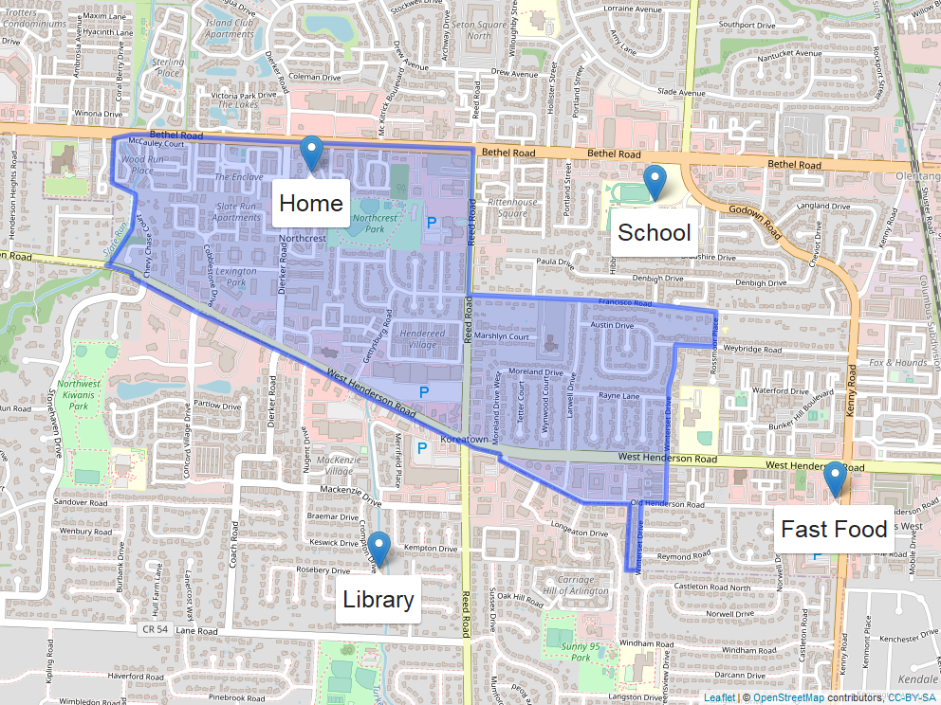
What is an Activity Space?
The set of places that individuals come into contact with as a result of their routine activities
In this illustration, key routine activity locations fall outside of the neighborhood, which was traditionally used to measure social and environmental exposures
Illustration of potential routine activity locations for a hypothetical individual. Home set within the residential neighborhood (defined as the Census tract; shown as blue polygon). School, fast food restaurant, and a library location also shown.

Slide 11
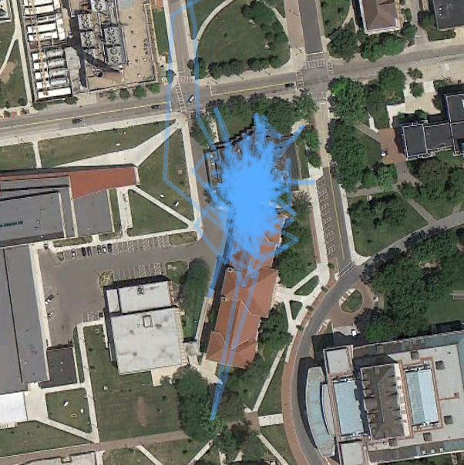
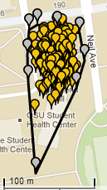

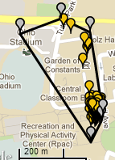
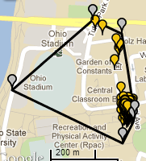
Operationalizing Activity Spaces
For example, a Convex Hull approach can generate a summary of stationary and mobile periods from continuous location data:
snap a rubber band around the points and calculate the area inside
track how the area changes when new points are added to determine when participant starts traveling
Boettner, Bethany, Christopher R. Browning, and Catherine A. Calder. 2019. “Feasibility and Validity of Geographically Explicit Ecological Momentary Assessment with Recall-Aided Space-Time Budgets.” Journal of Research on Adolescence 29(3):627–45. doi: https://doi.org/10.1111/jora.12474.
Notes:
There a many alternatives to operationalizing people’s activity spaces. We feature some in the chapter and some here. The first is the convex hull approach.

Slide 12
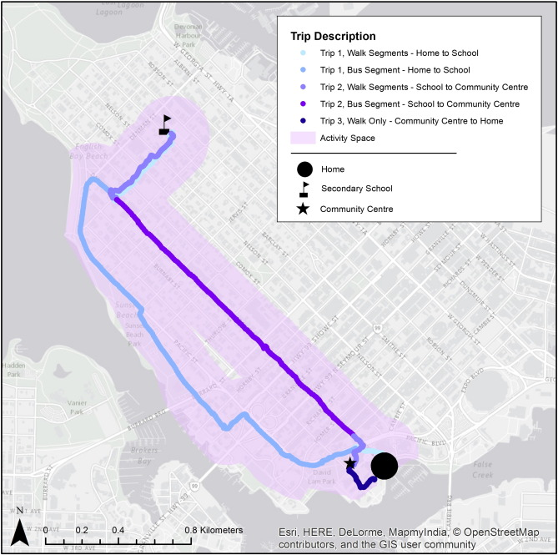
Operationalizing Activity Spaces
Another approach is the Daily Path Area (DPA), which constructs activity space as:
buffering each individual's GPS trips by specific radius (e.g. 50 meters, 200 meters)
dissolving all buffered trips into one polygon
Lee, Nolan C., Christine Voss, Amanda D. Frazer, Jana A. Hirsch, Heather A. McKay, and Meghan Winters. 2016. “Does Activity Space Size Influence Physical Activity Levels of Adolescents?—A GPS Study of an Urban Environment.” Preventive Medicine Reports 3:75–78. doi: 10.1016/j.pmedr.2015.12.002.
Notes:
Another approach to operationalizing the activyt space is called the daily path area.

Slide 13
A Cultural-Developmental Activity Space Framework for Studying Development In Context
Integrates mainstream and cultural developmental perspectives with place-based perspectives to incorporate:
the places developing youth go and how much time they spend there
consideration of structures and processes youth encounter in and across places
cultural-developmental perspectives on structures, processes, and development
Notes:
ultimately, the strongest promise for advancing an accurate understanding of neighborhood and contextual effects on development will come from incorporating activity space perspectives in cultural-developmental work and incorporating cultural-developmental models into scholarship on activity spaces. Such combined perspectives have the strongest potential to advance a version of research on development that is relevant to a wide range of contexts and populations.
Activity space perspectives and methods, particularly those combined with relevant cultural-developmental perspectives on development and on settings, can support researchers studying how development occurs in multiple contexts and settings simultaneously as well as across multiple dimensions of time. They can be used to capture the structures and processes that take place within the overall activity space, or how these structures and processes fluctuate as youth, caregivers, or families navigate across settings (i.e., microsystems) within their broader activity spaces (i.e., mesosystems). Information about activity spaces – both overall patterns and variability within – can be used to advance a comprehensive science of development in context in a diverse world where some groups are privileged above others.

Slide 14
Key Assumptions of our Framework
Development occurs in multiple contexts and settings that function at different levels of the human ecology (microsystems, mesosystems, exosystems, macrosystems) and across different dimensions of time (Bronfenbrenner & Morris, 2006)
Settings matter both in terms of how they are compositionally structured and what processes take place within them (Sampson, 2011)

Slide 15
Key Assumptions of our Framework
In a diverse world, where some groups are privileged above others, researchers must engage additional tools to meaningfully identify specific structures, processes, person characteristics and aspects of time implicated in the development of youth from specific bounded groups and communities
Developmental competencies are defined relative to what members of the bounded group-community value and relative to the environmental processes (both in terms of demands and affordances) are faced.
(Fuller & García Coll, 2009; White et al., 2018)

Slide 16
Conceptual, Methodological, and Cultural-Developmental Perspectives on Contextual Levels
Chapter 3

Slide 17
Bronfenbrenner’s Levels
Process, Person, Context, Time (PPCT)
Microsystem | “a pattern of activities, social roles, and interpersonal relations experienced by the developing person in a given face-to-face setting with particular physical, social, and symbolic features that invite, permit, or inhibit engagement” (Bronfenbrenner & Morris, 1998, p. 1013).
Mesosystem | “a system of two or more microsystems” (Bronfenbrenner & Morris, 1998, p. 817)
Exosystem | “linkages and processes taking place between two or more settings, at least one of which does not contain the developing person, but in which events occur that indirectly influences processes within the immediate setting[s] in which the developing person lives” (p. 818)
Macrosystem | broader societal blueprints and cultural norms; laws/regulations and real cultures in the maacrosystem leverage social position variables (e.g., race, ethnicity, gender, sexuality, religion, age, documentation status) to create differences in the characteristics and processes that can be found in lower levels of the ecological system.
Notes:
Our cultural-developmental activity space framework for studying child and adolescent development in context, which integrates residential neighborhood (e.g., Sampson et al., 1997), activity space (e.g., Matthews & Yang, 2013) and cultural-developmental (e.g., García Coll et al., 1996) perspectives from Chapter II requires careful conceptual and methodological attention to the contextual levels (see Noah, 2015, for more in-depth discussions) and to the nested and unnested natures of children’s contexts (see Matthews & Yang, 2013 for more in-depth discussions).
according to Bronfenbrenner’s developmental theory and related neighborhood theory (Bronfenbrenner & Morris, 2006; Browning et al., 2008; Leventhal & Shuey, 2014; Sampson et al., 2002), characteristics of the ecology range from the microsystem to the macrosystem. These characteristics both permit and constrain the variety of processes that take place within settings (McHale et al., 2009). This chapter, however, is largely concerned with elaborating the linkages between Bronfenbrenner’s ecological settings (from micro- to macrosystems) and activity space concepts and methods (Bronfenbrenner & Morris, 2006). Chapter IV is concerned with articulating both the structure of these settings and the processes that take place within them.

Slide 18
From the ‘Ecology of Human Development’ to ‘Human Development in a Setting or Two’
Most developmental research highlights single settings (home, school,or neighborhood), or a single microsystem
Less work examines two microsystems simultaneously
Thus, researchers are deciding, a priori, which microsystems matter for a developing person and ignoring all other microsystems in the developmental mesosystem
Instead, place-based perspectives can be used to support developmental researchers' efforts to identify all relevant microsystems and better capture mesosystemic influences on youth development
Notes:
Bronfenbrenner’s ecological systems are theoretically rich, but, in many ways empirically poor. In the developmental sciences, researchers often identify one or two microsystems, and study the systems’ implications for development.
Indeed, the developmental sciences have long been critiqued for failing to meaningfully capture or operationalize the mesosystem (McIntosh et al., 2008). Activity space frameworks can be used to support developmental researchers’ efforts to identify all the relevant microsystems and better capture mesosystemic influences on youth development.

Slide 19
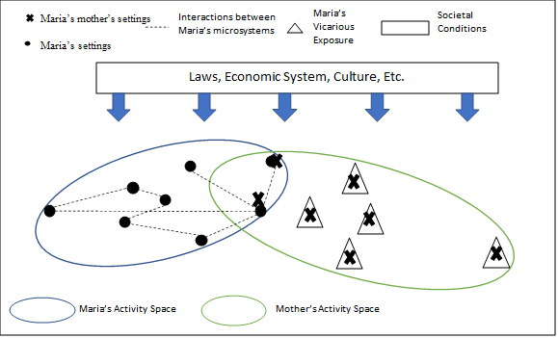
Notes:
Here we see two activity spaces.
The dots represent all the places Maria goes in a typical week. Thus, each dot is one of Maria’s microsystems 9e.g., home, school, library, church, sports practice, etc)
The blue circle represents Maria’s entire activity space, or mesosystem.
The Xs represent Maria’s mothers’ microsystems and the green circle is Maria’s mothers mesosystem.
The overlap in the two mesosystems represents places where Maria and her mother both go and spend time.
The proportion of the mother’s activity space/mesosystem that does not overlap with Maria’s mesosystem represents aspects of Maria’s exosystem, places Maria does not go, but in which events occur that indirectly influence processes within Maria’s microsystem.
The laws, economic systems, cultures, etc of the macroystem filter into developmental exo, meso, and microsystems.

Slide 20
The Intersection of Time, Place, and Culture in Developmental Science
Chapter 4
Notes:
Prominent developmental theories often overlook time or give it only a cursory nod. For example, it took almost 20 years (1977 to 1995) for time to become a central player in Bronfenbrenner’s ecological theory – one of the most influential developmental theories to date. Furthermore, often when developmental science theorizes time or space/place, rarely is culture explicitly considered. Notable exceptions include the PVEST and the integrative model.

Slide 21
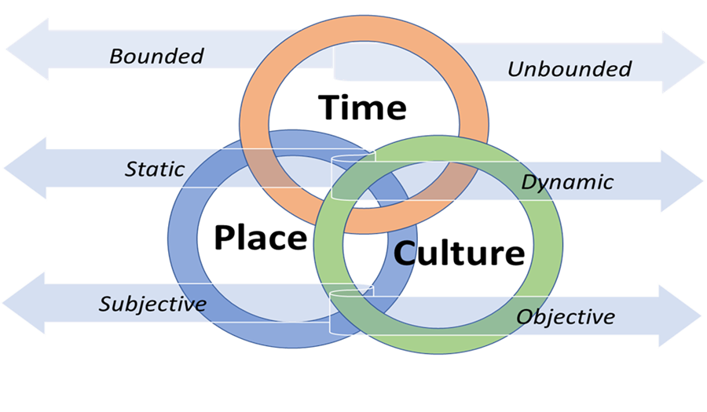
Three dimensions for the conceptualization of time-place-culture
Bounded vs. Unbounded
  Bounded: Having clear, fixed defining features
  Unbounded: Having variable, individually/group-defined features
Static vs. Dynamic
  Static: Linear, uniform, constant
  Dynamic: Developmental shifts, changes, disruptions
Objective vs. Subjective
  Objective: Concrete, observable, features, actions,
or behaviors
  Subjective: Perceptions, attitudes, and feelings
Notes:
This chapter contributes to the comprehensive cultural-development place-based framework by applying microtime, mesotime, and macrotime ideas from PPCT (Bronfenbrenner & Ceci, 1994) and advancing ideas related to cultural-developmental processes across time and space to place-based research.
This chapter provides a way for researchers to identify and conceptualize time, place, and culture as intersecting influences on development by describing three dimensions: 1) bounded vs. unbounded, 2) static vs. dynamic, and 3) subjective vs. objective.
This chapter contributes to a more comprehensive understanding of developmental contexts by offering and considering the important intersections between time, place, and culture and providing methodological recommendations for doing so (e.g., use of longitudinal data, creation of interdisciplinary teams, precise and specific measurement, incorporation of multiple research designs).

Slide 22
Examples
Feature | Bounded | Unbounded
TIME | Minutes, Days, Years | Grieving Periods, Transitions
PLACE | School, Neighborhood | Activity Spaces
CULTURE | Individual Identity/Endorsement | Manifesting across contexts (e.g. family traditions, daily rituals)
Notes:
The first of these dimensions represents the distinction between bounded and unbounded elements. The majority of setting-based research defines the settings that individuals inhabit as bounded units; families are defined by the people they contain. Schools are defined by the walls of a building or the district. Even neighborhoods, which arguably are more amorphous, are often defined by parameters assigned by government officials or researchers (e.g., census tracts in the U.S. or meshblocks in New Zealand; see Mavoa et al., 2019). The bounded conceptualization of settings can be problematic when it limits our thinking around how individuals understand space and interact with place (Matthews, 2012). For example, individuals have varying degrees of spatial knowledge; long-term residents may have better detailed knowledge of a local place, whereas more mobile residents may have more expansive knowledge covering more areas of a place. Additionally, not all individuals who live within the same neighborhood boundary use that space in the same way; some people may live, work, and access resources all within one geographical location, whereas others may do these things in geographically disparate places. This distinction has led to rapidly expanding theoretical and methodological research on activity spaces (Browning & Soller, 2014; Matthews, 2011; Matthews & Yang, 2013; Siordia & Matthews, 2016). This unbounded conceptualization of place does not explicitly apply boundaries to the settings that individuals inhabit, rather it uses information on where people spend their time (e.g., with travel diaries, GPS trackers, or interviews; e.g., see Mavoa et al., 2011) to quantify exposure to place(s). We encourage researchers to also apply this distinction to aspects of time and culture. For example, time can be conceptualized by bounded (e.g., minutes, days, years) or unbounded (e.g., a grieving period, transitions) units, and it can be chronic, accumulating over time, or acute. Similarly, we can think of culture as being bounded within the individual (e.g., one’s cultural identity; one’s cultural value orientation/endorsement) or being unbounded and manifesting itself across multiple aspects of individuals’ daily lives dependent on the demands or affordances of the context (e.g., daily rituals, family traditions).

Slide 23
Examples
Feature | Static | Dynamic
TIME | Passage of time | Shifts between developmental periods that co-occur with shifts in settings
PLACE | Development of a place | Shocks (e.g. mass shooting), Periods of rapid change (e.g. gentrification)
CULTURE | Evolution of a culture | Salient moments in history (e.g. Black Lives Matter) or within an individual (e.g. seeing an inspiring speaker)
Notes:
The second dimension that we highlight makes the distinction between conceptualizations that are static versus those that are dynamic. Developmental researchers have long highlighted the importance of this distinction in conceptualizations of time. Frequently, development, and subsequently time, is conceptualized as linear, uniform, and constant. Individual change is assumed to occur at a uniform rate, in one direction, as time passes in a steady manner. However, developmental scientists have also recognized that dynamic moments of time play a critical role in individual development. For example, developmental transitions, or the periods when children are moving between developmental periods (e.g., from middle childhood to adolescence), often co-occur with major shifts in settings (e.g., changing schools, widening peer groups) and can be times when youth are susceptible to contextual inputs (e.g., Eccles et al., 1993). Similarly, moments of disruption (e.g., change in family structure via divorce or composition such as a new sibling) or change in location (e.g., a residential move) can be salient moments in the developmental process that are dynamic.

Slide 24
Examples
Feature | Objective | Subjective
TIME | Objective units (e.g. minutes, hours) | Perceptions of moments when time “slows down”
PLACE | Observable features of a place (e.g. parks, people, features) | Perceptions or beliefs about a place (e.g. collective efficacy, school climate)
CULTURE | Observable actions and behaviors that reflect one’s culture (e.g. eating foods, reading authors, listening to music) | Beliefs and attitudes about one’s culture (e.g. pride, personal regard)
Notes:
Finally, we propose the distinction between subjective and objective elements as a critical aspect of time-place-culture conceptualization. Research on racial-ethnic identity has highlighted both subjective and objective elements of culture. For example, the Phinney (2000) model of ethnic identity development and corresponding Multigroup Ethnic Identity Measure integrate both subjective and objective aspects of identity and identity development. The objective elements include the experiences and individual actions and behaviors that facilitate the construction of identity over time. In comparison, the subjective elements of identity include the individual’s attitudes and sense of belonging to the individual’s ethnic group. By considering both subjective and objective aspects of identity development as PVEST asserts, the researcher can better understand the ways that internal and external aspects of culture shape individual development. As such, we argue that subjective and objective elements should also be regularly integrated into our conceptualizations of place and time. Although there are theories (e.g., Bronfenbrenner’s PPCT) and measures (e.g., collective efficacy, systematic social observations) that emphasize both subjective and objective measures of place, there are limited examples of research that explore these elements in combination (e.g., Pasco & White, 2021; Witherspoon et al., 2019; Witherspoon et al., 2021). Considering both the presence of objective characteristics in a place and how individuals subjectively perceive, and thus interact with, those characteristics to create memories and experiences can advance our understanding of place-based influences on development.
These ideas can also be applied to our conceptualizations of time. In developmental science, time is often thought of as an objective unit (e.g., minute, year). Although we recognize the form may change (e.g., shocks, disruptions) and individual change may happen at different rates, we generally think of time as an influence that exists external to the individual. However, there are also subjective experiences of time, such as perceptions of moments that pass slowly/quickly or stand out as particularly salient in our minds.

Slide 25
Three dimensions for the conceptualization of time-place-culture
These examples are in no way exhaustive
These features and dimensions often overlap and intersect
These dimensions can be used by scholars and practitioners to push thinking on the complex and intersecting ways that these features can shape individual development

Slide 26
Conceptual, Methodological, and Cultural-Developmental Advances on Structures and Processes in Place-Based Developmental Research
Chapter 5
Notes:
This chapter contributes to the comprehensive cultural-development activity-space framework for studying development in context by introducing individual-, dyad-, and network-centered conceptualizations of activity space structures and processes.
These conceptualizations draw on dominant theoretical traditions within the place-based developmental literatures, such as ecological systems theory, social disorganization theory, collective efficacy theory, and approaches to understanding racialized power hierarchies.
Individual-centered conceptualizations include those comparing outcomes of individuals with different activity space profiles (between-individual) and examining consequences of changes in individuals’ activity spaces over time (within-individual).
Dyad- and network-centered conceptualizations include those assessing consequences of shared or divergent activity space profiles across two-person interactions (e.g., parent-child), groups of individuals (e.g., peer networks), and networks of individuals tied through shared routine activity locations, i.e., ecological networks.

Slide 27
Differentiating Contexts by Structures and Processes
Structures - features related to the composition and spatial arrangement of neighborhood residents and institutions
Social processes - the on-the-ground collective dynamics that link structures with key outcomes
Notes:
The body of mainstream neighborhood effects scholarship draws heavily from early 20th century Chicago School of Sociology frameworks (Abbott, 1999) that have continued to guide scientists’ understandings of developmental changes in context (Browning et al., 2008; Park & Burgess, 1925; Sampson et al., 2002; Shaw & McKay, 1942; Wilson, 1987). Several major themes have emerged from this work. As a first theme, neighborhood structural characteristics – features related to the composition and spatial arrangement of neighborhood residents and institutions (e.g., socioeconomic disadvantage, ethnic/racial compositions, and residential instability) – can function to promote or constrain the types of social processes (e.g., social interactions, neighboring activities, experiences with local institutions, informal social control, social cohesion, collective efficacy) that take place in neighborhoods (Sampson et al., 1997). These processes in turn influence development (Leventhal & Brooks-Gunn, 2000). Moreover, prominent neighborhood effects frameworks propose that relevant social processes exist at multiple levels of ecological systems: at the levels of neighborhoods, institutions, social networks, families, and individuals (Browning & Soller, 2014; Sampson, 2012; Sharkey et al., 2012). Whereas a significant body of literature has observed associations between residence in economically disadvantaged neighborhoods and youth wellbeing, a substantially smaller body of literature seeks to identify the process-based mechanisms that account for the developmental impact of living in a poor neighborhood (Leventhal & Dupéré, 2019).

Slide 28
The increasing recognition of the complexity of everyday exposures and interactions – captured by the concept of “activity space” – challenges the artificially narrow and reductive approach to understanding broader place effects on youth represented by placing singular focus on conventional neighborhood designs (Browning, Calder, et al., 2021; Kwan, 2012; Matthews & Yang, 2013).

Slide 29
Common Processes Explored in Single Setting – Mostly Neighborhood – Research
Collective efficacy including, informal social interactions rooted in everyday neighborhood activities and mutual trust and willingness to act on behalf of shared goals
Acceptance of diversity
Pride
Place attachment
Connectedness

Slide 30
Need to Consider Processes in Activity Spaces
Activity spaces exhibit structural features
Activity spaces support or inhibit specific social processes
Notes:
Activity space frameworks offer important tools for capturing exposure to structures and processes in developmentally relevant places and settings. Like neighborhoods, activity spaces exhibit structural features, such as racial or socioeconomic composition, as well as social processes such as network dynamics, racialized power structures, and shared or fragmented cultural orientations. Yet, understanding the operation of structures and processes from an activity space perspective requires acknowledgment of the complex and variable nature of everyday routine experiences and their consequences for development. Extant approaches to examining the impact of activity spaces on youth have typically linked aspects of ambient contexts to outcomes marked by short-term temporal lags (e.g., same day) or considered average characteristics of activity spaces as measured over a given period (Cagney et al., 2020). Yet, few studies have examined structural and social process compositions of the total profile of individuals’ activity space exposures, nor has research considered the consequences of distinct or overlapping exposure patterns at the dyad or group level.
We offer a framework for conceptualizing developmentally relevant structures and processes within an activity space approach that takes as a starting point the potential for considerable variability in everyday exposures along consequential dimensions. This within-individual focus draws out the implications of activity space heterogeneity for youth and the potential for the impact of any given space to be conditional on the characteristics of other activity spaces. We then extend the focus on activity space profiles to consideration of interacting exposure patterns across dyads (e.g., caregivers and youth with differing or similar activity spaces) and networks (e.g., groups of individuals that share activity locations to varying degrees). We illustrate this relational ecology perspective on the role of activity spaces in youth development with reference to traditions of research incorporating a more nuanced approach to engagement with the socio-spatial environment.

Slide 31
Individual Level
Are activity locations (microsystems) within the child’s activity space (mesosystem) compositionally or in terms of processes heterogeneous or homogenous?
To what extent does composition/process heterogeneity in youths’ activity spaces (i.e., heterogeneity across microsystems in youths mesosystem) influence key developmental processes and outcomes?
Are adolescents’ experiences at an activity location of a given composition dependent on the composition of other activity locations (e.g., home neighborhood)?
Notes:
We begin by considering the structural features of activity space profiles at the individual level and the implications of these features for intra-individual processes relevant for youth development. Specifically, we argue that the multiplicity and diversity of activity spaces calls for considering the within-individual structure of activity space exposures.
With respect to racial identity, for instance, an individual youth’s neighborhood may be highly homogeneous in racial composition while actual experiences across activity locations exhibit substantial diversity, prompting or rewarding “code switching” behaviors or related bicultural competencies, which are extensively documented in the racial socialization literature (Bennett, 2006; Hamm, 2001; Harrison et al., 1990; Safa et al., 2019; Winkler, 2012).

Slide 32
Dyad Level
Two actors who spend time with one another will, by definition, share activity spaces – and exposure to structures and processes – at least to some extent
  Time outside of each other’s presence may involve activity space encounters of varying levels of similarity – similar structures and processes
  Or, time outside of each other’s presence may be marked by quite distinct activity spaces – distinct structures and processes
Notes:
Time outside of each other’s presence, however, may involve activity space encounters of varying levels of similarity. Although not co-present, activity space settings may be quite homogenous with respect to social composition and key social processes, leading to relative continuity of activity space characteristics even when separated.
Thus, relevant structures and processes may be seen to characterize the specific activity spaces encountered for each individual and the within-individual pattern of activity space encounters for each actor as well as the relationship between activity profiles across actors.

Slide 33
Dyad Level
Few studies have directly focused on the spatial arrangements characterizing interaction patterns within caregiver-youth dyads
Using activity space methods to capture co-presence
Using activity space methods to capture distinct exposures and experiences
Using activity space methods to understand the role of cultural structures and processes in intergenerational divergence between children and immigrant parents
Notes:
A focus on co-presence – or time spent together – is central to many investigations of the caregiver-child relationship, but a simultaneous focus on the contexts of co-presence is less commonly featured. For instance, few studies have assessed the extent to which caregiver-child interactions occur primarily within the home or extend beyond the home setting. Important exceptions do exist. For example, the racial socialization literature regarding caregivers and children discusses issues of race precisely because they are co-present in non-home activity spaces that inspire such discussion, such as shopping and entertaining venues, children’s extra-curricular activities, car rides through various neighborhoods (e.g., Winkler, 2012).
activity space settings that vary substantially in composition or the operation of key social processes may lead to dissonance in attitudes and expectations between caregivers and youth
Similarly, intergenerational divergence in the cultural content of activity spaces for foreign-born caregivers and their adolescent children has been the subject of extensive inquiry, but with little direct attention to the patterns of space use through which this divergence is shaped. A relational approach to activity space structures provides an opportunity to explore intergenerational dynamics within immigrant families through more precise characterization of divergence in activity spaces, with implications for “acculturation consonance” – or the extent to which the acculturation process is synchronous across generations (Gonzales et al., 2018; Ousey & Kubrin, 2018). Variability in the extent of acculturation consonance across immigrant households rooted in intergenerationally diverging activity spaces may also shed light on differences between families in new and older immigrant destinations. Moreover, older immigrant destinations may potentially provide greater opportunity for immigrant households to find community continuity with more traditional normative structures promoted within the home setting (White, Witherspoon, et al., 2021). These examples offer insight into the ways in which compositional and process-based differences in activity space profiles within an intimate, familial relationship may play a consequential role in youth development.

Slide 34
Network Level
Activity spaces and their structures/process may be similar or divergent at the network level
The degree of co-presence in combination with the characteristics of settings in which peer groups interact are likely to contribute significantly to group dynamics
The role of physical overlap in activity locations among network members as well as compositional homogeneity/heterogeneity at the network level in shaping group-level outcomes
Notes:
The application of social network concepts and methods to youth development has seen a dramatic increase in interest over the last several decades (Moody, 2001). Yet, the role of space has rarely been integrated into network analyses of youth outcomes, leaving a range of questions regarding the spatial nature of group dynamics unaddressed. As with dyads, the degree of co-presence in combination with the characteristics of settings in which peer groups interact are likely to contribute significantly to group dynamics. Here, we consider the role of physical overlap in activity locations among network members as well as compositional homogeneity/heterogeneity at the network level in shaping group-level outcomes. The discussion is necessarily limited given the complexity that consideration of networks introduces. We focus on ecological networks – ties through shared activity location – and their utility in understanding peer group dynamics as well as interaction potential among actors who share public spaces but may not be otherwise connected (Browning, Calder, Soller, et al., 2017).

Slide 35
The Study of Youth Development in Context: Methodological and Empirical Exemplars (link)
Chapter 6
Notes:
Chapter 6 features several exemplars. Our teaching resources offer one data note and highlight two exemplars.

Slide 36
Conclusions & Recommendations (link)
Chapter 7

