Slide 1
Understanding Heterogeneity in the Impact of Public Preschool Programs
Tyler W. Watts, Teachers College, Columbia University
Jade M. Jenkins, University of California, Irvine
Kenneth A. Dodge, Duke University
with
Robert C. Carr, University of North Carolina at Chapel Hill
Maria Sauval, University of California, Irvine
Yu Bai, Duke University
Maya Escueta, Duke University
Jennifer Duer, Rutgers University
Helen Ladd, Duke University
Clara Muschkin, Duke University
Ellen Peisner-Feinberg, University of North Carolina at Chapel Hill
Elizabeth Ananat, Barnard College, Columbia University

Slide 2
Why do preschool effects fade or persist?
Pre-K has reliable short-run effects on academic skills (Phillips et al., 2017)
Longer-term effects are less consistently observed
  Long-term positive effects (Gray-Lobe et al., 2021)
  Fadeout or adverse effects (e.g., Lipsey et al., 2018)
Explanations for longer-term effects depend on heterogeneity
  Skills targeted
  Program quality
  Variation in environments

Slide 3
Theory of persistence and fadeout
In this work, we consider three theories describing how pre-k interventions might interact with other environments:
Dynamic Complementarity
Compensatory Effects
Additive Effects

Slide 4
Dynamic Complementarity
Pre-K
No Pre-K
Long-run achievement
Statistics:
Positive interaction between Pre-K (tx) and subsequent positive environment
Elementary school quality
Notes:
With dynamic complementarity, the positive effects of preschool are enhanced when crossed with other environmental exposures that also have positive effects on developmental outcomes (e.g., a high quality kindergarten experience).

Slide 5
Compensatory Effects
Pre-K
No Pre-K
Long-run achievement
Statistics:
Negative interaction between Pre-K (tx) and subsequent positive environment
Elementary school quality
Notes:
With compensatory effects, the positive effects of preschool are diminished when crossed with other environmental exposures that also have positive effects on developmental outcomes (e.g., a high-quality kindergarten experience). Put another way, children who experience more disadvantages will benefit most from pre-k.

Slide 6
Additive Effects
Pre-K
No Pre-K
Long-run achievement
Statistics:
Null interaction between pre-k and subsequent environment
Elementary school quality
Notes:
With additive effects, the two environmental exposures do not interact. Thus, the effect of pre-k is consistent across different types of environments.

Slide 7
Sustaining Environments Hypothesis
Highly related to dynamic complementarity
Expectation that ECE effects will only persist given exposure to positive educational environments after preschool
Popular theory in ECE literature right now
Empirical evidence is limited (Bailey et al., 2020)
Most likely to be observed in instances where skill building is hierarchical and dependent on sequenced content in instruction

Slide 8
Theoretical issues
Less clear if we should expect dynamic complementarity when:
  environments are operationalized more generally (e.g., classroom quality; general environmental (dis)advantage)
  pre-k effects are conferred through channels not dependent on academic skill building
Sustaining environments hypothesis seems hard to square with accumulated evidence that pre-k may be most effective for kids from disadvantaged backgrounds

Slide 9
Compensatory (Buffering) Effects
Pre-K
Long-run achievement
No Pre-K
Exposure to poverty in early childhood

Slide 10
Compensatory (Buffering) Effects
Pre-K
No Pre-K
Long-run achievement
Family income in early childhood

Slide 11
Evidence for buffering
Demonstration programs (Elango et al., 2016)
Head Start (e.g., Bitler et al., 2014)
Scaled-up public pre-k programs (Cascio & Schanzenbach, 2013; Gormey & Gayer, 2005)
No reason to think that these forms of disadvantage end after the pre-k year
Key question in our work: Why do we expect interactions with subsequent environments to provide evidence for complementarity when interactions with previous environments reliably show buffering (or substitution)?

Slide 12
Scope of SRCD Monograph
Revisit NC Pre-K Funding Main Effects
  Focus on specific subgroups
  Add to modeling approach with Instrumental Variables Analysis
    Use county-level NC Pre-K funding to instrument for NC Pre-K enrollment
Heterogeneity by key environmental characteristics
  Access to alternative forms of ECE (Kline & Walters, 2016)
  Subsequent school environments (Bailey, Jenkins, Alvarez-Vargas, 2020)
  Economic conditions (Ananat, Gassman-Pines, Gibson-Davis, 2011)

Slide 13
Participants
Selected from all NC births between 10-17-87 and 8-31-05: 1,918,794
→ 74.3% matched to public school attendance at any time: 1,425,408
- loss from migration, private school attendance, or matching errors
→ Final analytic sample (complete case; non-charter) 1,207,576
-Matched group more likely to have single mom, BIPOC mom
-Match rates were not systematically related to county funding allocations.
Sample Characteristics
White 58%
Black 30%
Latinx 7%
Native American 2%
Asian 1%
Married parents at birth 65%
Economically disadvantaged (FRP lunch) 54%
Mother not graduated from high school 24%
Low birthweight 8%

Slide 14
Measures
Independent variables: $$ allocated to county in a year per child (average = $1,064)
NC Pre-k enrollment (IV analyses)
Dependent variables: Z Mean, Grade 5 reading & math EOG standardized test score
Special Ed. status, Retention status
Covariates:
Child County (at time of birth)
-quarter of birth -% births to non-Hispanic Blacks
-sex -% births to Hispanic
-birth weight category -% births to low-education mothers
-race and ethnicity -total population (log)
-mother’s race -% population receiving food stamps
-mother married -% population receiving Medicaid
-mother years of education -number of births (log)
-mother age at child birth -median family income (2019 dollars)
-father present at time of birth -Smart Start funding level
-primipara

Slide 15
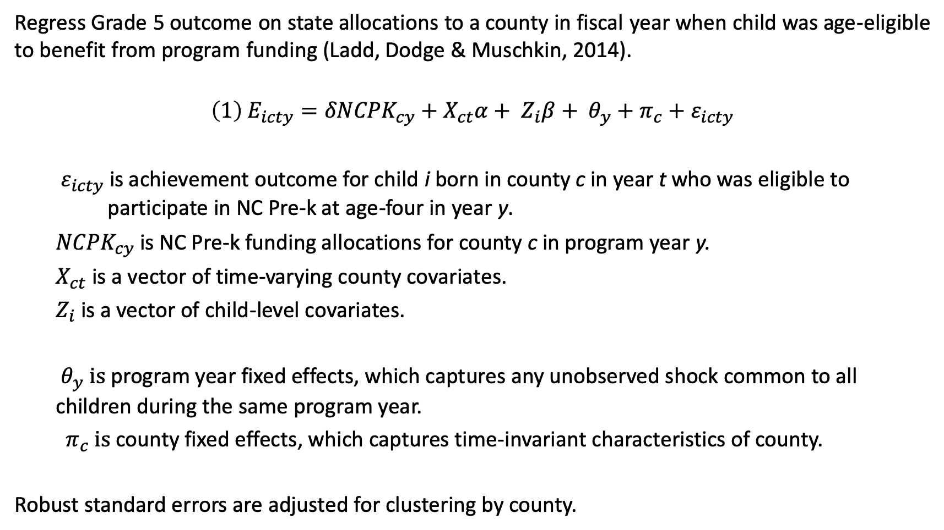
Identification Strategy for Main Effect
Regress Grade 5 outcome on state allocations to a county in fiscal year when child was age-eligible to benefit from program funding (Ladd, Dodge & Muschkin, 2014).
$${\left(1\right) E}_{icty}={δNCPK}_{cy}+{X_{ct}α+ Z_{i}β+ θ}_{y}+π_{c}+ε_{icty}$$
$ε_{icty}$ is achievement outcome for child i born in county c in year t who was eligible to participate in NC Pre-k at age-four in year y.
${NCPK}_{cy}$ is NC Pre-k funding allocations for county c in program year y.
$X_{ct}$ is a vector of time-varying county covariates.
$Z_{i}$ is a vector of child-level covariates.
$θ_{y} is$program year fixed effects, which captures any unobserved shock common to all children during the same program year.
$π_{c} is$county fixed effects, which captures time-invariant characteristics of county.
Robust standard errors are adjusted for clustering by county.

Slide 16
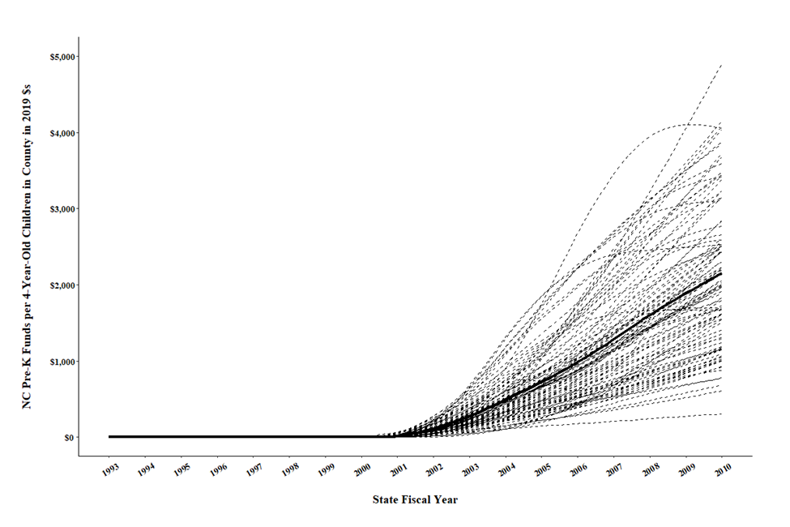
NC Pre-K Funds per 4-Year-Old Child in County: 1993 to 2010

Slide 17
Main Effects
An additional $100 is associated with a 0.003 SD increase in achievement.
An average investment of $1,064 leads to a 0.03 SD increase in achievement.
Consistent effects of funding on grade-5 achievement overall and in most subgroups.
 |  | Race/Ethnicity |  |  |  | Gender |  | Birthweight |  | Mother’s Education
 | Baseline Model | Black | Hispanic | White | Other races | Male | Female | Low | Normal or High | Less than high school | High school or more
 | (1) | (2) | (3) | (4) | (5) | (6) | (7) | (8) | (9) | (10) | (11)
A. Academic Achievement
NC Pre-K funding ($000s) | 0.030** | 0.033* | 0.044** | 0.018+ | 0.012 | 0.029* | 0.032** | 0.025 | 0.031** | 0.046*** | 0.021+
 | (0.011) | (0.015) | (0.013) | (0.009) | (0.019) | (0.011) | (0.011) | (0.017) | (0.010) | (0.013) | (0.011)
Observations | 1,207,576 | 349,373 | 82,527 | 706,617 | 69,058 | 608,273 | 599,303 | 97,633 | 1,109,742 | 283,408 | 924,168
B. Special Education (Logistic Regression, odds-ratios)
NC Pre-K funding ($000s) | 1.015 | 0.987 | 1.024 | 1.034 | 1.021 | 1.022 | 1.002 | 0.996 | 1.017 | 1.030 | 1.009
 | (0.019) | (0.023) | (0.035) | (0.021) | (0.022) | (0.017) | (0.024) | (0.032) | (0.018) | (0.022) | (0.021)
Observations | 1,248,937 | 368,087 | 85,182 | 724,170 | 71,492 | 635,146 | 613,791 | 104,753 | 1,143,956 | 299,788 | 949,149
C. Grade Retention (Logistic Regression, odds-ratios)
NC Pre-K funding ($000s) | 0.996 | 1.007 | 1.047 | 0.968 | 0.989 | 0.994 | 1.000 | 0.954 | 1.002 | 1.018 | 0.986
 | (0.055) | (0.067) | (0.094) | (0.058) | (0.071) | (0.058) | (0.059) | (0.078) | (0.055) | (0.064) | (0.057)
Observations | 1,248,937 | 368,073 | 85,015 | 724,170 | 71,261 | 635,146 | 613,791 | 104,753 | 1,143,956 | 299,788 | 949,149
Notes:
Achievement effect is larger for Black children than for other groups (p<.001)
Achievement effect is larger for Latinx children than for other groups (p<.002)
Achievement effect is larger for children with low-education mothers than for other groups (p<.001)

Slide 18
Instrumental Variables Analyses
Effect on enrolled children is strong for all groups
Pattern aligns with main effect coefficients
First Stage Results: Pre-k funding and Pre-k enrollment
 | Full Sample | Child's Race/Ethnicity |  |  |  | Gender |  | Birthweight |  | Mother Education
 |  | Black | Hispanic | White | Other race | Female | Male | Low | Normal or High | Less than HS | HS or More
 | (1) | (2) | (3) | (4) | (5) | (6) | (7) | (8) | (9) | (10) | (11)
NC Pre-K funding ($000s) | 0.153** | 0.184** | 0.148** | 0.122** | 0.167** | 0.154** | 0.151** | 0.167** | 0.151** | 0.155** | 0.150**
 | (0.004) | (0.011) | (0.015) | (0.009) | (0.006) | (0.004) | (0.004) | (0.005) | (0.004) | (0.010) | (0.005)
Obs. | 1,200,135 | 346,630 | 81,686 | 703,248 | 68,570 | 597,325 | 602,810 | 96,856 | 1,103,081 | 280,345 | 919,790
Enroll. mean | 0.09 | 0.11 | 0.25 | 0.05 | 0.13 | 0.09 | 0.09 | 0.10 | 0.08 | 0.13 | 0.07
F statistic | 1,462.28 | 264.64 | 93.19 | 183.08 | 708.17 | 1,237.15 | 1,473.82 | 977.27 | 1,403.33 | 226.55 | 763.84

Slide 19
Instrumental Variables Analyses
Pattern aligns with main effect coefficients
Second Stage Results: Pre-k funding and Academic Achievement Composite
 | Full Sample | Child's Race/Ethnicity |  |  |  | Gender |  | Birthweight |  | Mother Education
 |  | Black | Hispanic | White | Other race | Female | Male | Low | Normal or High | Less than HS | HS or More
 | (1) | (2) | (3) | (4) | (5) | (6) | (7) | (8) | (9) | (10) | (11)
NC Pre-K funding ($000s) | 0.199** | 0.177* | 0.300** | 0.146+ | 0.071 | 0.205** | 0.194* | 0.149 | 0.204** | 0.297** | 0.142+
 | (0.073) | (0.086) | (0.096) | (0.075) | (0.116) | (0.075) | (0.076) | (0.104) | (0.071) | (0.079) | (0.076)
Obs | 1,200,135 | 346,630 | 81,686 | 703,248 | 68,570 | 597,325 | 602,810 | 96,856 | 1,103,081 | 280,345 | 919,790

Slide 20
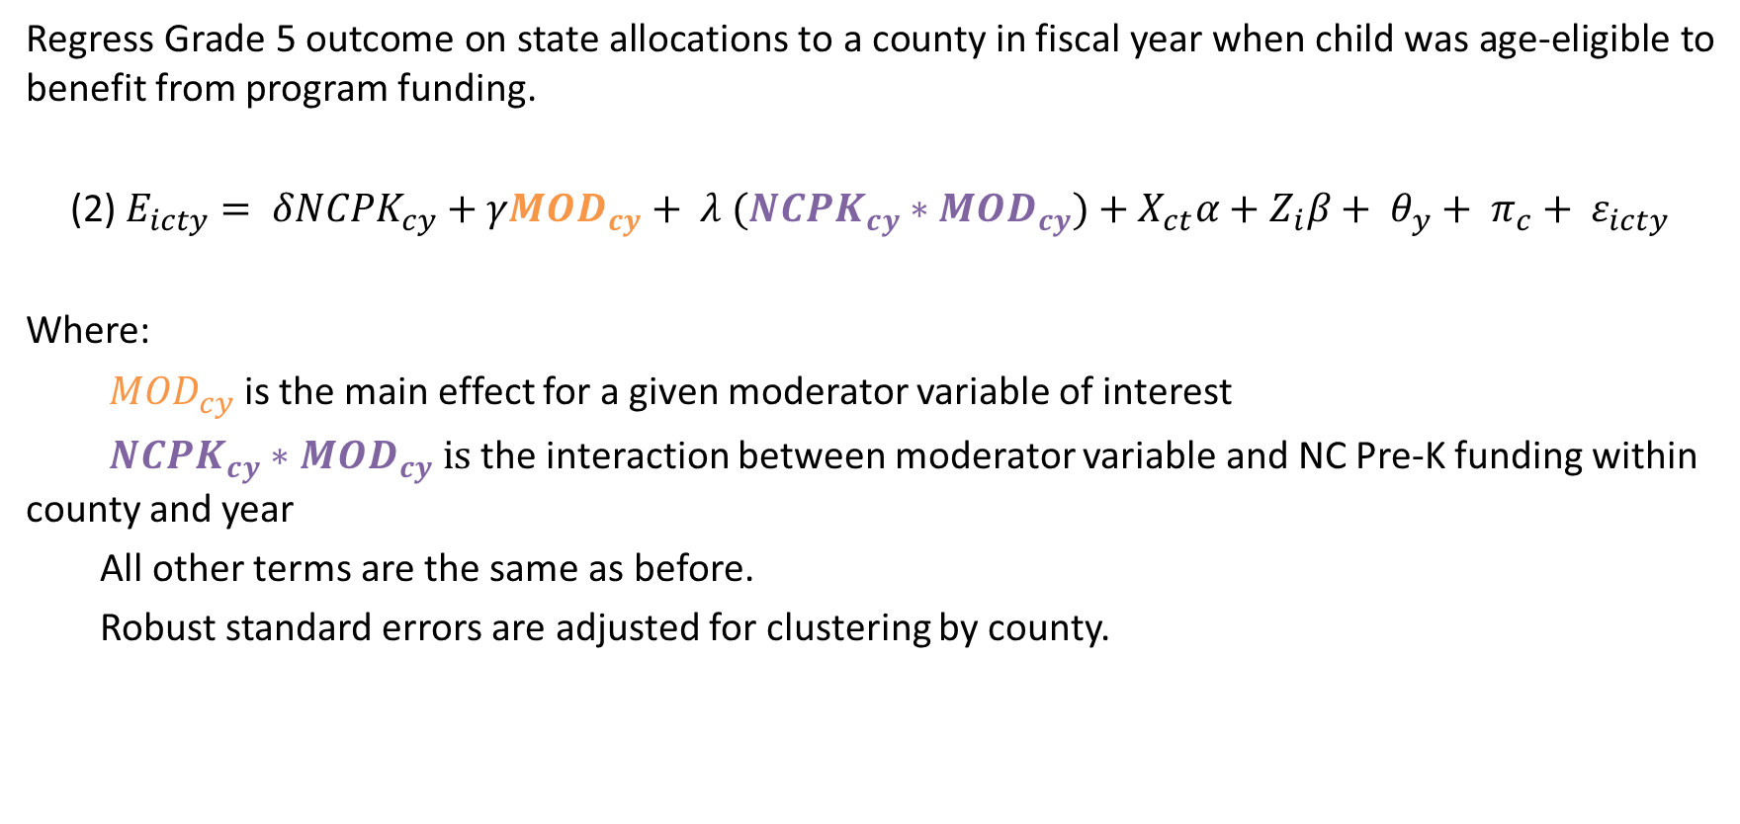
Identification Strategy for Moderation
Regress Grade 5 outcome on state allocations to a county in fiscal year when child was age-eligible to benefit from program funding.
(2) $E_{icty}= δNCPK_{cy}+γMOD_{cy}+ λ (NCPK_{cy}∗MOD_{cy})+X_{ct}α+Z_{i}β+ θ_{y}+ π_{c}+ ε_{icty}$
Where:
${MOD}_{cy}$ is the main effect for a given moderator variable of interest
$NCPK_{cy}∗MOD_{cy} is$ the interaction between moderator variable and NC Pre-K funding within county and year
All other terms are the same as before.
Robust standard errors are adjusted for clustering by county.
Notes:
$λ$ shows the key estimate to examine the key hypotheses regarding environmental interactions.

Slide 21
Environmental Factors: Moderators
Early Childhood | Elementary School | County Economic Conditions
Head Start Saturation | School achievement composite | Median Family Income
Early Head Start Saturation | Local, State and Federal PPE | % SNAP recipients
Smart Start $$ | Student-teacher ratio | % Medicaid enrolled
Head Start “presence” (0/1 coded) * | % National Board-Certified Teachers | % affected by Job loss
Baseline HS saturation (2003 levels) * | Teachers with <3 years experience
 | Teacher turnover (%)
*not time-varying
Notes:
JL: (Business closings and layoffs)/18-64 yo

Slide 22
Results: ECE environment
 | Mod: Head Start | Mod: Early Head Start | Mod: Smart Start | All Mods.
 | (1) | (2) | (3) | (4)
NC Pre-K funding ($000s) | 0.038** | 0.033** | 0.021+ | 0.029*
 | (0.012) | (0.011) | (0.013) | (0.014)
Head Start Saturation (in 10pp) | -0.004 |  |  | -0.005
 | (0.007) |  |  | (0.007)
HS Saturation X NC Pre-K funding | -0.013 |  |  | -0.008
 | (0.008) |  |  | (0.009)
Max Early Head Start Enrollment (in 10pp) |  | -0.061+ |  | -0.061+
 |  | (0.032) |  | (0.032)
Max EHS Enrollment X NC Pre-K funding |  | -0.028 |  | -0.020
 |  | (0.023) |  | (0.025)
Smart Start funding ($000s) |  |  | 0.002 | 0.001
 |  |  | (0.006) | (0.006)
Smart Start funding X NC Pre-K funding |  |  | 0.012 | 0.010
 |  |  | (0.010) | (0.010)
Observations | 1,207,576 | 1,207,576 | 1,207,576 | 1,207,576
p-value (Interactions=0) |  |  |  | 0.380
+ p<.10 * p<.05 ** p<.01 *** p<.001
Notes:
Not shown: HS as a “springboard” for NC Pre-K: no significant interaction detected

Slide 23
Results: School factors
+ p<.10 * p<.05 ** p<.01 *** p<.001
 | Mod: Academic composite | Mod: Local PPE | Mod: State PPE | Mod: Federal PPE | All Mods
 | (1) | (2) | (3) | (4) | (5)
NC Pre-K funding ($000s) | 0.019* | 0.028* | 0.030* | 0.013 | 0.004
 | (0.008) | (0.011) | (0.012) | (0.011) | (0.009)
School-average achievement composite (lagged;std.) | 0.187*** |  |  |  | 0.184***
 | (0.003) |  |  |  | (0.003)
School-average achievement composite X NC Pre-K funding | -0.008* |  |  |  | -0.003
 | (0.003) |  |  |  | (0.003)
Local PPE (in 2019 $000s) |  | 0.059*** |  |  | 0.023***
 |  | (0.008) |  |  | (0.007)
Local PPE X NC Pre-K funding |  | -0.003 |  |  | 0.000
 |  | (0.009) |  |  | (0.008)
State PPE (in 2019 $000s) |  |  | -0.028** |  | 0.034***
 |  |  | (0.008) |  | (0.008)
State PPE X NC Pre-K funding |  |  | -0.001 |  | -0.017*
 |  |  | (0.007) |  | (0.007)
Federal PPE (in 2019 $000s) |  |  |  | -0.128*** | -0.030
 |  |  |  | (0.022) | (0.021)
Federal PPE X NC Pre-K funding |  |  |  | 0.032* | 0.053**
 |  |  |  | (0.014) | (0.016)
Observations | 1,149,113 | 1,149,113 | 1,149,113 | 1,149,113 | 1,149,113
p-value (Interactions=0) |  |  |  |  | 0.031

Slide 24
Results: Teacher factors
+ p<.10 * p<.05 ** p<.01 *** p<.001
 | Mod: S-T ratio | Mod: NBC | Mod: Experience | Mod: Turnover | All Mods.
 | (1) | (2) | (3) | (4) | (5)
NC Pre-K funding ($000s) | 0.029* | 0.031** | 0.026* | 0.028* | 0.027*
 | (0.011) | (0.010) | (0.010) | (0.011) | (0.011)
Student-teacher ratio in the school | 0.008*** |  |  |  | 0.006***
 | (0.001) |  |  |  | (0.001)
Student-teacher ratio X NC Pre-K funding | 0.003 |  |  |  | 0.001
 | (0.003) |  |  |  | (0.002)
N. Board Certified teachers (in 10pp units) |  | 0.045*** |  |  | 0.024***
 |  | (0.008) |  |  | (0.006)
N. Board Certified teachers X NC Pre-K funding |  | 0.001 |  |  | 0.006
 |  | (0.006) |  |  | (0.006)
Teachers with <3y experience (in 10pp units) |  |  | -0.051*** |  | -0.042***
 |  |  | (0.004) |  | (0.004)
Teachers with < 3y exp. X NC Pre-K funding |  |  | 0.008* |  | 0.011**
 |  |  | (0.004) |  | (0.003)
Annual teacher turnover (in 10pp units) |  |  |  | -0.035*** | -0.014***
 |  |  |  | (0.003) | (0.002)
Annual teacher turnover X NC Pre-K funding |  |  |  | 0.001 | 0.002
 |  |  |  | (0.003) | (0.003)
Observations | 1,187,543 | 1,187,543 | 1,187,543 | 1,187,543 | 1,187,543
p-value (Interactions=0) |  |  |  |  | 0.013

Slide 25
Results: County economic factors
 | Mod: Median Income | Mod: % SNAP | Mod: % Medicaid | All Mods.
 | (1) | (2) | (3) | (4)
NC Pre-K funding ($000s) | 0.008 | -0.002 | 0.026 | -0.008
 | (0.017) | (0.021) | (0.018) | (0.025)
Median Family Income ($00s) | 0.001*** |  |  | 0.000+
 | (0.000) |  |  | (0.000)
Median Family Income X NC PreK funding | -0.000 |  |  | -0.000
 | (0.000) |  |  | (0.000)
SNAP recipients (%) |  | -0.022*** |  | -0.020***
 |  | (0.005) |  | (0.006)
SNAP recipients X NC PreK funding |  | 0.004* |  | 0.009**
 |  | (0.002) |  | (0.003)
Medicaid recipients (%) |  |  | -0.025*** | -0.008*
 |  |  | (0.003) | (0.003)
Medicaid recipients X NC PreK funding |  |  | 0.000 | -0.005+
 |  |  | (0.001) | (0.003)
Observations | 1,207,336 | 1,207,336 | 1,207,336 | 1,207,336
p-value (interactions=0) |  |  |  | 0.022
+ p<.10 * p<.05 ** p<.01 *** p<.001
Notes:
Q: why no NCPK effect and no NCPK interaction with median family income?

Slide 26
Results: County economic factors
 | Main baseline model w/subsample | Moderator: County-level Job Loss
 | Baseline | Baseline | Interaction | Baseline | Interaction
 | (1) | (2) | (3) | (4) | (5)
NC Pre-K funding ($000s) | 0.059* | 0.056* | 0.061* | 0.008 | 0.012
 | (0.027) | (0.027) | (0.025) | (0.019) | (0.019)
Percent affected by job loss per full academic year |  |  | 0.002 |  | 0.003
 |  |  | (0.003) |  | (0.003)
Percent affected by job loss X NC PreK funding |  |  | 0.017 |  | 0.029*
 |  |  | (0.019) |  | (0.013)
Observations | 824,416 | 824,416 | 824,416 | 824,416 | 824,416
Analysis Specific Controls
Year of test FE |  | X | X | X | X
Time trends and Quadratic |  |  |  | X | X
+ p<.10 * p<.05 ** p<.01 *** p<.001

Slide 27
Additional results
Similar results for math and reading
For most of the significant moderation results, there were no differences by population subgroup
Exception: school achievement interaction for Black students
  Attending a school with higher average achievement appeared to provide a complementary relation with NC Pre-K funding
  Particularly true for Black students attending schools in the middle of the performance distribution
  This pattern did not hold for Black students attending schools with higher average achievement

Slide 28
Robustness analyses
We assessed the sensitivity of our results through several additional analyses
Alternate sets of control variables (Table 5; Appendix 16, 17)
Multiple estimation approaches
  OLS regression with county and year fixed-effects
  Instrumental Variables analyses
  Subgroup models and interaction models to test group differences
  Logistic and OLS regressions for dichotomous outcomes
Endogeneity checks of moderators (Table 10, 11)
Alternate developmental periods of environmental moderators (Appendix 13, 19, 20)

Slide 29
Summary & Discussion
NCPK main effect on achievement is robust to most model specifications
No effect detected for special education placement or grade retention
Compliance-adjusted IV models show meaningful, reasonable impacts for those enrolled on achievement
Achievement effects largest for disadvantaged subgroups
  IV estimates illustrate this very well
Our results support the continued targeting of pre-k to disadvantaged children
  Think carefully about the best way to achieve this

Slide 30
Summary & Discussion
Not much support for “sustaining environments”: ”goods” are good for everyone
  But, rough/proxy measures of “sustaining” factors
Some evidence of substitutability for other positive experiences
”Buffering”, “protective”, or “compensatory” relationships between NC Pre-k and later negative experiences
  Bad things also bad for everyone, but NCPK helps weather storm
  Aligned with compensatory effects/design of large-scale targeted ECE programs (e.g., Head Start)

Slide 31
Acknowledgement
This research study was supported by grant funding from the National Institute of Child Health and Human Development (1R01HD095930-01A1)
North Carolina State Center for Health Statistics
North Carolina Department of Public Instruction
North Carolina Division of Child Development and Early Education
North Carolina Partnership for Children
North Carolina Education Research Data Center
Consortium on Early Childhood Intervention Impact
Gayane Baziyants, Caroline Botvin, Hunter Kaufman, Susan Kruglinski for RA work

Slide 32
Additional Resources
The statistical method used here has been well-explained in several methodological texts. Scott Cunningham’s Causal Inference: The Mixtape provides a great open-source introduction to the method: see chapters 8 and 9).
Richard Murnane and John Willett’s Methods Matter text (Chapter 8) also explains the methodological assumptions in a clear way, and their text is written specifically for educational researchers.
For an approachable discussion of the advantages to using archival data for social science research, we recommend Andrew Penner and Kenneth Dodge’s 2019 article.

Slide 33
Contact info for the study lead authors:
Tyler Watts – tww2108@tc.columbia.edu
Jade Jenkins - jvjenkin@uci.edu
Kenneth Dodge - dodge@duke.edu
(corresponding author)

