Slide 1
Viewing Joint Attention Inclusively
Kim A. Bard, Heidi Keller, Kirsty M. Ross, Barry Hewlett, Lauren Butler, Sarah T. Boysen, & Tetsuro Matsuzawa
Notes:
To accompany our monograph, we have provided several teaching/research powerpoint resources.
In this resource, we highlight the shift in our views about joint attention when we use a more inclusive perspective. We contrast ‘what we think we know’ with what we learn both by including diversity in samples, that is, including observations of infants from a variety of socio-ecological contexts in which hominoids live, and by being more inclusive in how joint attention is defined. In the slides that follow, we describe what Joint Attention looks like in 1-year-olds human infants living in diverse socio-ecological settings.

Slide 2
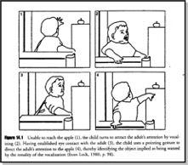


We think we know about Joint Attention (through 50 years of study)
Notes:
Developmental scientists think they know what joint attention looks like. Textbooks may illustrate Joint Attention by focusing on distal communication signals, as shown in this illustration from Lock (1978). Infants refer to objects and their mother with gaze alternations and use pointing to communicate the desired, distal object.
And a google search gives the bottom two images (among many others), involving an infant (left) or child (right) pointing to something for shared visual engagement with a parent.

Slide 3
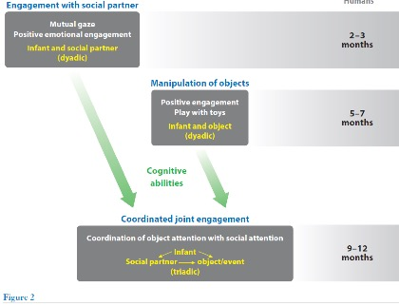
We think we know about how joint attention develops
Bard & Leavens, 2014
Notes:
This figure illustrates what we think we know about how joint attention develops (from Bard & Leavens, 2014). Specifically, mutual gaze and positive emotion mark social engagements in infants during their first 3 months of life. Infants engage with toys, around 6 months.
And then, by the end of the first year, infants become able coordinate social engagements with engagement with toys, forming a coordinated joint engagement, or referential triangle.

Slide 4
BUT – what we think we know is biased!
Because 90% of developmental research has been conducted with WEIRD samples
WEIRD samples prioritize:
distal caregiving, infant signaling, toys, high positive emotion
WEIRD samples are neither ‘the norm’ nor ‘the optimal’ context
Notes:
What we think we know is biased, primarily due to sampling biases in which 90% of developmental research is focused on Western, Educated, Industrialized, Rich & Democratic (WEIRD: Henrich et al., 2010) samples (Nielson et al., 2017).
Western middle-class samples, in part due to ethnotheories of infant agency and independence, focus on distal, visually-based interactions, and the primary shared topic is toys.
Approximately 10% of the worlds’ population is WEIRD.
The vast majority of infants, therefore, live in other socio-ecological-cultural contexts. In decolonizing developmental psychology, we should not view WEIRD samples as the norm or the optimal context for infant development (Kline et al., 2018; see more in the monograph and the ppt slides about decolonizing joint attention).

Slide 5
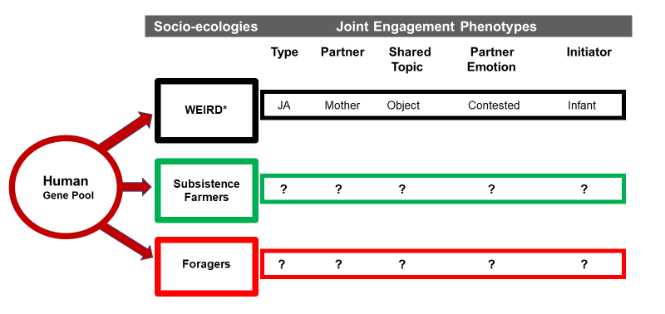
Joint Attention can be described by specifying characteristics
Notes:
In our monograph, we constructed a way to describe the predominant forms of joint engagement in the three samples we studied. We consider each of 5 dimensions (type of triadic connectedness, partner, shared topic, partner emotion, & initiator), and arrive at a Joint Engagement phenotype for each sample.
The WEIRD phenotype, as described in the literature, is described as the infant engaged with the mother, about an object, usually accompanied by positive emotion, and the bout is initiated by the infant. In our monograph, we label this the Joint Attention Phenotype (JA). We studied infants living in University towns in the South of England as our WEIRD sample.
To assess the extent to which our views about joint attention might shift if we consider human infants from different non-WEIRD settings, we studied infants from Aka communities (from Central African Republic: Hewlett, 1991) living in the tropical rain forest with a forager lifestyle, and infants from Nso communities ( from rural NW Cameroon: Keller, 2007) living a subsistence farming lifestyle.
The following slides provide descriptions of the behavioral phenotypes in the three samples we studied, considering one characteristic at a time.

Slide 6
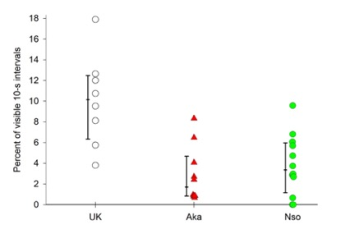
Joint Attention Phenotype Frequency
Joint Attention phenotype defined as Engagement with mother, about objects, with positive emotional tone, & initiated by Infant
Notes:
The first characteristic was Type of Triadic Connectedness. This graph shows the amount of the JA phenotype across the three groups of human infants. The JA phenotype is the form most often reported in past literature, and is defined in the slide.
We conclude that the JA phenotype does occur across all three samples, and in most, but not all of the human infants. It is significantly more prevalent in the UK sample. But even in the WEIRD sample, it is relatively infrequent (occurring a median of 10% of the observable time).

Slide 7
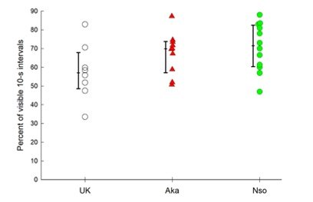
Joint Engagement Frequency
Joint engagement defined as “engagement with someone, about something” [triadic connectedness]
Notes:
The alterative type of triadic connectedness was Joint Engagement, which was more inclusive than the JA phenotype in the previous slide. Joint Engagement allowed for visual & non-visual forms of engagement, varieties of partners, diversity in shared topics, positive, negative & neutral emotional tones, and initiations by either partner.
We find that joint engagement is very common across diverse settings (with all medians above 60%). There was no significant differences in frequency of joint engagement across the diverse socio-ecological settings.

Slide 8
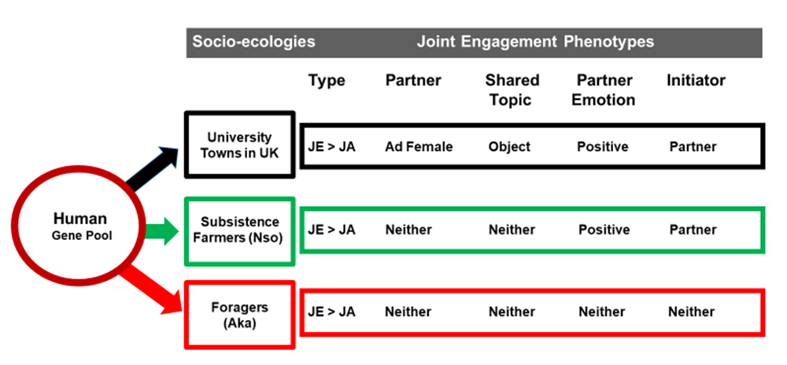
Joint Engagement Phenotype
Notes:
So let’s construct Joint Engagement Phenotypes for our three groups of human infants, with the data we collected.
The first characteristic of Joint Engagement was type of triadic connectedness – and here we found that in our 3 samples, Joint Engagement was significantly more frequent than the Joint Attention phenotype.

Slide 9
Joint Engagement Phenotype
Notes:
The second characteristic of Joint Engagement (JE) was partner.
The past literature suggests this is typically the mother (an Adult Female), which we contrasted to the other categories of partner (infant, juvenile, adult male, multiple).
An adult female was the predominant JE partner in our WEIRD sample, but in our other samples, we found that other partners were as frequent as were Adult Females. The Nso and the Aka infants did not have an adult female as their predominant social partner in joint engagement.

Slide 10
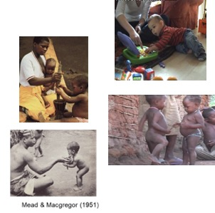
Joint Engagement Phenotype
Notes:
The third characteristic of Joint Engagement (JE) was the Shared Topic.
Infants in all eco-cultural settings engaged with others about activities, for example, give & take, joint action, and many types of social activity, such as dancing (as soon in these photos). We compared the samples on whether objects were the predominant type of shared topic, or whether social activity (play + social other topics) was significantly more frequent.
As we expected from the literature on WEIRD samples, objects were the primary shared topic in our UK sample.
However, in our other samples, objects were not the predominant type of shared topics. In the Nso and Aka socio-ecological settings, joint engagement with objects as the shared topic was not more frequent than JE about Social Activity (play + social other topics).

Slide 11
Joint Engagement Phenotype
Notes:
The fourth characteristic of Joint Engagement (JE) was the emotional tone provided by social partners during JE bouts.
As we expected, there were high levels of positive emotion in the UK sample. And the predominant emotional tone for the Nso was positive, but at significantly lower levels than in the UK sample. However, the Aka infants did not experience positive as the predominant emotional tone of JE partners. Although the Aka infants experienced significantly higher number of JE bouts without any overt emotional tone compared to the other groups, the predominant emotion was neither Positive nor Non-Positive (negative + neutral).

Slide 12

Joint Engagement Phenotype
Notes:
The final characteristic of Joint Engagement (JE) was who initiated JE bouts.
In this characteristic, we were surprised with the results. Recall that the past literature prioritizes infant initiations (as evident in illustrations of infants pointing).

Slide 13
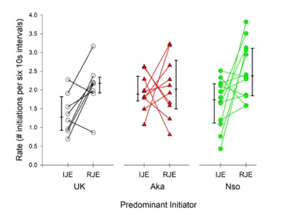
Initiator of Joint Engagement
Notes:
We were surprised because, in the UK sample, we found rates of infant-initiated joint engagement (IJE) were significantly lower than rates of partner initiated JE (RJE).
This was also the pattern we found in the Nso infants living in a subsistence farming context.
In the Aka infants, living in a foraging context, however, we found there was no significant difference in rates of IJE and RJE. So, the surprise was that the rate of infant initiations were not higher than partner initiations in any of the human groups.

Slide 14
Joint Engagement is Contextualized
Notes:
To complete the JE phenotype, we add in the predominant initiator for each sample. The partner was the predominant initiator for the UK infants and the Nso infants. The Aka infants had equivalent rates of IJE and RJE, neither the infant nor the partner predominated.
With these 5 characteristics, we describe joint attention in our three samples. We call these the Joint Engagement Phenotypes.
We note that the only characteristic that all three human groups shared was the type of triadic connectedness - that Joint Engagement was significantly more frequent that the JA phenotype.
This slide describes one of the most important findings from our research, specifically that joint attention looks different in human infants living in different socio-ecological contexts.

Slide 15
 | Hunter-Gatherers | Small-Scale Farmers | Middle-class Western
General caregiving style | Proximal | Proximal | Distal
How to engage and stimulate infants | Touch, Body movement, Gaze | Touch, Body movement | Verbalization, Gaze, Use of objects
Socialization goals; core values | Sharing, Cooperative autonomy | Deference and respect, Belonging, Obedience | Rapid cognitive development, Independence
Daily living | Adult focused | Adult focused | Infant focused
Adult interventions in infant learning | Limited and subtle | Limited but explicit | Common and explicit
Infant mortality | High | High | Low
Notes:
The samples we selected were purposefully diverse. One characteristic that differed was the type of caregiving infants experienced.
As we mentioned earlier, western middle-class infants experience distal caregiving, whereas our other groups experienced proximal caregiving. But this distinction does not explain our joint engagement phenotypes. This is likely because, although the core practice of proximal caregiving involves touch and close proximity versus the core practice of distal caregiving involving gaze and verbal communication, there can be substantial differences in cultural values and socialization goals, as we illustrate in the table comparing hunter-gatherers to small-scale farmers (Hewlett, 2016).
Further research is needed to specify which characteristics of social cognition are linked with the social, ecological, and cultural variables that infants experience.

Slide 16


Triadic Connectedness is the Core Ability
Notes:
We conclude that the core aspect of joint attention is Triadic connectedness – 1-year-olds and social partners connecting, and engaging together in a variety of shared topics (e.g., social activities, object activities). Triadic connectedness is ubiquitous and frequently occurring.
The behavioral phenotypes of joint attention, however, vary across socio-ecological settings. The figures on the left highlights that jointness may be indexed with the lack of visual contact & avoidance of the shared topic (here a potentially dangerous, multi-legged insect). The figures on the right illustrates that infants may engage with touch in a type of motor play (the adult female and infant swayed back & forth together) and that the adult may not emit positive emotional tone.
Even with our small number of samples, we found significantly different forms of joint engagement. It is notable that there does not appear to be any form that can be said to be ‘the norm’: there was not any phenotype that was universal in our study. We conclude that the core ability underlying joint attention, triadic connectedness, may be universal, but the forms of joint engagement are highly contextualized.

Slide 17

For this issue, visit
doi.org/10.1111/mono.12435
For videos, commentaries, and teaching materials,
visit monographmatters.srcd.org

Slide 18
Corresponding author
Kim A. Bard
Kim.Bard@port.ac.uk
Editorial inquiries
Lynn S. Liben
liben@psu.edu
Citation
Bard, K.A., Keller, H., Ross, K., Hewlett, B., Butler, L., Boysen, S.T. & Matsuzawa, T. (2021). Joint Attention in Human and Chimpanzee Infants in Varied Socio-ecological Contexts. Monographs of the Society for Research in Child Development, 86(4). https://doi.org/10.1111/mono.12435

