Slide 1
Five Steps to Decolonizing the Study of Joint Attention
Kim A. Bard, Heidi Keller, Kirsty M. Ross, Barry Hewlett, Lauren Butler, Sarah T. Boysen, & Tetsuro Matsuzawa
Notes:
There are three PowerPoint slide resources associated with our monograph: inclusivity in joint attention, implications for theories of social cognition, and decolonizing joint attention.
In this ppt resource, we consider the process of decolonizing joint attention. We present 5 steps to follow to arrive at a more inclusive investigation of this developmentally important topic. We designed these procedures to facilitate our study of Joint Attention in 1-year-olds. Although we think these steps will be helpful in the study of any developmentally important topic, in these slides, we highlight how the steps were important for our study

Slide 2
5 Steps to Decolonization
Consider the phenomenon from multiple cultural viewpoints
Consider its development from multiple cultural perspectives
Construct (and use) inclusive operational definitions
Study the phenomenon in multiple diverse socio-ecological settings
Be cautious of unconscious bias in conclusions & interpretations
Notes:
Here are the five steps that we used in our study of joint attention. Please see the monograph for details, but here we present an example or two of each step in the decolonization process.

Slide 3
Why Decolonize?
Over 90% of developmental research is conducted in WEIRD infants, yet only ~10% of infants live in WEIRD settings
WEIRD settings
  prioritize distal interactions, visual engagements, mothers serving as playmates, teachers, & caregivers, infant initiations, & independence
  may present a biased of development outcomes & milestones
  may present a biased view of development
Notes:
First, we should check that the decolonization process is necessary.
We know that 90% of developmental research in the top journals is conducted in WEIRD (Western, Educated, Industrialized, Rich & Democratic: Henrich et al., 2010) settings, but that only 10% of the world’s population lives in WEIRD settings (Nielson et al., 2017).
We know (a lot) about the types of interactions that are prioritized in WEIRD settings but we must question about whether they generalize to, and are presentative of humans in all settings. In our monograph we detail many cultural variations in social cognition outcomes and milestones, and conclude that there is bias in the literature on joint attention.

Slide 4
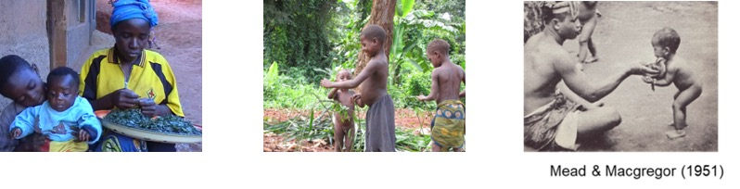
5 Steps to Decolonization
Consider the phenomenon from multiple cultural viewpoints
Notes:
The first step is to look at the phenomenon of interest, for us it was joint attention in 1-year-olds, across multiple cultural viewpoints.
Humans have two inheritance systems: genes and culture (e.g., Jablonka & Lamb, 2007). Culture is basically any socially transmitted and acquired information (e.g., skills, knowledge) shared by a group. There are cultural differences in how people think and feel about the world, including who should be responsible for infant care and appropriate ways to interact with infants.
We considered existing literature concerning the socialization goals, caregiving practices, and beliefs about 1-year-olds across different socio-cultural-ecological settings. We learned that in some cultural settings older children may care for 1-year-olds, 1-year-olds may be expected to do chores (like carrying bundles of sticks back to the village or assisting with building temporary huts), and in some settings infants already engage in social etiquette, such as receiving things that they then give to others. In many settings, it is rare for infants to have toys or to play with adults.

Slide 5


2. Consider its development from multiple cultural perspectives
N. Deriabina
Proximal caregiving (e.g., Nso)
Tactile engagement
Stimulate with Body Movement
Anticipate infant’s needs
Socialization Goal – belongingness & obedience
Ethnotheory – direct & guide infant
Distal caregiving (e.g., USA, middle-class)
Visual engagement
Stimulate with Objects
Respond to infants’ needs
Socialization Goal – independence
Ethnotheory – Follow infant’s interests
Notes:
The second step is to view the development of joint attention from multiple cultural perspectives. One cultural difference is between proximal and distal caregiving practices, as these two sets of photos illustrate.
Concerning the development of joint attention, important cultural differences are (1) in the primary modality of engagement; (2) in what will become shared topics; (3) in expectations about infant signalling; (4) in socialization goals; and (5) in expectations about the role of the infant and partner in initiating, directing or controlling interactions.
In this table, we describes the type of proximal caregiving experienced by infants living in the Nso farming communities in rural Cameroon (Keller, 2007), but acknowledge that there are many variations of proximal caregiving (e.g., between Hunter-Gatherers and Farmers [Hewlett, 2016], as well as across different Hunter-Gatherer communities [e.g., Hewlett & Lamb, 2009]).
There is also variety in types of distal caregiving across different western, middle-class settings (see monograph for details). This list show what is typically experienced by infants living in middle-class America (upon which most of the existing joint attention literature is based: Nielson et al., 2017).

Slide 6
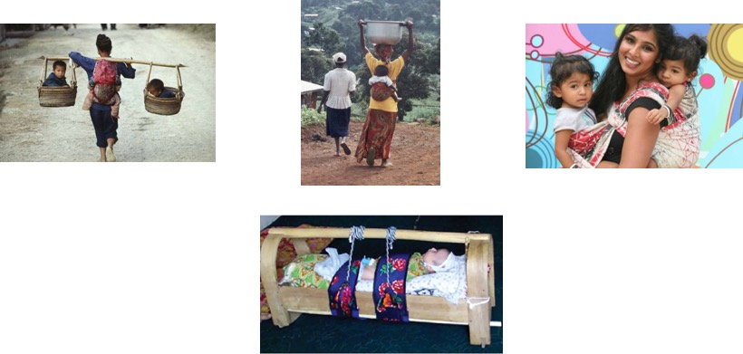
Karasik et al. 2018
Notes:
In some cultures, infants are positioned without visual contact with caregivers. In China, they may be carried in baskets, in Cameroon & India, infants may be carried on the back. In Tajikistan, for example, Karasik & colleagues (2018) found infants were often tightly swaddled and placed in cradles for many hours each day to facilitate their socialization goal of infants being minimally aroused (i.e., maximally soothed).
Yet even in cultures that minimize visual contact, infants grow up to be fully functioning members of their community. Based on our extensive review of the literature, we conclude that there are multiple developmental paths to competency in social cognition.

Slide 7
3. Construct (and use) inclusive operational definitions
Triadic connectedness is our core construct, labelled as joint engagement (“infants engaging with someone, about something”).
We need to be inclusive in operational definitions
(a) social engagement (visual, tactile, and auditory);
(b) the partner (not assuming it is -or should be- the mother);
(c) the shared topic (not assuming it must be an object)
(d) the emotional tone (not assuming it is positive)
(e) who initiates (not prioritizing infant initiations)
Notes:
Based on this extensive consideration of diversity in developmental paths leading to joint attention, we arrived at what we consider to be the core construct – triadic connectedness. With this label, we do not privilege theoretic views about the function of joint attention as it appears in WEIRD settings, or specify in advance the roles of infant and social partner. We conceived of the behavioral form of joint attention as having multiple components ( listed in a – e above).
For example, past definitions give infants extra credit if they initiate a bout of joint attention, say with a point and gaze alternation (e.g., Mundy, 2003). In contrast, in some cultures, social partners direct infants’ activity. Sometimes joint activity may be the goal, as in dancing together in harmony (e.g., Takada, 2020). Sometimes infants are expected to comply with adults’ directives, for example, to give a preferred food item to an older sibling.
Our definition of Joint Engagement focuses on mutual engagements about shared topics, without prioritizing the partner, the type of shared topic, the type of emotion, or who initiates.

Slide 8
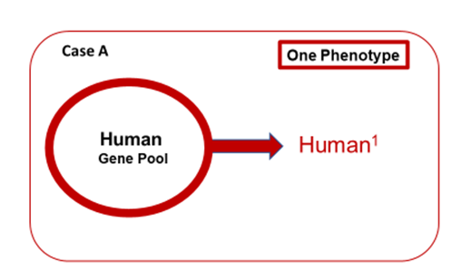
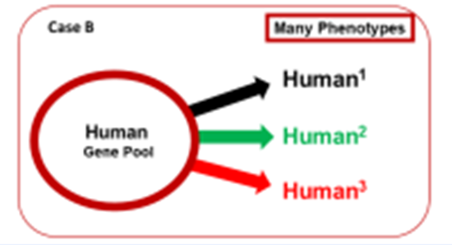
4. Study the phenomenon in multiple, diverse socio-ecologies
Multiple samples are crucial
The human species has a great deal of flexibility in social cognitive outcomes
Notes:
The fourth step is to study the phenomenon of interest in multiple, diverse socio-ecological settings. The goal is to describe the phenomenon with a view to documenting the ways that outcomes manifest across settings.
In contrast to many theoretic views of social cognition (e.g., Tomasello, 2019) that may assume there is a single behavioral form of joint attention that is prototypic of all humans (i.e., a product of genes alone as illustrated in Case A), we conceive of behavioral expressions (phenotypes) as a product of genes and socio-ecological variables, as illustrated in Case B.
In Case B, phenotypes of joint attention differ across socio-cultural-ecological setting. In other words, joint attention phenotypes are contextualized.

Slide 9
5. Be cautious of unconscious bias in conclusions & interpretations
Developmental psychology, in the past, has viewed WEIRD infants (and families) as both the norm and as optimal. When we take a decolonized view, we make a different assumption, namely that each socio-ecological group has contextualized goals and the predominant forms of joint attention in each socio-ecological group will match these goals.
Notes:
The fifth, essential, and final step in the decolonization process is to be cautious of unconscious bias.

Slide 10

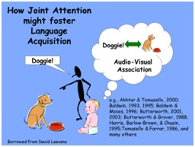
5. Be cautious of unconscious bias in conclusions & interpretations
Be wary of adopting positions that prioritize western middle-class results
e.g., Pointing is a universal marker of JA, pointing is essential for language
Notes:
The main aim is to avoid prioritizing western, middle class outcomes and to be conscious that most current theories are based almost exclusively on western, middle class studies.

Slide 11
5. Be cautious of unconscious bias in conclusions & interpretations
Be wary of adopting positions that prioritize western middle-class results
WEIRD forms are neither universal nor the gold standard
(avoid the Western centrality assumption: Kline et al., 2018)
Be wary of interpreting differences as deficits (in the non-WEIRD groups)
WEIRD groups should not be the benchmark for comparisons
(avoid the deficit assumption: Kline et al., 2018)
Be wary of using western middle-class-derived measures, tests, & definitions
tests designed for WEIRD samples may not be valid for all samples
(avoid the equivalency assumption: Kline et al., 2018)
Notes:
Our study illustrates how socio-ecological settings influence the phenotypic expressions of joint attention. Our findings support the conclusion that WEIRD forms are not universal.
By avoiding considerations of the WEIRD form as the normative form (i.e., a benchmark), we also avoid considering any group as deficient in comparison with the WEIRD group.
In our studies, we adhered to an ecological commitment (Dahl, 2017), by using naturalistic observation. Standardized tests of joint attention are based on western, middle-class studies, assessing types of joint attention that may not be prioritized in other socio-ecologies. Tests derived from one cultural perspective may be invalid in other socio-ecologies.

Slide 12
Conclusions and Implications
Studies of Social Cognition need to be decolonized
  we present 5 steps to follow in the process
  cultural differences in engagement & shared topics, etc
Developmental theories of social cognition need revision
  with inclusivity in definitions
  with increased diversity in samples
  based on contextualized outcomes
Notes:
From our study of joint attention viewed inclusively, we conclude that the core construct, triadic connectedness, is likely universal, but the phenotypes, the behavioral forms of joint attention, are contextualized in line with local ethnotheories and caregiving practices.
A decolonized view has allowed us to focus on the ways in which joint attention is manifestly different in infants living in different socio-ecologies. Since phenotypic expressions and their developmental history differ so dramatically, we must revisit development theories of social cognition that are based on a mono-cultural foundation.
This means that developmental theories that are based only on WEIRD samples must be revised to embrace diversity. (Please see the additional resource on implications for theories for more details.)

Slide 13

Please see the additional resources available at monographmatters.srcd.org
Notes:
We provide an overview about how behavioral phenotypes of joint attention differ in 1-year-old human infants from three diverse socio-ecological settings, in the ppt resource on inclusivity (and, of course, details are in the monograph). We found in our three samples that there were three different joint engagement phenotypes.

Slide 14

For this issue, visit
doi.org/10.1111/mono.12435
For videos, commentaries, and teaching materials,
visit monographmatters.srcd.org

Slide 15
Corresponding author
Kim A. Bard
Kim.Bard@port.ac.uk
Editorial inquiries
Lynn S. Liben
liben@psu.edu
Citation
Bard, K.A., Keller, H., Ross, K., Hewlett, B., Butler, L., Boysen, S.T. & Matsuzawa, T. (2021). Joint Attention in Human and Chimpanzee Infants in Varied Socio-ecological Contexts. Monographs of the Society for Research in Child Development, 86(4). https://doi.org/10.1111/mono.12435

