Slide 1
Methods for Studying Prosocial Behavior and Aggression Over Time
Questionnaires, Direct Observation, and
Experimental Decision-Making Tasks
Notes:
General Guidelines:
-

Slide 2
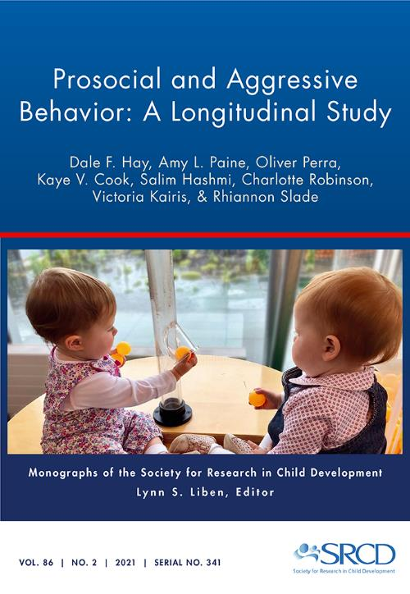
For this issue, visit
https://doi.org/10.1111/mono.12427
For videos, commentaries, and teaching materials,
visit monographmatters.srcd.org

Slide 3
Methods Used in Longitudinal Studies
Large longitudinal studies have traditionally drawn on an informant’s report of the child’s development, using interviews or questionnaires
  Parents
  Teachers
  Older Children’s and Adolescents’ Self-Reports
Smaller longitudinal studies might include some standardized testing, experimental tasks, or direct observation
Our aim was supplement informants’ reports of prosocial and aggressive behavior with direct observation and experimental tasks

Slide 4
Measuring Prosocial Behavior, Aggression, and their Correlates
Measures of Prosocial Behavior
Measures of Anger and Aggression
Informants’ questionnaires
Home Observations
Simulated Birthday Party
Prosocial Decision-Making Tasks
Informants’ questionnaires
Home Observations
Simulated Birthday Party
Aggressive Decision-Making Tasks
Clinical Interview
Notes:
We also examined possible correlates of prosocial and aggressive behaviour, including emotion regulation and social understanding.

Slide 5


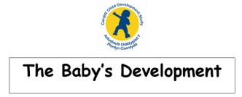
Informants’ Reports: Angry Aggressiveness at 6 months,
1 year, 1.5 years, 2.5 to 3 years, and 7 years
The Cardiff Infant Contentiousness Scale (CICS; Hay et al., 2010)
Angry moods
Hits out at others
Bites
Temper Tantrums
Hits or Kicks Children to Get Toys
Grabbing Toys
Notes:
We used informants’ reports of angry aggressiveness at 6 months, 1 year, 1.5 years, 2.5 to 3 years, and 7 years. Informants included mothers, fathers, and a third person who knew the child well. Informants reported on angry aggressiveness in the context of age-appropriate developmental milestones (see Chapters 3, 6 and 7).

Slide 6
Informants’ Reports: Prosocial Behavior at
1.5 years, 2.5 to 3 years, and 7 years
Cardiff Child Prosocial Scale at 1.5 and 2.5 to 3 years
Upset when another is distressed
Comforts others
Shows affection
Shows toys (1.5 years only)
Shares toys
Plays Cooperative Games
Plays Ball Games
Is Considerate (2.5 to 3 years only)
Is Helpful (2.5 to 3 years only)
Is Kind (2.5 to 3 years only)
Teachers’ Report of Prosocial Behavior in the Classroom at 7 years
(Weir & Duveen, 1981)
Notes:
We also used informants’ reports of prosocial behavior at 1.5 years, 2.5 to 3 years, and 7 years. Informants included mothers, fathers, and a third person who knew the child well, and at 7 years, teachers also reported on children’s prosocial behaviour in the classroom (see Chapters 3 and 6).

Slide 7
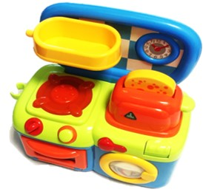
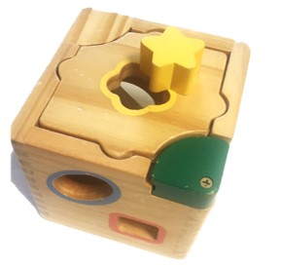
Observational Methods:
Aggression, Prosocial Behavior, and Emotion Regulation with a familiar peer in the home
Notes:
At 1.5 years, children from the sample were observed in the home with a familiar same-aged peer (guest). Peer interaction was observed for prosocial and aggressive behavior. Researchers provided children with a toy kitchen and shape sorter, but children were encouraged to play as they normally would.

Slide 8
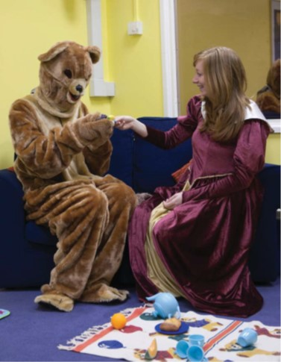
Observational Methods:
Aggression, Prosocial Behavior, and Emotion Regulation during Laboratory Birthday Parties
Notes:
At 1 and 2.5 years, children from the sample met unfamiliar peers (other participants) during experimental birthday parties held in the laboratory. Peer interaction was observed for prosocial and aggressive behavior. The parties included an emotional regulation challenge: a Teddy Bear’s Picnic scenario enacted by costumed characters.

Slide 9
Observational Methods:
The Peer Interaction Coding System (PICS; Hay & Ross, 1982)
Focal child | Guest
 | 1. OFFER red block to participant (but it falls on the floor) and SP “’ere go [participant name]”
2. ACCEPT red block from peer, bends down to floor and picks up the block
 | 3. NR
4. REACH for spatula in peer’s hand
 | 5. OFFER spatula to participant and SP “’ere go”
6. ACCEPT spatula from peer
Notes:
Children’s behavior in the home and in the laboratory was coded using the Peer Interaction Coding System (PICS; Hay & Ross, 1982).
The PICS is designed to capture episodes of social interaction between at least two infants or toddlers. Social interaction between the peers is defined as an alternating sequence of each child’s peer-directed behaviours. Peer-directed behaviours may be physical, vocal, or verbal, but they must clearly be directed to the peer, as signalled by the actor’s gaze at the other child, or by words (e.g., calling the other child by name). So the first thing the observer must do is decide whether one child is looking in the direction of the other. With nonverbal children, the direction of looking is our best guide to the intentionality of the action.
In the PICS, observers will try to identify peer-directed behaviours. If one child (the actor) directs a behaviour to the other (the recipient), and the recipient responds by directing a behaviour back to the actor, an episode of social interaction has taken place. An episode must contain at least two moves, but may be much longer.
Here we show an example of the PICS used to code an interaction at the 1.5 year home visit (Chapter X). Note, OFFER = The actor extends an object toward the peer’s hands or lap, possibly releasing it into the recipient’s hand or lap, ACCEPT = The recipient grasps or picks up an object that has just been offered by the peer, NR = No response, REACH = The actor extends a hand toward an object physically held by the peer, extending the hand with outstretched fingers, as if to grasp the object.

Slide 10
Observational Methods: Peer Interaction Coding System cont.
Child A | Child B | Child C
 | 1. SP to everyone in room “I haven’t got a plate, I haven’t got a plate! Look, that, this, that.”
2. SP to everyone in room “I’m a cake!”
3. ADD plate of food to B’s array
 | 4. NR to A, SP to C “he drink it! Look! With the handle!”
 |  | 5. WATCHES B
 | 6. TAKE5 teapot from A
7. NR
Notes:
Here we show an example of the PICS used to code an interaction at the 2.5 year visit to the laboratory (Chapter X). Note, SP = Speech, ADD = The actor shares by releasing an object into an array of objects in the peer’s possession (e.g., the actor adds a shape to an array of shapes that can be put into a shape-sorting box, or a ring to a pile of multi-coloured rings with which the peer is playing), NR = No response, WATCHES = The recipient responds to the peer’s socially directed action only by looking at the peer, TAKE5 =The actor picks up an object that the peer has just put down, within the last 5 seconds.

Slide 11

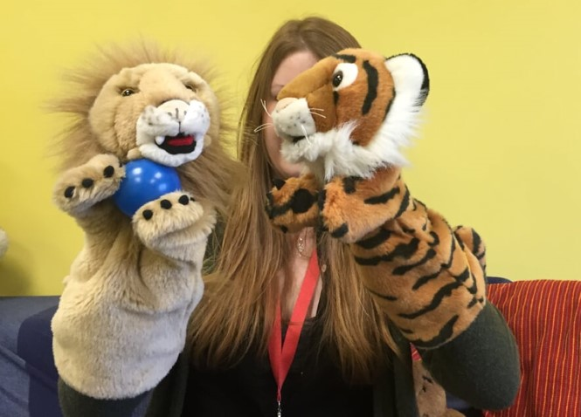

Experimental Tasks:
Measuring Children’s Social Decision-Making at Age 7
What do you do if a peer wants
to take your toy?
What do you do if unfamiliar
children taunt you?
Watch full play-through (13:22): https://youtu.be/SpixvsHypg8
Notes:
At 7 years, we used a battery of tasks to assess children social, cognitive, and emotional development. Among these we included social decision-making tasks, including The Puppet Task (Hay, Zahn-Waxler, Cummings, & Iannotti, 1992) and The Castell Arth Mawr Adventure Game (CAMGAME; Hay, Johansen, et al.). We designed the Castell Arth Mawr Adventure Game (CAMGAME) to study children’s choices in an unfamiliar situation where they met unfamiliar peers (see Chapter 6).

Slide 12
Standardized Assessments of Children’s Clinically Significant Behavioral Problems
The Child Behavior Checklist (CBCL; Achenbach & Rescorla, 2000)
The Teacher Report Form (TRF; Achenbach & Rescorla, 2000)
Callous-Unemotional Traits (Frick et al., 2014)
Preschool Age Psychiatric Assessment (PAPA; Egger & Angold, 2004)
Notes:
At age 7, we also used standardized assessments of children’s clinically significant behavioral problems.

Slide 13
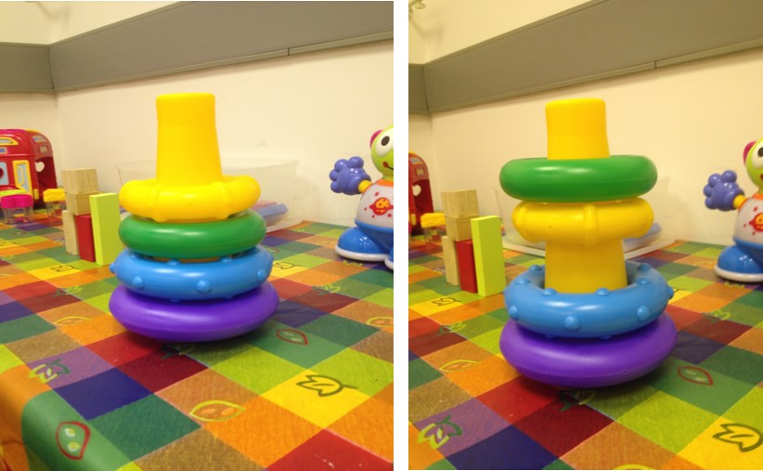
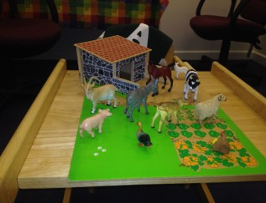
Correlates of Aggression:
Measures of Inhibitory Control at 2.5 Years
Tower of Cardiff Task
Whisper Task
These tasks were used to see whether children with self-control would be less likely to use aggression against their peers.
Notes:
In addition to informant reports, observation, and experimental tasks to tap aggression and prosocial behavior, we also administered developmentally appropriate tasks to measure correlates of aggression. For example, at the 2.5-3 year visit to the laboratory, children completed inhibitory control tasks (including the Tower of Cardiff Task and The Whisper Task). These tasks were used to see whether children with self-control would be less likely to use aggression against their peers (see Chapter 5).

Slide 14
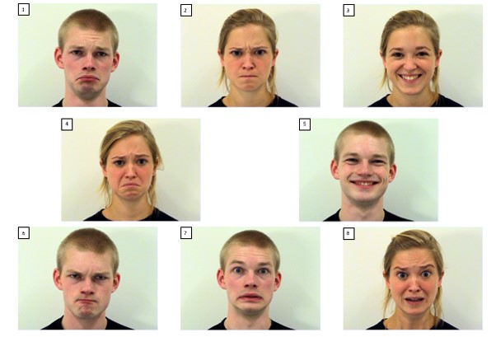
Correlates of Prosocial Behavior and Aggression at 7 Years:
Emotion Recognition and Perspective-Taking
Emotion | Vignette
1. Happy | Johnny/Susie wanted his/her friends to come over to play. So he/she asked them, and they came over to play with him/her.
2. Sad | Johnny's/Susie's friend, who he/she really liked to play with moved away.
3. Scared | Johnny/Susie was in his/her room at night. It was dark, and he/she saw a tree outside that looked like a person with his hand about to come in the window.
4. Cross | Johnny/Susie let his/her best friend use his/her new ball. His/her friend wasn't careful and lost the ball.
Notes:
At 7 years, we investigated children’s emotion recognition and perspective-taking as correlates of prosocial behavior and aggression (Denham, 1986; Lane et al., 2010; van der Schalk et al., 2011) (see Chapter 6).

Slide 15
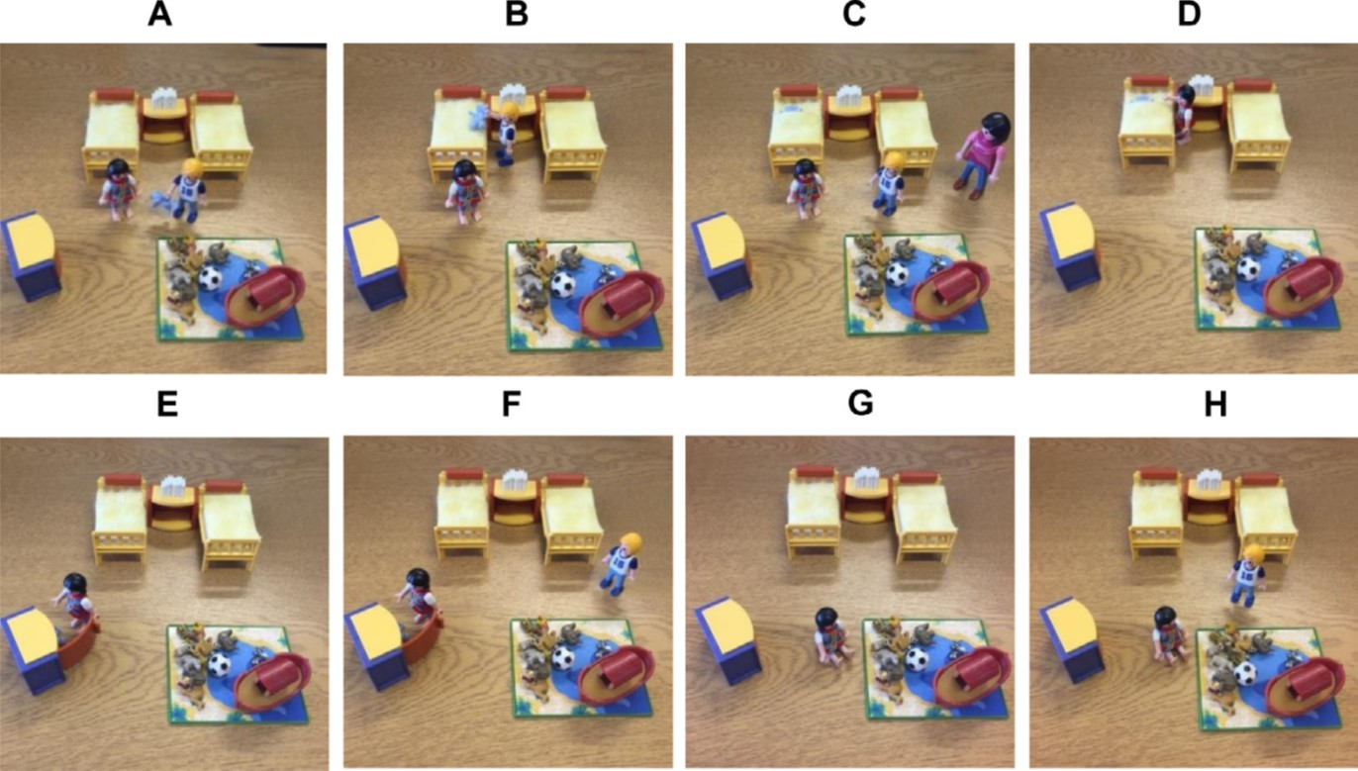
Correlates of Prosocial Behavior and Aggression:
Second-order False Belief
Notes:
We also investigated children’s advanced understanding of minds in relation to prosocial behavior and aggression using a second-order false belief task (Paine et al., 2018) adapted from Coull et al., 2006 and Perner & Wimmer, 1985. In this illustration of the story, the protagonist (Nick) shows his special teddy to the child (A) and tucks the teddy inside the bed (B). The mother comes into the room and asks Nick to brush his teeth, and they leave the room (C). In Nick’s absence, the sibling removes the teddy from the duvet (D) and hides the teddy in the cupboard (E). Unbeknownst to Alex, Nick returns and watches Alex hiding the teddy (F) before leaving the room again (G). When Nick comes back into the room, he says, ‘‘I want my teddy.” (H). See Chapter 6.

Slide 16
Corresponding author
Dale Hay
haydf@cardiff.ac.uk
Editorial inquiries
Lynn S. Liben
liben@psu.edu
Citation
Hay, D. F., Paine, A. L., Perra, O., Cook, K. V., Hashmi, S., Robinson, C.,
Kairis, V., & Slade, R. (2021). Prosocial and aggressive behavior:
A longitudinal study. Monographs of the Society for Research in
Child Development, 86(2). https://doi.org/10.1111/mono.12427

