Slide 1

This PowerPoint is a companion teaching and research resource of issue 86(1) of the Monographs of the Society for Research in Child Development.
For this issue, visit
https://doi.org/10.1111/mono.12425
For videos, commentaries, and
teaching materials, visit
monographmatters.srcd.org

Slide 2
Practices that Improve the
Quality of Early Childhood Classrooms
Dale C. Farran & Kimberly T. Nesbitt
Adapted in part from materials developed by Alana Tunstel

Slide 3
Topics
Terminology and Research Design
Positive Classroom Climate
Teachers’ Quality of Instruction
Associative and Cooperative Interactions among Children
Children’s Engagement

Slide 4
I. Terminology and Research Design

Slide 5
Terminology
The terms “High Quality” are routinely used in all legislation funding prekindergarten programs
Prekindergarten programs should improve both short- and long-term child outcomes
Advocates often talk about only supporting “high quality” programs
The definition of high quality, however, is vague
Most definitions use structural features that are easy to regulate
  Group size
  Teacher child ratio
  Licensed teacher
Recently many have proposed the use of a highly scripted, intentional, and academically focused curriculum to improve quality and outcomes for children

Slide 6
Tools of the Mind Prekindergarten Curriculum
Highly scripted
  63 activities to use during the academic year
  Each activity has between 5 and 13 steps
  Implementation steps change across the year
Intentional
  Focus on development of self-regulation and executive function skills
  These skills help children learn literacy, math, science and social studies
Requires teacher training and support

Slide 7
Randomized Controlled Trial Evaluation of Tools
The Monograph reports evaluation methods and results in detail
Quick summary
  No positive effects for implementing the curriculum at the end of prekindergarten year or into kindergarten and first grade
  Classroom practices curriculum developers thought would distinguish Tools were not different in classrooms with and without the curriculum
  Those classroom practices were predictive of children’s gains
  Classroom interactions predicted gains in this and other studies independent of curriculum used

Slide 8
Behavioral Counts: Alternative to Ratings
Data in Tools and comparison classrooms collected using:
  Day-long observations conducted three times across the school year
  Snap-shot approach
  Each child, teacher, and assistant observed 20-24 times across the day
Child Observation in Preschool (COP) & Teacher Observation in Preschool (TOP)
  Matrix system in which codes are independent and can be combined for analyses
  Child behaviors focus on social interactions and engagement, teacher behaviors focus on climate and instructional quality (full list of behaviors provided in Monograph)

Slide 9
II. Positive Classroom Climate

Slide 10
Why Classroom Emotional Climate Matters
Children who are emotionally supported in their classrooms will
Feel valued and safe
Be more highly engaged in learning activities
Take academic risks
Interact more with teachers and peers

Slide 11
Positive classrooms have responsive teachers who manage behavior and attention challenges, as well as social and emotional needs for individual children.
Key aspects of responsive teaching include:
Using behavior-approving language more frequently than redirecting
Using praise focused on specific behaviors and/or emphasizing effort
Maintaining a pleasant affect and tone in interactions with children
Notes:
A person's affect is the expression of emotion or feelings displayed to others through facial expressions, hand gestures, voice tone, and other emotional signs such as laughter or tears

Slide 12
Disapproving Behaviors and Redirections
The intent is to change the child’s behavior. They say to the child: “I want you to do something different from what you are doing.”
The goal is not to eliminate redirections, but for children to receive comparatively more positive, affirming messages about their behaviors.
Examples
  Disapproving facial expressions, verbal comments, tone of voice, physical contact
  Statements do not have to be negative in tone to be a disapproving
“Remember, keep your hands to yourself, Suzy.”
“Are you making a good choice, DeShawn?”
“I said stay in your space, Jonathan.”
Notes:
Non-verbal Examples of Behavior Redirection:
Grimacing, frowning, side-to-side head-shaking, gesturing
Verbal Examples of Behavior Redirection (most often directed to and singling out one child):
“Criss-cross applesauce, Jonathan.”
“Put a bubble in it, Janie.”

Slide 13
Setting Expectations
Initial instructions are not disapprovals or redirections. Disapprovals and redirections are reactive to behavior that has already occurred.
Setting expectations up front can limit redirections. For example:
  “When we all walk down the hall, we are using safe bodies. Who can tell me another way we can have safe bodies?”
  “We have center cards that show you how many friends can be in each center. Use the center cards to help you make your center choice.”

Slide 14
Threats, Sarcasm, Derogatory Comments
Threats and sarcasm are inappropriate forms of redirection. These are disrespectful and potentially damaging to children.
“You must not want to go to the playground today, Keisha!”
“If you’re not bleeding or on fire, then I don’t want to hear from you.”
“I just love repeating myself.”
Eye Rolling
Derogatory comments made to other adults within earshot of children
“She’s crying because her mom babies her too much.”
“Well you know he isn’t getting a positive example at home.”
Notes:
All of these comments have been heard and recorded verbatim in prekindergarten classrooms – with licensed teachers.

Slide 15
Indicators Of Teacher Affect/Emotional Tone
POSITIVE | Vibrant | Strong positive interaction – genuine excitement for teaching
 | Pleasant | Shows positive interest – smiling, eye contact, eyebrows raised, leaning forward
 | Neutral | Shows no facial expression – neutral affect, “resting face”
NEGATIVE | Negative | Negative affect — frowning, headshaking, negative gestures, eye rolling, sighing; may use mild threats
 | Extreme Negative | Strongly negative affect – sarcasm, yelling, insults; physically dragging/pulling child
Most of the time teachers display a flat/neutral affect
Vibrant excitement almost never observed
Children in classrooms where teachers have more positive affect make more gains academically and in self regulation

Slide 16
Discussion Questions
What strategies can teachers use to create a more positive climate in their classrooms?
What supports do teachers need to maintain a positive classroom climate?

Slide 17
III. Teachers’ Quality of Instruction
Notes:
All data collection considerations should align with the theory of change.

Slide 18
Quality of Instruction
Most questions in pre-k classrooms are known-answer, right-wrong types focused on concrete learning not discovery.
Didactic instruction leads to immediate gains in “fragile” skills that then are learned by everyone almost immediately in kindergarten.
Open-ended (inferential) questions happen seldom in prekindergarten classrooms.
Inferential learning requires a different instructional approach than whole group, the most common type of instruction observed in prekindergarten classrooms.

Slide 19
Example Pre-K Classroom Board

Slide 20
Quality of Instruction in Pre-K Classrooms
Breakdown of Instruction in Pre-K Classrooms
21%
71%
8%
Low Level
Basic Skills
Inferential
LOW LEVEL INSTRUCTION | BASIC SKILLS INSTRUCTION | INFERENTIAL INSTRUCTION
Typical of ECE | Requires children to…
Teacher and child engaged with same material | Give the right answer (e.g., recite facts, identify objects) | Draw from experiences, background knowledge, context clues
Teacher role primarily to assist | Sit quietly and take in new information (e.g., listen to a story) | Actively construct links between experiences and ideas, past/present content

Slide 21
Unpacking Quality Of Instruction
Most instruction observed in prekindergarten is at a “Basic Skills” level.
Low Level Instruction
Assisting with developmental demands of fine and gross motor activities
Helping spread glue or hold scissors
Singing along to a song without a clear academic focus
Basic Skills Instruction
Asking questions with predetermined answers, with the goal of having children learn or recite the correct response
What sound does “g” make?
Do we have more boys or girls here today?
Reciting alphabet, counting to 10
Inferential Instruction
Exploring a topic using authentic, open-ended questioning with several turns
What do you think is going to happen next?
Why do you think that?
Talking about glue’s “stickiness” and what else might be sticky.

Slide 22
Moving Beyond Basic Skills
The key is to help children make inferences. Inferential questions are open-ended, have more than one possible answer, and require abstract thought.*
How do you know...?
Why do you think...?
What makes you say…?
TRY ASKING CHILDREN TO…
Explain
their thought process to a teacher or peer
Predict
based on context clues or prior knowledge
What would happen if…?
How could we…?
Tell your friend about a time when you…
Connect
content with personal experiences
Reflect
on parts of previous activities or lessons
What do you remember about …?
What was your favorite part of…?
*Teachers must listen to the answers and build on them
Notes:
While some Basic Skill instruction is necessary in preschool, research shows that young minds also thrive when they have opportunities to think more deeply. The key to moving beyond basic skill instruction is to help children make inferences.

Slide 23
Discussion Questions
What do you think causes teachers to focus so strongly on basic skills? How easy will it be for them to change?
What supports within a curriculum would help achieve a higher quality of instruction?

Slide 24
IV. Associative and Cooperative Interactions Among Children
Notes:
Data analysis should correspond to the methodology employed in the study.

Slide 25
Types Of Social Learning Interactions
Cooperative
Shared goal with clear roles and structure
Parten’s Types of Play describe the social parameters of a child’s learning experience.
Interactions are determined by:
Individual preference (favorite friends)
Developmental competence (socioemotional and language skills)
Opportunities provided (adults allowing/ encouraging discussion and partner work)
Associative
Using shared materials to co-construct an idea or experience
Unoccupied
Not attending to any activity
Types of Play
Parallel
Playing near other children with similar materials
Solitary
Playing alone with unique materials
Onlooker
Observing other activities without participating
Associative and Cooperative interactions require higher levels of engagement with peers.

Slide 26
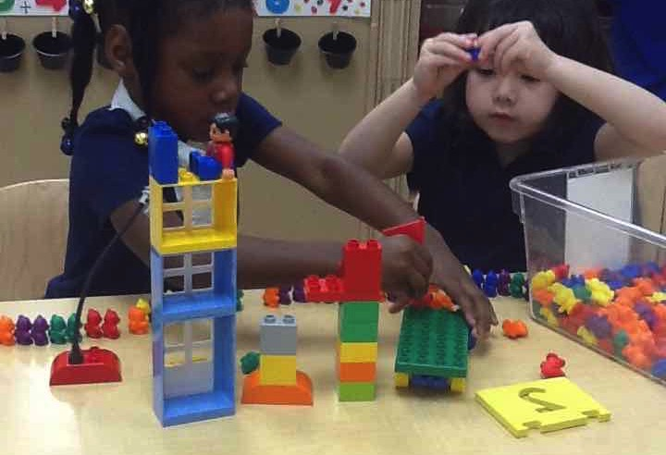
Associative Learning Interactions
Shared materials
Communicate about task with peers
Co-construct a product or idea
Generally open-ended with no clear goal
Interaction would change if a child walked away
EXAMPLES:
Completing a puzzle together
Sharing a book
Helping with a task (e.g., cleaning up)
Conversation/Brainstorming
Associative interactions allow children to learn from each other.

Slide 27
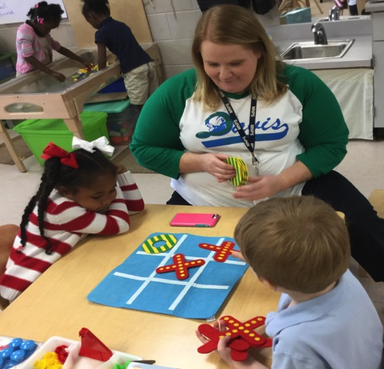
Cooperative Learning Interactions
Work together with shared goal and formal organization (i.e., rules, turn-taking)
Games with rules (for 4-5 year olds, requires adult assistance)
Academic tasks with clear goal (e.g., spelling, counting tasks)
High-level dramatic play
  Recognizable scenario
  Appropriate role speech
  Interactions that follow a script
  Acting out a favorite book
Cooperative interactions help children learn turn taking, winning and losing, and inhibitory control.
Notes:
Cooperative Learning in the Parten sense is not the same as “cooperation.” Children may cooperate with each other and share, such as sharing a cookie together but that is different from formal cooperative learning.

Slide 28
Supporting Associative & Cooperative Interactions
Join in on the fun!
Participate in the first few rounds of a formal game to make sure everyone understands the rules (remember, children have to learn turn taking!)
Gracefully enter and exit children’s play
Use language facilitation strategies to help children understand each other
Help children who have a hard time engaging with others feel included
Tyler, try saying: Can I play with you?
Oops! It’s not my turn…that means I keep my hands to myself and send good luck vibes to Charlie!
I’ll bet you can build a wonderful tower. You can plan it together!

Slide 29
Supporting Associative & Cooperative Interactions
Set up spaces and activities to encourage interactions among children
Balance the number of children in each center
Fewer centers encourage playing together
Praise partner work and discussion
Limit similar materials and encourage sharing
Suggest different roles for contributing to an activity
We need a lot of people to run our pizzeria today!
Turn to your shoulder partner and tell them your favorite part of Henny Penny.
It looks like we only have one geo- board today. You can work together to make interesting shapes.
For this activity, we need a Counter, a Checker, and a Recorder.

Slide 30
Discussion Questions
In which areas of the classroom are children more likely to interact?
How can you arrange the classroom environment to encourage more interactions among children?

Slide 31
V. Children’s Level of Engagement

Slide 32
Increasing Children’s Engagement In Learning
High levels of Engagement
Creating a positive climate
Reducing time in transitions
Improving quality of instruction
Increasing teacher listening to children
Planning sequential activities
Promoting associative and cooperative interactions
Providing opportunities for math
Engagement in learning refers to children’s level of…
…related to a learning task.
Attention
Curiosity
Interest
Motivation
Optimism
Passion

Slide 33
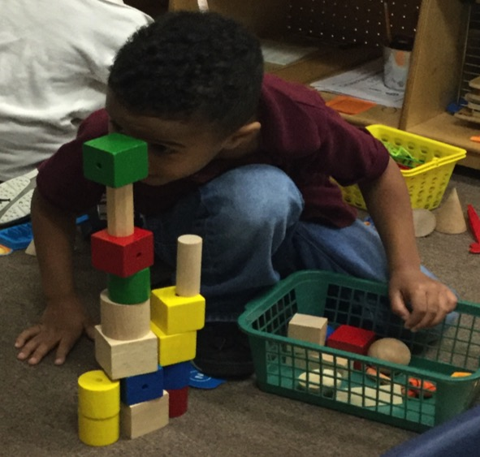
Benefits Of High Engagement In Learning
Children who are highly engaged in learning activities:
Have more opportunities to deepen their learning
Are more likely to remember what’s learned
Have better self-regulation
Are less likely to engage in off-task or disruptive behaviors
Being deeply engaged in preschool fosters a love of learning and discovery that will serve children for years to come.

Slide 34
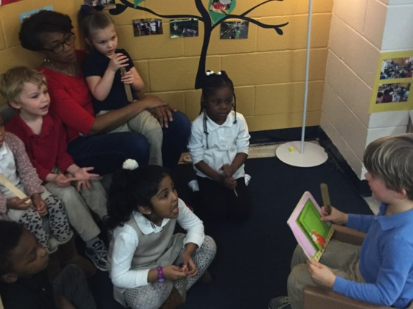
Teacher Support For Higher Levels Of Engagement
Rotate materials throughout the year
Incorporate new and unusual materials
Vary the centers/interest areas
Allow children to lead parts of the day
Follow children’s unique interests
Consider children’s academic and social skills when setting up learning interactions
Remain flexible when the unexpected happens
…and, most important
Enjoy themselves! Enthusiasm (or lack thereof) is contagious

Slide 35
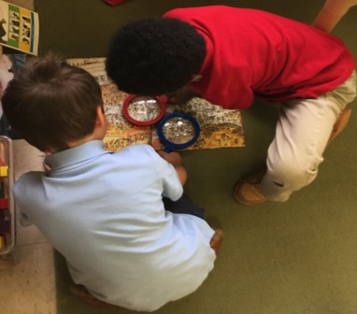
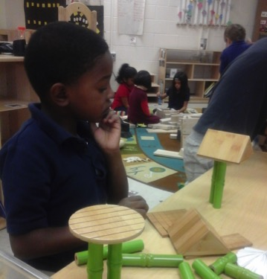
Activities & Spaces Promoting Higher Engagement
Activities that lead to higher levels of engagement…
Allow children to pursue their interests
Encourage associative interactions with other children and/or adults
Occur in a smaller-group format
Are self-correcting in nature so children can learn independently without having to ask for help

Slide 36
Discussion Questions
How can you distinguish between children being quiet/compliant, versus actively excited and engaged?
Think of some activities or settings where students are most likely to be engaged? Do these activities or settings have elements in common?

Slide 37
Special Thanks & Additional Resources
We are grateful to the following Metro Nashville Public Schools Pre-K Instructional Coaches and Multi-Classroom Leaders for their invaluable feedback in developing these and other materials (2017-18 PD Activities (MNPS PDG-E funds) awarded to D.C. Farran).
Special thanks to:
SeTara DeThrow
Carrie Head
Susan McClain
Stephanie Mullins
Holly Stone
Ashley Aldridge Wilson
Rhiannon Wilson
For information and handouts on all the classroom practices described in the monograph visit:
https://my.vanderbilt.edu/mnpspartnership/

Slide 38
References for Further Reading
Coelho, V., Aström, F., Nesbitt, K., Sjöman, M., Farran, D., Björck-Äkesson, E., Christopher, C., Granlund, M., Almqvist, L., Grande, C., & Pinto, A. (2021). Preschool practices in Sweden, Portugal, and the United States. Early Childhood Research Quarterly, 55, 79-96. https://doi.org/10.1016/j.ecresq.2020.11.004
Christopher, C. & Farran, D.C. (2020). Academic gains in kindergarten related to eight classroom practices. Early Childhood Research Quarterly, 53. 638-649. https://doi.org/10.1016/j.ecresq.2020.07.001
Farran, D.C., Meador, D., Christopher, C., Nesbitt, K. & Bilbrey, L. (2017). Data-driven improvement in prekindergarten classrooms: Report from a partnership in an urban district. Child Development, 88, 1466-1479. http://doi.org/10.1111/cdev.12906
Nesbitt, K., Farran, D., & Fuhs, M. (2015). Executive function skills and academic achievement gains in prekindergarten: Contributions of learning-related behaviors. Developmental Psychology, 51, 865-878. http://doi.org/10.1037/dev0000021
Parten, M.B. (1932). Social participation among pre-school children. The Journal of Abnormal and Social Psychology, 27, 243-269. https://doi.org/10.1037/h0074524

Slide 39

Corresponding Author
Kimberly Nesbitt, Ph.D.
Kimberly.Nesbitt@unh.edu
For this issue, visit
https://doi.org/10.1111/mono.12425
For videos, commentaries, and
teaching materials, visit
monographmatters.srcd.org

