Slide 1
Youth in Northern Ireland: Linking Violence Exposure, Emotional Insecurity, and the Political Macrosystem

Slide 2
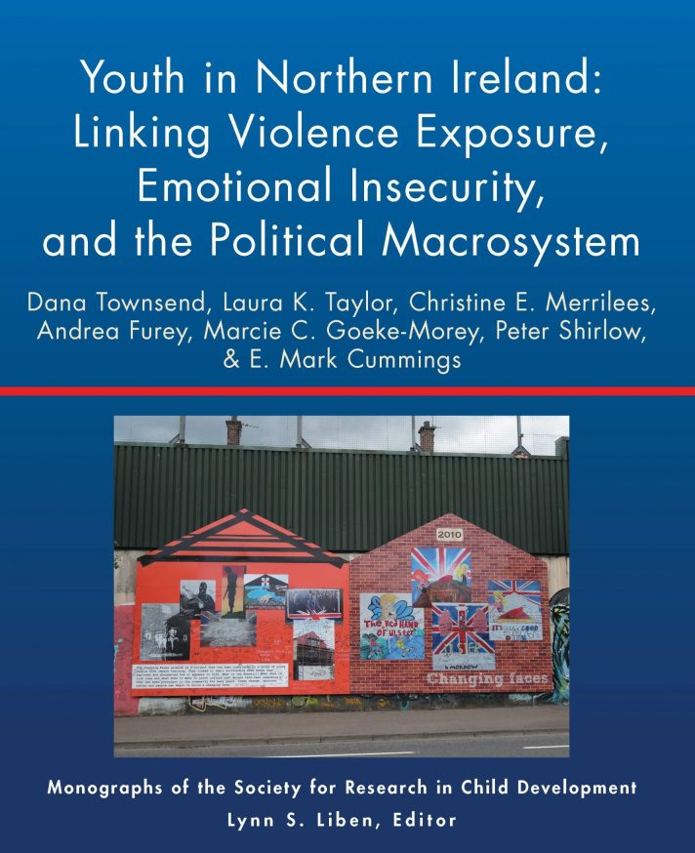
Videos, commentaries, teaching materials and more are available at monographmatters.srcd.org
Townsend, D., Taylor, L. K., Merrilees, C. E., Furey, A., Goeke-Morey, M. C., Shirlow, P., & Cummings, E. M. (2020). Youth in Northern Ireland: Linking violence exposure, emotional insecurity, and the political macrosystem. Monographs of the Society for Research in Child Development, 85(4). https://doi.org/10.1111/mono.12423

Slide 3

Introduction
Long history of strife between Catholics and Protestants
Conflict between Catholics and British for hundreds of years
Division of Ireland into two states in 1920’s
Beginning of “The Troubles” in 1960’s
Good Friday Agreement 1998
Northern Ireland
Ireland
United Kingdom

Slide 4
Introduction
Violence continued in post-accord period:
Omagh bombing in 1998
Crime with suspected sectarian motives
Activity from dissident paramilitary groups
Rioting and protests during the marching season
Northern Ireland
Ireland
United Kingdom

Slide 5
Introduction
Exposure to political violence repeatedly linked with youth adjustment problems in Northern Ireland and elsewhere
Prior research suggests that emotional insecurity explains this link
Maintaining a sense of protection, safety, and security is a central goal for children
Exposure to threats can activate regulatory systems and lead to insecurity
Prolonged insecurity can overtax these systems and lead to maladjustment
Does a tense or threatening political climate exacerbate this effect?

Slide 6
Introduction
Bronfenbrenner & Morris, 1998
Time, Life transitions, Generation effects
Macrosystem
Chronosystem
Norms, Ideology, Political Climate,
Societal Narratives
Exosystem
Local Government, School Board,
Parent’s Workplace
Microsystem
Few psychological studies incorporate factors beyond the microsystem
Family, Peers, School
Individual

Slide 7
Method
Macrosystem Data:
2 local newspapers: Belfast Telegraph, The Irish News
Selected keywords to identify all articles related to the conflict, 2006 -2011
Selected 2 articles from each newspaper per day (N = 6,082)
4 local coders rated each article. To what degree does it reflect:
  Political tension between Catholics and Protestants
  Threat or detrimental impact to Catholics
  Threat or detrimental impact to Protestants
Each scored using a Likert scale: 0 = “not at all” to 4 = “very much”

Slide 8
Method
Microsystem Data
5 waves of survey data with mothers and their adolescent children (N = 999)
Surveys took place during the same time period (2006 -2011)
61% Protestant, 38% Catholic; mean age 12.18 years old at Time 1
Working class, socially deprived neighborhoods
35-40 families selected per neighborhood
Youth self-report measures of exposure to sectarian violence
Mother self-report measures of their children’s emotional insecurity

Slide 9
Method
Political Tension / Threat
Exposure to Sectarian Violence
Emotional Insecurity in the Community
Average Exposure to
Sectarian Violence
Political Tension / Threat
Emotional Insecurity in the Community

Slide 10
Results: All Adolescents
For adolescents in general:
Association between political tension in the macrosystem and emotional insecurity is negative for adolescents with higher-than-average exposure to violence
Less impact on adolescents with little to no exposure to violence
Newspaper Data

Slide 11
Results: Catholics Only
Association between sectarian violence exposure and emotional insecurity was weaker during periods of high threat in the macrosystem
Newspaper Data
Newspaper Data

Slide 12
Results: Catholics Only
Association between macro-level threat and emotional insecurity is positive for those with no violence exposure and negative for those with higher-than-average violence exposure
Newspaper Data
Newspaper Data

Slide 13
Summary of Key Findings
For adolescents with higher-than-average exposure to violence:
As macro-level political tension increased, emotional insecurity decreased
For Catholics in general:
Impact of violence exposure on emotional insecurity weaker during periods of high threat
For Catholics with higher-than-average exposure to violence
As macro-level threat increased, emotional insecurity decreased
For Catholics with little to no exposure to violence
As macro-level threat increased, emotional insecurity increased

Slide 14
Discussion
Qualitative examination of news reports shows:
High levels of youth recreational participation in protests, rioting, and mobs
May explain why adolescents were more secure during periods of high tension
Events coded as highly threatening corresponded with dissident republican activity (i.e., activity from hardline Catholic groups)
May explain why some Catholics were more secure during periods of high threat
More research is needed to understand the processes through which macrosystem factors (like the political climate) interact with proximal processes

Slide 15







Authors of the Monograph
Dana Townsend, Ph.D.
Laura K. Taylor, Ph.D.
Christine E. Merrilees, Ph.D.
Andrea Furey, Ph.D.
Marcie Goeke-Morey, Ph.D.
Peter Shirlow, FAcSS
E. Mark Cummings, Ph.D.

Slide 16
Acknowledgements
This research was supported by the Eunice Kennedy Shriver National Institute of Child Health and Human Development (NICHD grant 046933 to E. Mark Cummings) and the Office of the First Minister and Deputy First Minister in Northern Ireland (OFMDFM grant 2110018224).
The authors would like to express their immense gratitude to all the families in Belfast who participated in this study, the students at Ulster University who painstakingly coded each news report, and the students at Notre Dame who helped with data entry.

Slide 17
Videos, commentaries, teaching materials and more are available at monographmatters.srcd.org
Townsend, D., Taylor, L. K., Merrilees, C. E., Furey, A., Goeke-Morey, M. C., Shirlow, P., & Cummings, E. M. (2020). Youth in Northern Ireland: Linking violence exposure, emotional insecurity, and the political macrosystem. Monographs of the Society for Research in Child Development, 85(4). https://doi.org/10.1111/mono.12423

