Slide 1




Key Findings from
Pathways to Civic Engagement among Urban Youth of Color

Slide 2

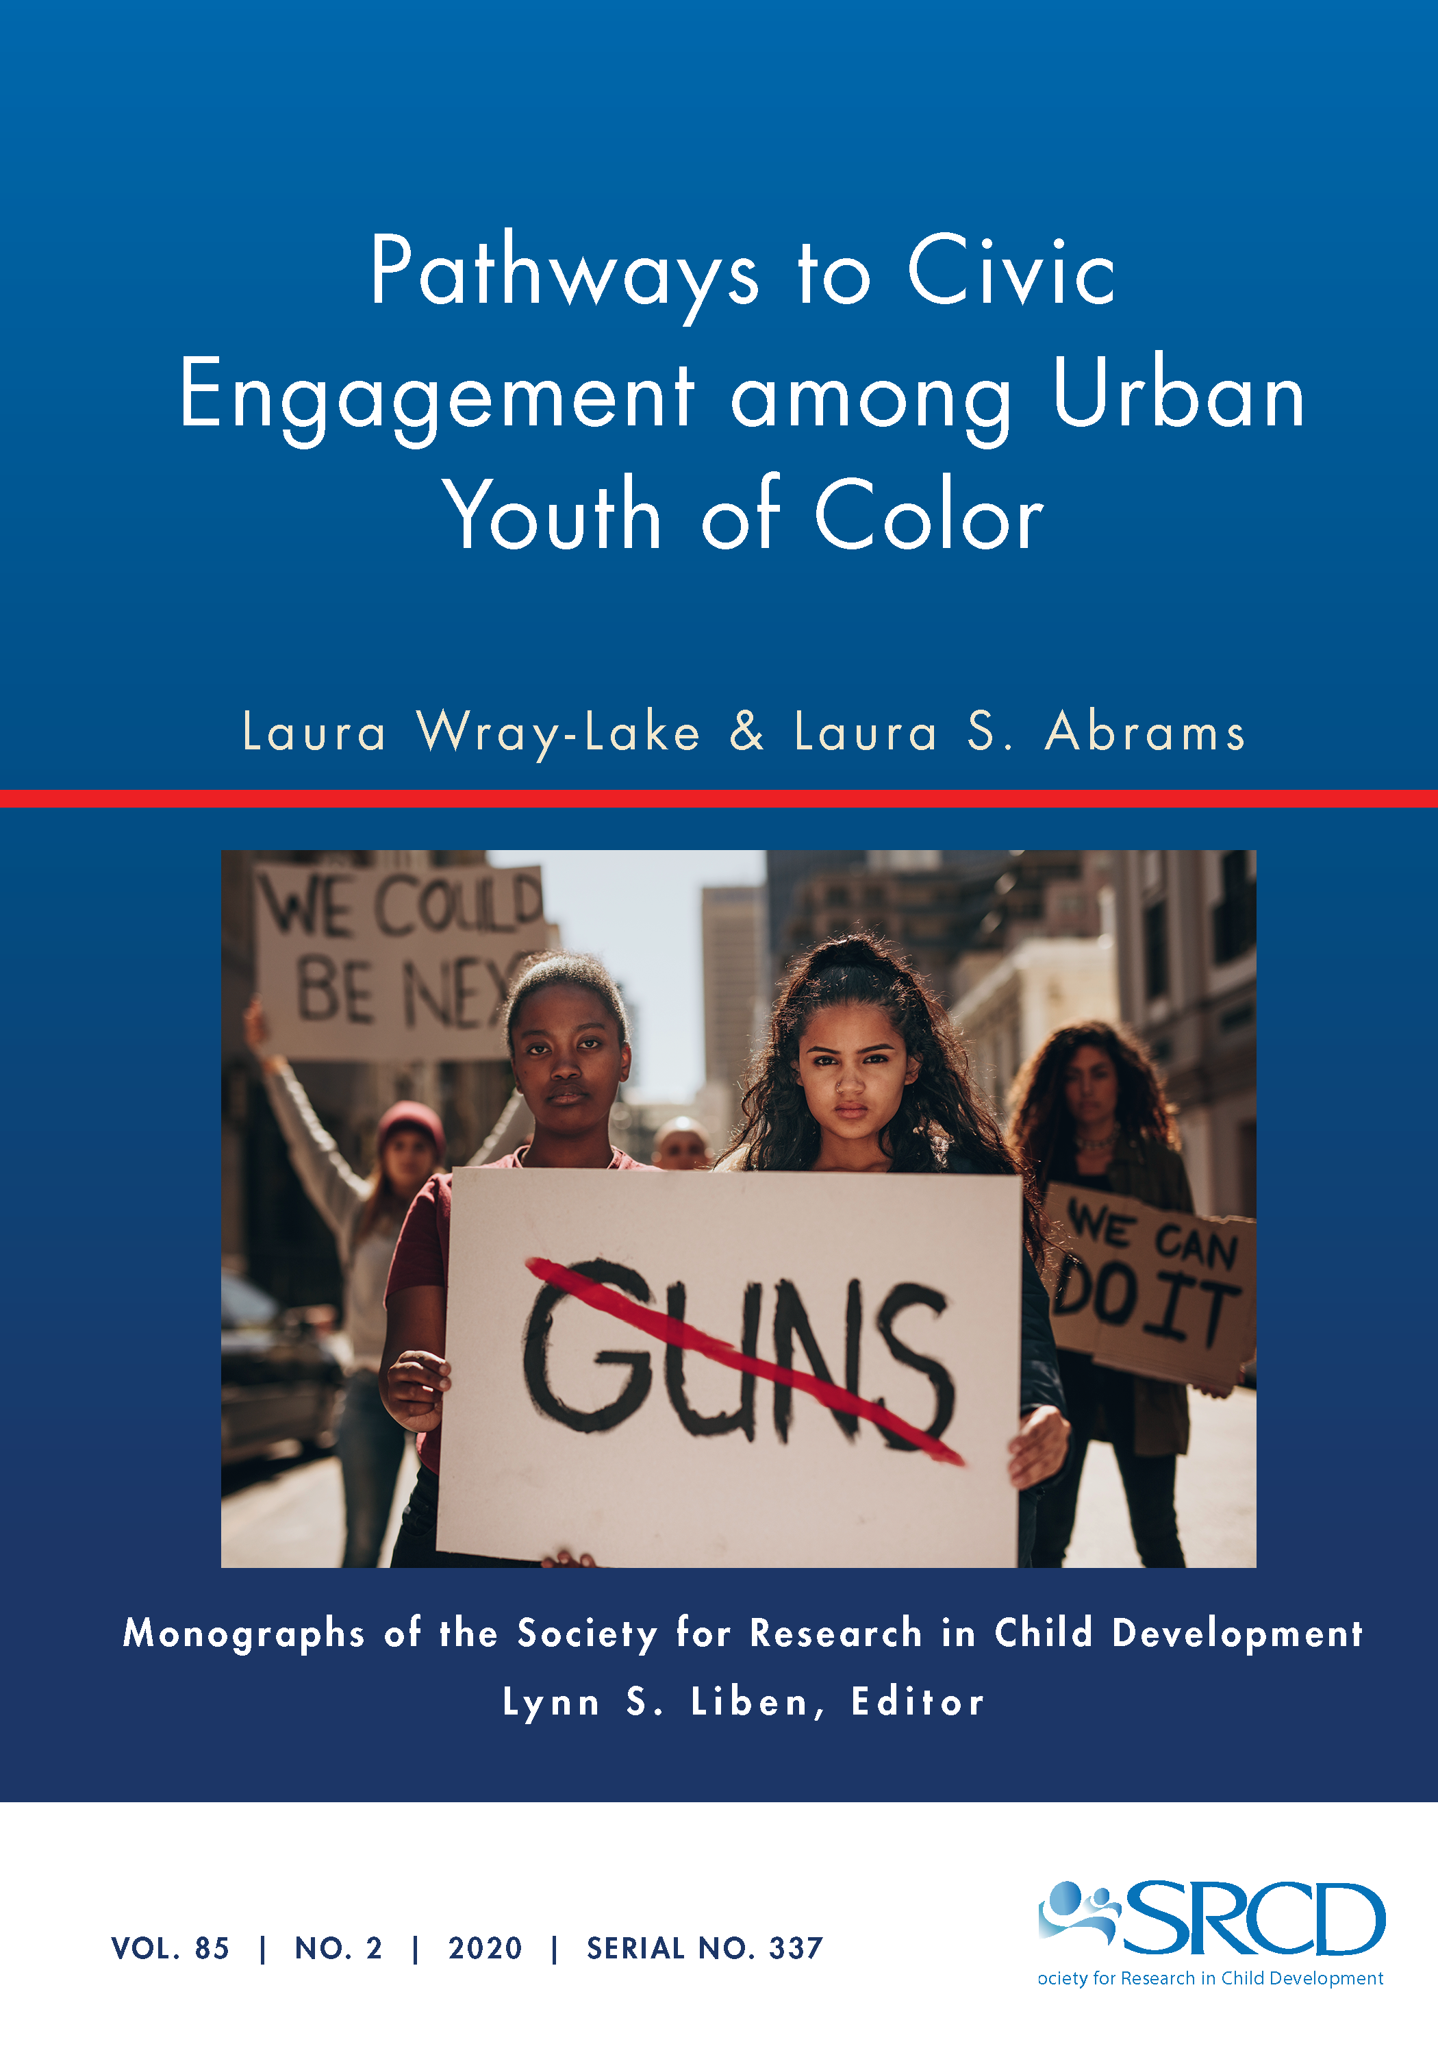
Videos, commentaries, teaching materials and more
are available at monographmatters.srcd.org
Wray-Lake, L. & Abrams, L. S. (2020). Pathways to civic engagement among urban youth of color. Monographs of the Society for Research in Child Development, 85(2). doi.org/10.1111/mono.12415

Slide 3
Key definitions
Civic Engagement: Multiple dimensions of commitments and contributions to community and society.
Civic Participation: Behavioral or action dimension of civic engagement.
Civic Empowerment: Psychological dimension of civic engagement, defined as feelings of mastery in addressing social, political, or community problems.
Civic Development: Growth, loss, or stability in civic engagement; how dimensions of civic engagement interrelate; how one or more dimension of civic engagement links to internal or ecological factors.
Created by Laura Wray-Lake & Laura S. Abrams. All rights reserved.

Slide 4
Study rationale
Youth civic engagement is often defined and measured in ways that may not fit urban youth of color’s experiences of civic engagement.
Positive Youth Development (PYD) theory posits that civic engagement arises from internal and ecological assets, but may need to be revised and infused with other perspectives to be relevant to urban youth of color’s experiences and relevant contextual factors.
We know little about the role of adversities for civic development among youth of color or how adversities and assets work together to shape youth civic development.
Created by Laura Wray-Lake & Laura S. Abrams. All rights reserved.
Notes:
TALKING POINTS:
Most of the research on youth civic engagement has come from mostly middle-class White samples. And typically the dimensions of civic engagement – i.e., what constitutes civic engagement – is defined by researchers. Thus, we do not know whether our definitions and measures of civic engagement are appropriate or whether they fully capture the experiences of urban youth of color. We may be underestimating the civic engagement of urban youth of color. Often urban youth of color are stereotyped as being unengaged in civic life. Taking an inductive qualitative approach can shed light on what civic engagement means to urban youth of color and how they experience civic engagement.
PYD theory is a widely used perspective and presents a model of how youth become civically engaged (see Lerner et al., 2014, page 73 for a depiction of this model). However, again the model was derived from and tested with samples of mostly White youth. Scholars have begun to argue that the internal and ecological assets of PYD may be specific to particular cultural groups and community contexts. Examining urban youth of color’s experiences of civic engagement may highlight unique ecological or internal assets that lead to more contextually relevant models of PYD.
Research does not often consider the role of adversities in the development of youth civic engagement. Whereas some research has examined experiences of discrimination in relation to civic engagement, many other adversities could serve as obstacles to civic engagement such as poverty or community violence. Some of the research on discrimination suggests that adversities can deter civic engagement for many but motivate some youth to become engaged. Additionally, adversities may interact with or shape assets in important ways that are not yet known, but that could help us better understand civic development.

Slide 5
Main research questions
How do youth of color in high-poverty urban neighborhoods experience community violence, and what are the implications of these experiences for civic engagement?
How do youth of color in high-poverty urban neighborhoods define and experience civic engagement?
How do youth experience civic empowerment and what is the role of civic empowerment in urban youth of color’s civic action?
What ecological assets do youth identify that support civic development and what role do adults play in shaping youth’s experiences of civic engagement?
How do assets and adversities shape pathways to civic engagement for urban youth of color?
Created by Laura Wray-Lake & Laura S. Abrams. All rights reserved.

Slide 6


Sample Demographics
87 youth recruited from 5 youth centers
Ages 12-19 (mode = 15)
Mostly Black (61%) and Black multiracial (27%)
60% male
24% of parents completed high school
36% of parents had some college or more
Created by Laura Wray-Lake & Laura S. Abrams. All rights reserved.
Notes:
See Monograph Table 1 for more information.
See Chapter 2 for more detail on recruitment and sampling.

Slide 7
Interview content
Youth’s definitions of community and community engagement.
Discussions of community problems and solutions.
Experiences of community connections and disconnections.
Experiences of community engagement and disengagement.
Experiences of connection to / engagement in broader society.
Views of politics and government.
Views of police shootings and Black Lives Matter.
Experiences and views on adult supports.
Created by Laura Wray-Lake & Laura S. Abrams. All rights reserved.
Notes:
The interviews were semi-structured and typically asked 10 main questions in the same order. Follow up questions varied based on youth’s particular experience. See Monograph Table 2 for a full list of the main interview questions.
We used the term community engagement instead of civic engagement, because the latter term is not well understood by the general public. We asked other questions to get at interest and participation in politics to capture a range of ways that young people may be civically engaged.

Slide 8
Analysis steps
Step 1: Transcribed interviews
Step 2: Created codes through inductive, multi-phase, consensus building process
Step 3: Engaged in focused coding
Step 4: Analyzed themes within and across codes by memo-writing; took multiple iterations
Step 5: Analyzed individual cases to test conceptual model
Created by Laura Wray-Lake & Laura S. Abrams. All rights reserved.
Notes:
See Chapter 2 for more detail about the steps of the analysis process.

Slide 9
Chapter 3 Results: Community violence is a prevalent adversity that contextualized civic development for our sample.
You see it everywhere. You could ride down the street,
you would see somebody arguing. You go down another
street, see somebody fighting.
Justin, a 17-year old Black and Asian youth
Created by Laura Wray-Lake & Laura S. Abrams. All rights reserved.
Notes:
TALKING POINTS:
Youth experienced violence as pervasive and frequent, and youth or close family members were targeted by violence. Others experienced violence more indirectly, hearing about events in the neighborhood, on the news, or via social media.
Youth identified several root causes of violence in Rochester, such as gang disputes, access to guns, drugs, and experiences of poverty. Youth also noted that police can be racist, violent, and not trustworthy.

Slide 10
Chapter 3 Results: Youth displayed three patterns of adaptation to community violence: (1) Feeling disempowered; (2) Restricting movement and connection; and (3) Responding through civic action.
I don’t like it. It’s too many killings. Too many violence and
stuff like that. I don’t…I wish it was different – everything.
Horrible…I can’t choose, I can’t do nothing about it. I’m still young.
(Emphasis added).
Salome, a 16-year old Latina youth
Created by Laura Wray-Lake & Laura S. Abrams. All rights reserved.
Notes:
TALKING POINTS:
For some youth, violence was so overwhelming and pervasive that they expressed a sense of feeling disempowered. This sense of feeling overwhelmed was directly tied to expressions of low efficacy to address community violence. Because violence appeared so ingrained in the context, it was difficult for youth to find avenues to address the issue. These youth felt people wouldn’t listen or they would put themselves at risk of violence by speaking out.
Violence also restricted youth’s movement in the community. For some youth to preserve their own safety, they had to actively monitor their geographical locations and choices of peers with which to associate. Youth who opted for self-protection also saw a need to disconnect from peers out of fear for their own safety.
A small subset of youth felt that in order to effectively respond to community violence, they ought to speak out and join forces with others. They responded by intervening in fights or engaging in direct protest or community action to speak out against violence.

Slide 11
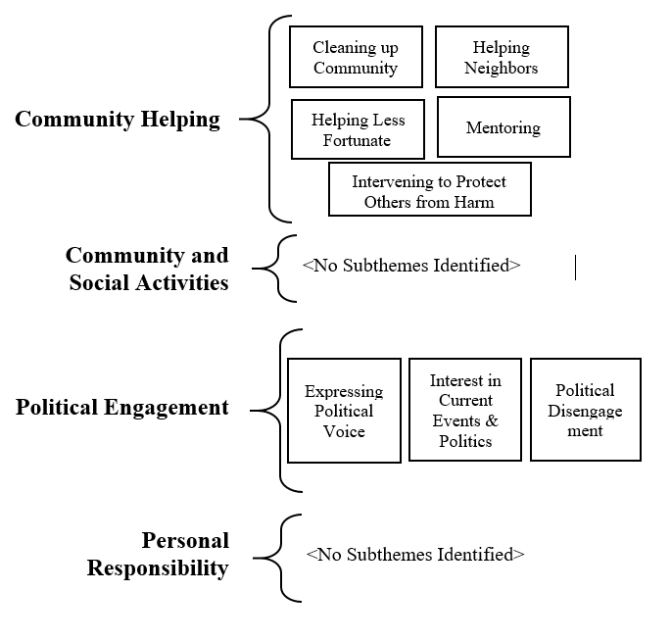
Chapter 4 Results: Youth described a range of civic engagement experiences and most centered on local, community helping.
Created by Laura Wray-Lake & Laura S. Abrams. All rights reserved.
Notes:
TALKING POINTS:
Community helping took diverse forms. Youth discussed informal helping more frequently and meaningfully than formal helping. Informal mentoring and intervening to protect others from harm were unique forms of community helping.
Community & social activities - Youth participated in church and community organizations, but varied in the meaning they derived from it. Informally, youth engaged in social and leisure activities designed to build community.
Youth expressed political voice and interest in current events, especially issues relevant to race, such as Black Lives Matter. A more common experience was political disengagement, arising from feelings that the government cannot be trusted.
Personal responsibility - Staying out of trouble, making good choices, and focusing on personal goals defined civic engagement for some. Personal responsibility was a way that youth acted as good community members.

Slide 12
Chapter 5 Results: Civic empowerment is a multidimensional asset that is essential for civic participation.
Emotional Empowerment
“And you always got a mouth to speak, cuz, why we got a mouth? Our opinions do matter. It can even change the world.” Kendra, 15-year old Black youth
Relational Empowerment
“Just cooperating. We all have to communicate and cooperate. If we don’t, what would we get? You know, I just feel like if everybody just came together and put their minds together about what the community should be and how it should be, I think the community would probably be much better place for kids to grow up and to come around.” Jamal, 17-year old Black youth
Cognitive Empowerment
Critical Social Analysis: “Try to understand where we came from. We came from slavery. You know? And then y’all bringing it back to slavery…” Kendra, 15-year old Black youth
Plans for Change: “Maybe I can start a group. Maybe? Two or three people and then it expands. And you can promote it on Facebook and Twitter.” David, 17-year old Black youth
Created by Laura Wray-Lake & Laura S. Abrams. All rights reserved.
Notes:
See Table 6 for codebook definitions for each type of empowerment.
TALKING POINTS:
Some youth also experienced disempowerment, expressing the belief that they could not make a difference in their community, had difficulty envisioning ways to make a difference, and felt like little could be done about social problems or injustices.
A common theme among youth who expressed disempowerment was individual attributions for community problems, such that some youth blamed community problems on individuals’ poor choices or lack of personal responsibility.
In examining overlaps between types of empowerment, The most cohesive theme pertained to the overlap between relational and cognitive empowerment. There is a natural link between working together to find solutions and cognitively empowered visions for social action.
Emotional empowerment had the most robust connection to civic behaviors, and this connection appeared to be reciprocal.

Slide 13
Chapter 6 Results: Youth identified general assets that provided safety and support and specific assets that encouraged their civic engagement.
 | General Assets | Civic-Specific Assets
Positive Community Spaces | Safety Shared values and interests | Formal and informal community activities Reciprocity – Helping and being helped
Adult Supports | Love and concern Motivation Guidance | Feeling heard Avoiding judgments and stereotypes Role modeling
Created by Laura Wray-Lake & Laura S. Abrams. All rights reserved.
Notes:
TALKING POINTS:
Safety was a defining feature of positive community spaces for youth and youth saw it as essential to developing positive and supportive community ties.
Youth identified an ethos of reciprocity as a community asset that strengthens communities and fuels civic engagement by creating norms of helping for themselves and others.
Youth articulated many experiences of what it is like to feel heard by adults, but more often, youth felt dismissed and not heard by adults. Youth directly linked feeling heard to feeling civically empowered and engaged.
Youth saw parents, youth center staff, and teachers (although less so) as playing supportive roles. Youth conveyed a very clear and consistent perception of youth center staff playing a positive, supportive, and meaningful role in their lives. In contrast, youth often described teachers as having authoritarian qualities such as harsh or aggressive behaviors and deliberate intimidation.
These youth identified multiple ecological assets found in prior literature, suggesting that these youth desire the same community connections and supports from adults that other youth benefit from. At the same time, findings illustrated how various assets play unique and salient roles in these youth’s lives.

Slide 14
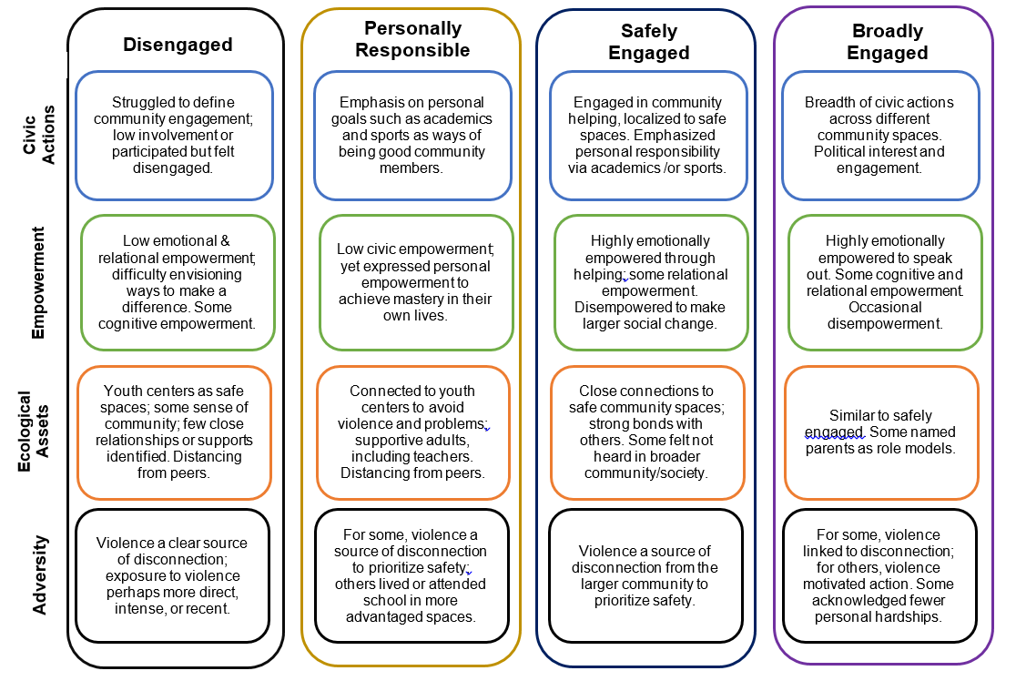
Created by Laura Wray-Lake & Laura S. Abrams. All rights reserved.
Notes:
Chapter VII tests a conceptual model of four pathways of civic development.
TALKING POINTS:
The disengaged pathway included youth (n = 22) who pulled back from peers, other relationships and community spaces to avoid community violence. These youth expressed civic disempowerment, feeling like they could not make a difference, although they had some cognitive empowerment in articulating structural roots of problems.
The personally responsible pathway (n = 10) include youth who focused on academics, sports, and other personal strivings, and saw these activities as ways of being a good community member. They were lower on civic empowerment and not civically engaged in other ways.
The safely engaged pathway (n = 42) was the most common, and youth were passionate about community helping and emotionally empowered within the specific spaces where they felt safe such as youth centers. Youth felt deeply connected to and supported by adults in these spaces, but not civically empowered or engaged in the broader community or society.
The broadly engaged pathway (n = 10) included youth who described a larger breadth of civic actions across settings and included political interest and/or engagement. These youth expressed emotional empowerment.

Slide 15
Implications for theory: Four tenets to make theory of civic development relevant for urban youth of color in high-poverty neighborhoods.
  Re-conceptualizing and measuring youth civic engagement
  Recognizing multiple pathways of civic development
  Integrating assets and adversities
  Specifying the primacy of empowerment
Created by Laura Wray-Lake & Laura S. Abrams. All rights reserved.
Notes:
TALKING POINTS:
Re-conceptualizing and measuring civic engagement to capture more informal, localized ways of engaging and new forms of civic engagement such as intervening to protect friends from harm.
Multiple pathways of civic development must be recognized, as youth are civically engaged in different ways depending on opportunities, experiences, and interests.
Future research should replicate findings on general and specific assets for civic development and be more precise about how, when, why, and for whom ecological assets support civic development. Adversities and assets work together to inform civic development and theory of civic development should incorporate adversities.
Theory of civic development would be strengthened by incorporating a multidimensional understanding of civic empowerment. This study adds evidence to support the validity of emotional, relational, and cognitive empowerment as concepts that map well onto youth of color’s expressions of civic commitments. There are other equally appropriate terms for these empowerment constructs, such as in the sociopolitical development (SPD) framework.

Slide 16
Implications for policy
Find macro solutions to community violence that involve youth in decision making and advocacy.
Invest in safe community spaces such as youth centers and ensure that all youth feel safe and welcome within them.
Prioritize schools as safe spaces and contexts where positive youth development can take place.
Created by Laura Wray-Lake & Laura S. Abrams. All rights reserved.

Slide 17
Implications for social work, youth work, and direct practice
Create civic opportunities that build on youth’s passions for local community issues.
Create an ethos of reciprocity with youth by showing youth they are cared for, valued, and heard.
Build informal civic opportunities into informal everyday safe community spaces.
Avoid general strategies to increase civic engagement without attending to the realities of the lived experiences of urban youth of color in high-poverty neighborhoods.
Listen to youth and avoid negative stereotypes and judgements against urban youth of color.
Created by Laura Wray-Lake & Laura S. Abrams. All rights reserved.

Slide 18

Funding
This material is based upon work funded by the Office of Research and Evaluation at the Corporation for National and Community Service (CNCS) under Grant No. 17REHCA001 through the National Service and Civic Engagement research grant competition. Opinions or points of view expressed in this document are those of the authors and do not necessarily reflect the official position of, or a position that is endorsed by, CNCS.
Created by Laura Wray-Lake & Laura S. Abrams. All rights reserved.

