Slide 1

Modeling the emergence of size sequencing skills
Maggie McGonigle-Chalmers (maggie.mcgonigle@ed.ac.uk)
Iain Kusel (iainkusel@hotmail.com)
monographmatters.srcd.org
Notes:
This presentation is an introduction the computational models specified in Chapters 3 and 5 of the monograph.
These are the heuristic, transitional, principled and ordinal models.

Slide 2
Monograph citation
McGonigle‐Chalmers, M. & Kusel, I. (2019). The development of size sequencing skills: An empirical and computational analysis. Monographs of the Society for Research in Child Development, 84(4). https://doi.org/10.1111/mono.12411
monographmatters.srcd.org
Notes:
The monograph citation is included here.

Slide 3
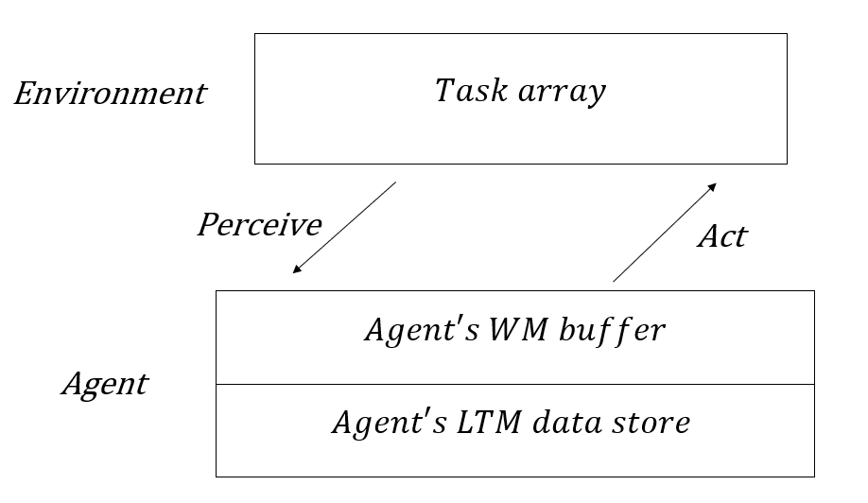
Overview of task and agent
monographmatters.srcd.org
Notes:
The models in the paper aim to get ‘inside the head’ of the child as they learn to seriate.
As shown in the diagram, the models all consist of a simulated agent interacting with a simulated task array.
The agent has a working memory (WM) buffer, a long-term memory (LTM) data store, and some design constraints.
It can perceive, buffer information, learn representations and act in an ongoing simulation cycle.

Slide 4
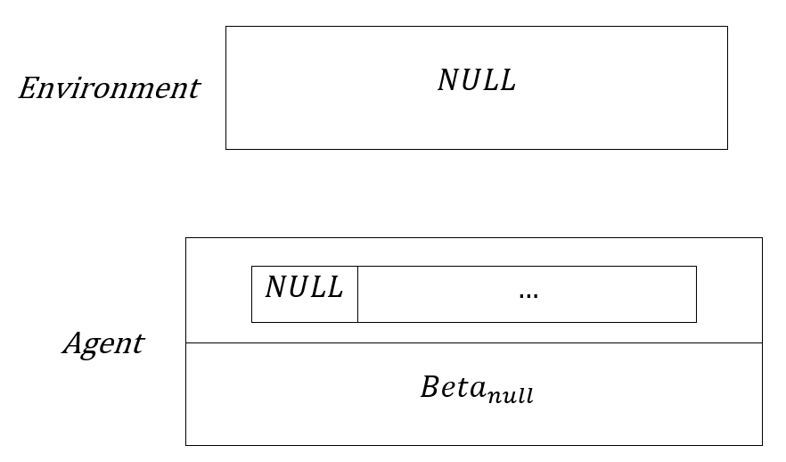
Overview of task and agent (con.)
monographmatters.srcd.org
Notes:
The agent can be considered to have an empty WM and LTM, prior to any exposure to information in the task environment.
This diagram represents the absence by NULL values in agent and environment.

Slide 5
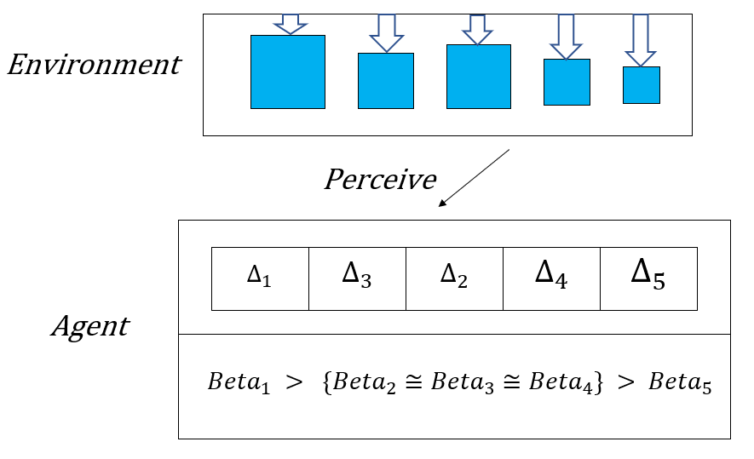
Heuristic model #1
monographmatters.srcd.org
Notes:
On 1st exposure to a set of stimuli, the immature agent uses its design constraints to parse what it sees.
It starts off with a very fuzzy concept of different size relations (BIG and SMALL relations only).
An evolving rank of Beta distributions in LTM makes this fuzzy concept more concrete over task time.
As illustrated in the diagram, on being presented with a set of stimuli to sequence, the agent:
Detects the perceived size differences between the initial reference point and each set element;
Stores these size differences in WM;
Initiates an LTM representation via a set of Beta distributions, with small biases towards each end.

Slide 6
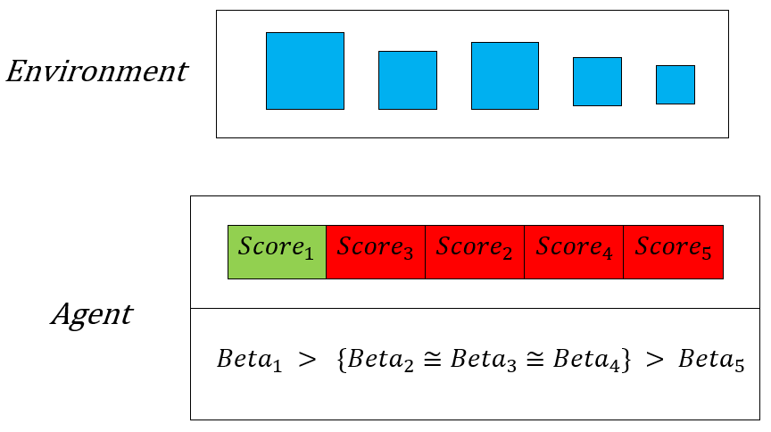
Heuristic model #2
monographmatters.srcd.org
Notes:
As illustrated in the diagram, on completing a scan of the set, the agent:
Scores the stimuli using an equation that combines WM and LTM values;
Assigns each stimulus a probability value, which collectively sum to 1;
Assigns a winning stimulus from a set of probabilities (as indicated by the green cell);
If an error is made (as indicated by the red cells), the agent tries again until the right stimulus is selected.

Slide 7
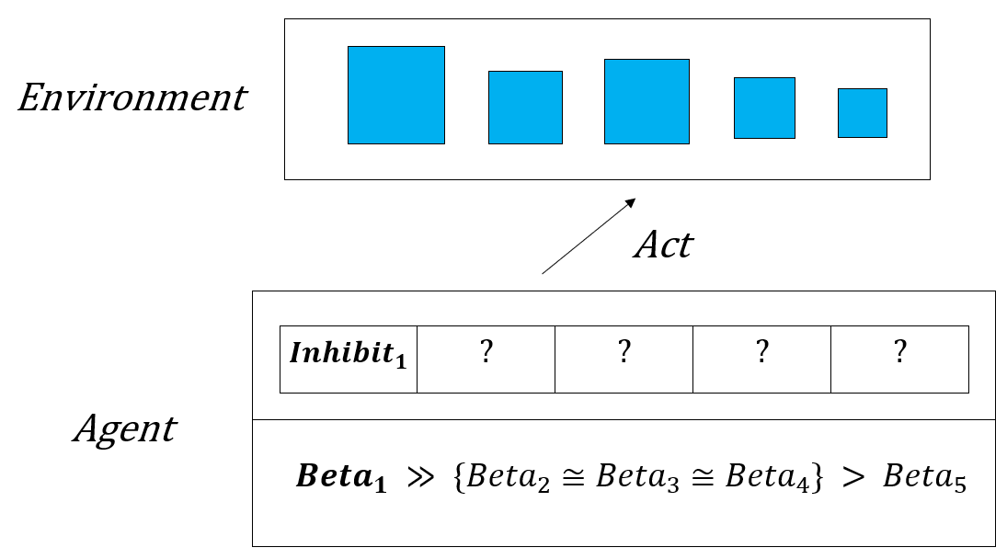
Heuristic model #3
monographmatters.srcd.org
Notes:
As illustrated in the diagram, on selecting the winning set element, the agent:
Inhibits the selected stimulus from further selection;
Updates the Beta distributions to a stronger rank.
The immature agent’s WM cannot maintain the set of perceived differences.
On stimulus selection, these size differences are 'knocked out' of WM on action selection.
The assumption is that the immature agent has a weak WM.
However, it’s WM can maintain an inhibition tag against the stimuli selected.

Slide 8
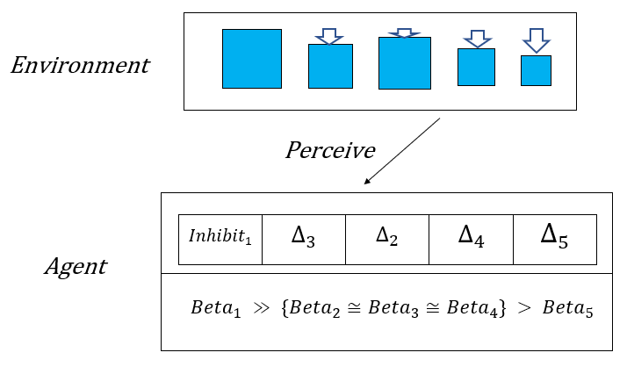
Heuristic model #4
monographmatters.srcd.org
Notes:
Now, the agent must select the next target stimulus.
As illustrated in the diagram, the selected stimulus is now the referent, and the remaining stimuli are processed in the same way as the 1st stimulus, until a correct target sequence has been made.

Slide 9
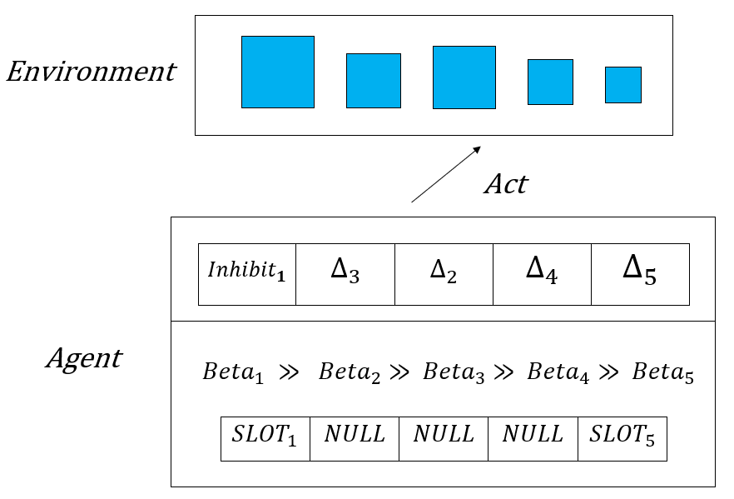
Transitional model
monographmatters.srcd.org
Notes:
The transitional model represents developmental progression from an immature to a mature system.
As illustrated in the diagram:
This model has a stronger WM, allowing the agent to maintain size difference information on correct action selection, unlike within the heuristic model;
Now the size differences in WM form a set, within which meaningful comparisons can be made;
The discovery is then made that the smallest size difference between elements of any such set always indicates the correct answer;
We represent this growing knowledge of set structure via a set of gradually emerging slots.

Slide 10
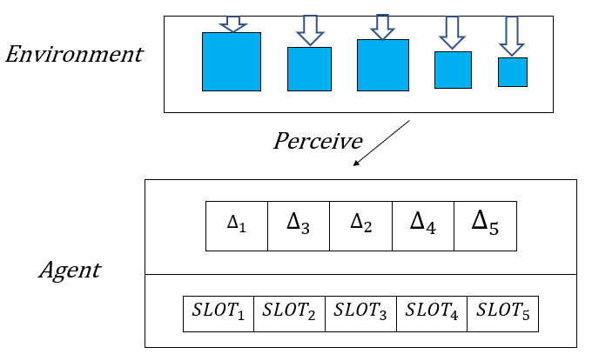
Principled model
monographmatters.srcd.org
Notes:
As illustrated in the diagram:
Within the principled model, a set of slots is now in place in LTM, having been established via the transitional model;
The mature agent can now spontaneously use slots to inform choice (‘select smallest size interval’).
This results in close to error-free size sequencing.

Slide 11
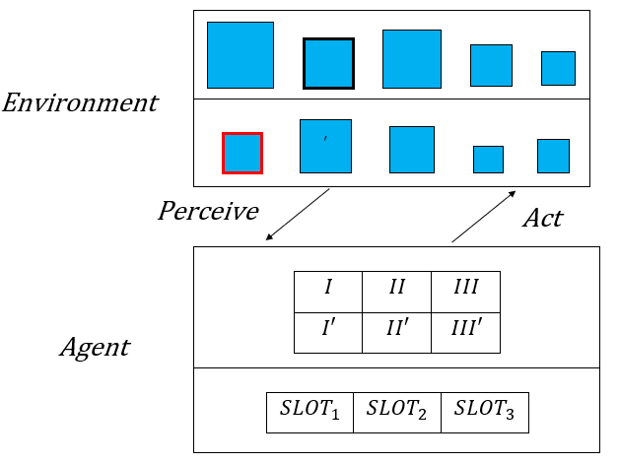
Ordinal model
monographmatters.srcd.org
Notes:
Within the ordinal model, a set of slots is now in place, having been established via the transitional model.
As illustrated in the diagram:
The agent must select the shape indicated by the red border on the bottom array, which is analogous to the shape indicated by the black border in the top array (these colors are for illustration of the target ordinal position only);
The mature agent can now spontaneously use slots now in place in LTM to inform choice, as per the principled model;
However, the task demands now provoke the agent into cumulatively tallying the results of such choices in WM;
This results in close to error-free ordinal matching.
Within the heuristic model, we had very noisy, uncertain selection, allowed by classifying the stimuli into BIG and SMALL relations.
Within the principled and ordinal models, the agent has ordering knowledge gained from prolonged trial and error experience with size-related sets.
A discontinuous, process model, it has allowed us to look ‘inside the head’ of the child in the context of these ordering tasks.

