Slide 1

Computational Models in Developmental Psychology
Maggie McGonigle-Chalmers (maggie.mcgonigle@ed.ac.uk)
Iain Kusel (iainkusel@hotmail.com)
monographmatters.srcd.org
Notes:
This presentation is supplementary teaching material for the monograph.
It considers the two existing models of seriation referenced in the monograph, and then considers more broadly the theme of computationally modeling in developmental psychology.

Slide 2
Monograph citation
McGonigle‐Chalmers, M. & Kusel, I. (2019). The development of size sequencing skills: an empirical and computational analysis. Monographs of the Society for Research in Child Development, 84(4). https://doi.org/10.1111/mono.12411
monographmatters.srcd.org
Notes:
The monograph citation is included here.

Slide 3
What should a model of development deliver?
How best understand the transition mechanisms that promote change?
First, simulate the competence of a child at an initial level X
Second, establish a mechanism that can transform representations at X to a new level Y
Finally, account for all activities between X and Y
monographmatters.srcd.org
Notes:
(Adapted from Simon and Halford, 1995, p. 2.)
There are three components that are required in order to understand the central question in development: What is the nature of the transition mechanisms that promote change?
First, there needs to be a performance model that can simulate the competence of a child or adult at a given level of competence;
Second, there needs to be a principled mechanism that can transform the representations at the initial level into new representations supporting some more advanced level of processing;
Finally, there must be a clear account of the activities engaged in by the individual(s) to be modeled between the start and end states of the transition concerned.

Slide 4
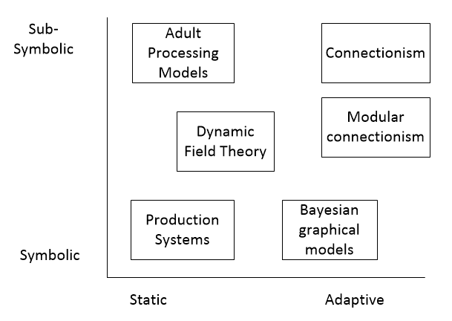
Developmental models ‘taxonomy’
See Schlesinger & McMurray, 2012
monographmatters.srcd.org
Notes:
Schlesinger & McMurray (2012) considered a wide range of computational models in developmental psychology.
As illustrated, they produced a ‘taxonomy’ of models along two dimensions:
1. Symbolic v’s Sub-symbolic;
2. Static v’s Dynamic.
‘Symbolic’ as a term is broadly the use of knowledge representations that include logical or linguistic aspects, and ‘sub-symbolic’ is the distributed representation of knowledge across graphical structures.
Another way of looking at models of cognitive development is whether they are normative (specifying how an ideal cognition may be structured) or process (specifying information processing mechanisms of cognition) based.
See Mareschal (2010) on this valuable 3rd dimension of comparison.

Slide 5
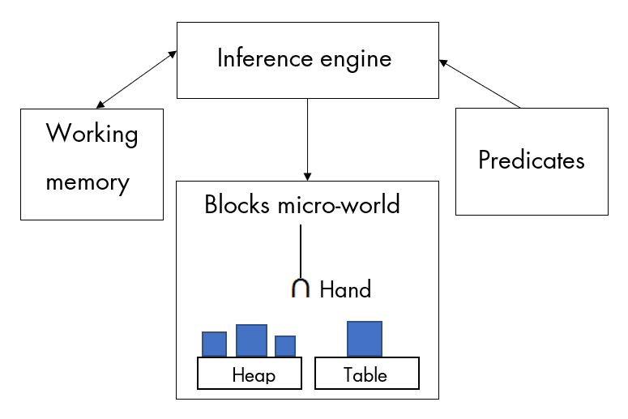
Production systems model of seriation (Young, 1978)
monographmatters.srcd.org
Notes:
Production systems can be used to model cognition and were widely used in the 1970s to represent Piagetian tasks.
As illustrated, Young (1978) showed how a production system’s working memory, knowledge base and inference engine can work together to seriate blocks.
He used sets of rules to specify how the younger child may fail to seriate, as well as how the older child may achieve expertise.
A continuous, process model of development, expertise was represented as the principled addition of more and more rules.
It did not consider ordinal understanding, however.

Slide 6
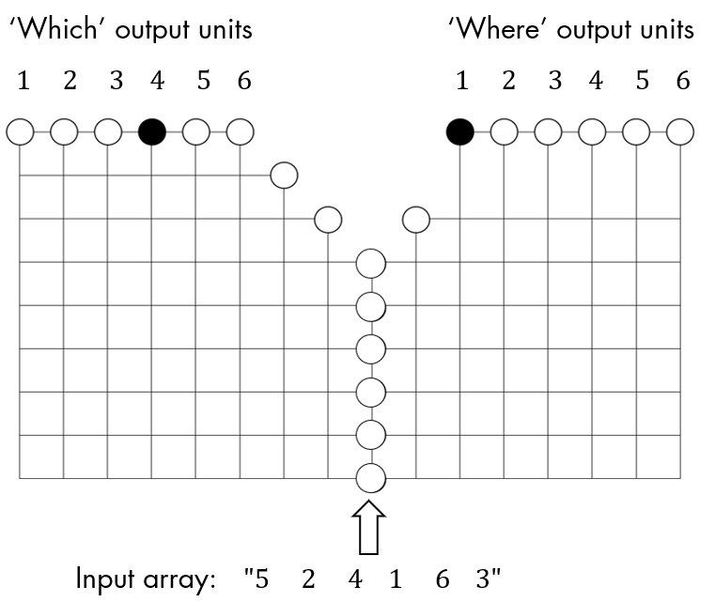
Connectionist model of seriation (Mareschal & Shultz, 1999)
monographmatters.srcd.org
Notes:
Connectionist systems can also be used to model cognition, were used in the 1990s to represent Piagetian tasks, and are widely used in developmental psychology today.
As illustrated, Mareschal & Shultz (1999) showed how connectionist systems split up to solve different tasks (modules for ‘which one to I select?’ and ‘where do I put that?’) can work together to seriate blocks.
They used two dynamically evolving modular connectionist systems to specify how the younger child may fail to seriate, as well as how the older child may achieve expertise.
A continuous, process model of development, expertise was represented as the principled addition of ‘hidden units’ within the two modules.
It did not consider ordinal understanding, however.

Slide 7
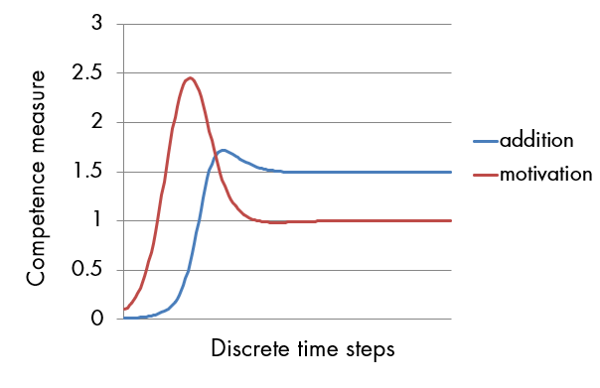
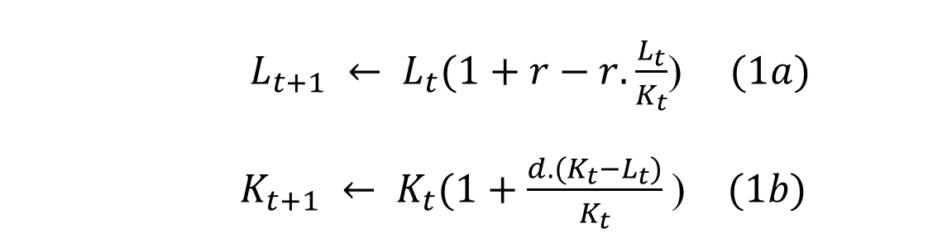
Dynamical systems of development
$L_{t+1} ← L_{t}(1+r−r. \frac{L_{t}}{K_{t}}$) $(1a)$
$K_{t+1} ← K_{t}(1+\frac{d.(K_{t}−L_{t})}{K_{t}}$) $(1b)$
See van Geert (1994, p. 180; 2014, supplemental spreadsheet)
monographmatters.srcd.org
Notes:
Dynamical systems can also be used to model developmental cognition, were also used in the 1990s to represent developmental psychological tasks and are also widely used in developmental psychology today.
As illustrated, van Geert (1994, p. 180; 2014, supplemental spreadsheet) showed how difference equations can simulate the shape of developmental change.
Coupled difference equations (such as those for addition competence and motivation, shown in equations 1a and 1b) represent the growth of a competence level over time.
They show how configuring the coupling variables in various ways may lead to the spurts, plateaus and regressions characteristic of developmental change.
Being a normative model, it does not consider information processing mechanisms.

Slide 8
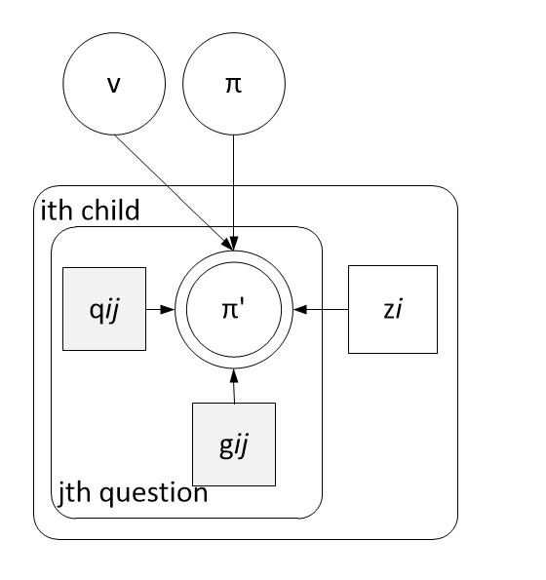
Bayesian models of development
See Lee & Sarnecka, 2011
monographmatters.srcd.org
Notes:
Bayesian graphical models can also be used to model developmental cognition and are also widely used in developmental psychology today.
As illustrated, Lee & Sarnecka (2011) modeled Carey’s ‘number knower’ task, Give-N.
This task asks children to generate sets of a given number.
A set of probability distributions are given data about how children answer questions in this task.
These probability distributions are tuned to generate answers to Give-N questions, giving insights into why younger children fail and older children pass.
Being a normative model, it does not consider information processing mechanisms.

Slide 9
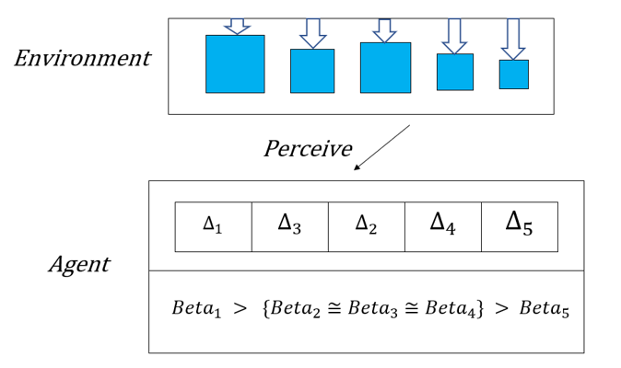
A hybrid model of emergent size sequencing
See McGonigle‐Chalmers & Kusel, 2019
monographmatters.srcd.org
Notes:
The monograph proposes a set of models that learn to sequence sets of varying size, and subsequently address tasks of ordinal understanding.
Combining modeling methodologies, it is a hybrid model; as such, it combines different ways of representing knowledge and processing information in WM and LTM.
A discontinuous, process model of development, expertise was represented as a set of LTM slots (evolving from LTM continuous probability distributions).
Slots indicate the emergence of a rule that guides action (‘select smallest size difference’).
These models are described in the PowerPoint presentation ‘Models featured in the Development of Size Sequencing Skills monograph - SRCD - 84.4.pptx’.
Readers are encouraged to inspect these models and ask how well they answer the question posed in slide, ‘What should a model of development deliver?’

Slide 10
Exciting routes towards modeling development
Neuroconstructivism: “…encellment, embrainment, embodiment and ensocioment.” (Sirois et al., 2008)
Enaction and the cognitive dynamics of living systems (Di Paolo et al., 2017)
Developmental and evolutionary robotics (Cangelosi et al., 2015; Pollack, 2014)
Models of human logical reasoning (Stenning & Van Lambalgen, 2012)
monographmatters.srcd.org
Notes:
These four approaches model the development of perception, learning and action selection in new ways, as well as incorporating symbolic cognition.
Readers are encouraged to inspect this literature and ask how well the models answer the question posed in slide, ‘What should a model of development deliver?’

Slide 11
Where is my model in Popper’s three worlds?
Dynamical models
World 1
Physical and biological
World 2
Mental
World 3
Cultural artefacts
Symbolic models
monographmatters.srcd.org
Notes:
The diagram shows Popper’s three worlds of knowledge: 1. the physical and biological; 2. the mental; and 3. the cultural.
Depending on where in these three worlds your interest lies, your route towards building a suitable model will likely change.
Dynamical systems are suitable for building a wide range of physical and biological models of change, including cognitive change.
However, modeling human adult reasoning may need a type of model that represents symbols and their manipulation, e.g. logic programming (Stenning & Van Lambalgen, 2012).
Merging such modeling requirements is a significant challenge for models of development.

Slide 12
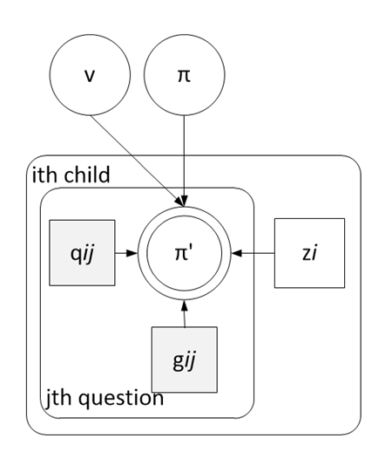
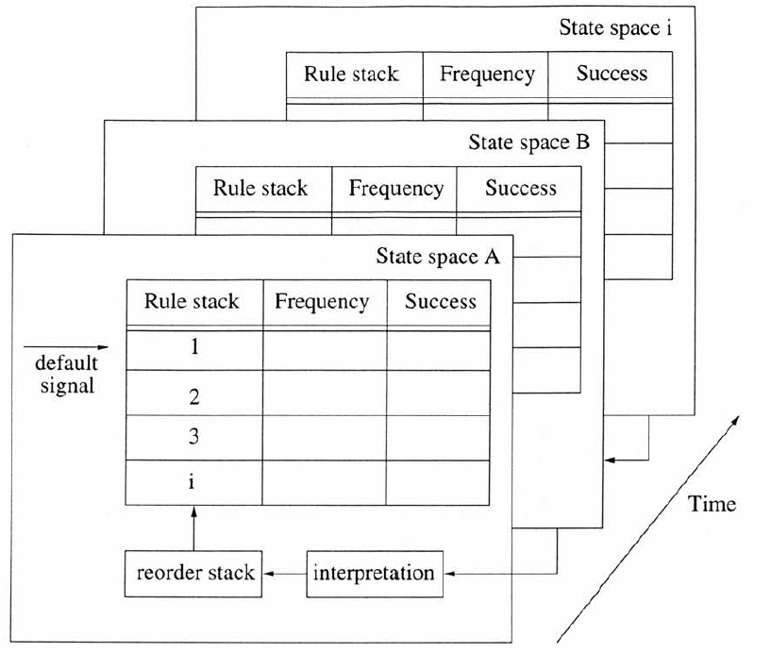
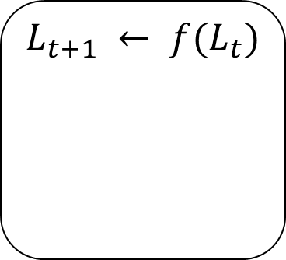
Concluding remarks
Many different types of model are needed to understand development!
The importance of multiple representations (Minsky, 1988)
Agent
$$L_{t+1} ← {f(L}_{t})$$
monographmatters.srcd.org
Notes:
It is becoming clear that multiple ways of representing knowledge and learning in models are needed to understand how cognition develops.
This point intersects with Minsky’s (1988) position on how we likely hold many different representations for solving problems.

Slide 13
Concluding remarks (con.)
Piagetian criticisms of computational modeling:
  Bayesian inference is only one learning rule of many. What’s so special about it? (Bickhard, 2016)
  “…implication is logically necessary, and so is not the same thing as stochastic likelihood….” (Smith, 2011)
Is it possible to model the emergence of necessary knowledge?
monographmatters.srcd.org
Notes:
Piagetian theorists have pointed out the limitations of computational models.
Bickhard (2016) points out that there are many ways of representing learning, and Bayesian inference is only one of these. Other routes to learning are equally plausible.
He also notes that the Bayesian modeling approach assumes the presence of hypotheses and does not usually specify how new hypotheses come into play.
He points to Piaget’s concept of equilibration, which does describe the emergence of novelty.
Smith (2011) echoes this position, pointing to the modal notion of necessity (a conscious understanding that, for example, 2 + 2 = 4 must be the case, as opposed to probably be the case) being absent in probabilistic models of mind.
This raises the question: can this crucial aspect of development be represented by a computational model?
If so, what sort of a design for an intelligent system would do this aspect of development justice?

Slide 14
References
Bickhard, M. H. (2016). Probabilities over What? Human Development, 59(1), 34-36.
Cangelosi, A., Schlesinger, M., & Smith, L. B. (2015). Developmental robotics: From babies to robots. MIT Press.
Di Paolo, E., Buhrmann, T., & Barandiaran, X. (2017). Sensorimotor life: An enactive proposal. Oxford University Press.
Lee, M. D., & Sarnecka, B. W. (2011). Number-knower levels in young children: Insights from Bayesian modeling. Cognition, 120(3), 391-402.
Mareschal, D., & Shultz, T. R. (1999). Development of children’s seriation: A connectionist approach. Connection Science, 11(2), 149–186.
Mareschal, D. (2010). Computational perspectives on cognitive development. Wiley Interdisciplinary Reviews: Cognitive Science, 1(5), 696-708.
monographmatters.srcd.org
Notes:
All authors discussed in this presentation are referenced in this section.

Slide 15
References (con.)
Minsky, M. (1988). Society of mind. Simon and Schuster.
Pollack, J. B. (2014). Mindless intelligence: Reflections on the future of AI. In P. A. Vargas, E. A. Di Paolo, I. Harvey, I., & P. Husbands (Eds.), The horizons of evolutionary robotics. Cambridge: MIT Press.
Schlesinger, M., & McMurray, B. (2012). The past, present, and future of computational models of cognitive development. Cognitive Development, 27(4), 326-348.
Schöner, G., & Spencer, J. (2015). Dynamic thinking: A primer on dynamic field theory. Oxford University Press.
Simon, T. & Halford, G.S. (Eds) (1995) Developing Cognitive Competence: New Approaches to Process Modelling, Hillsdale, N.J.: Erlbaum
monographmatters.srcd.org
Notes:
All authors discussed in this presentation are referenced in this section.

Slide 16
References (con.)
Sirois, S., Spratling, M., Thomas, M. S., Westermann, G., Mareschal, D., & Johnson, M. H. (2008). Précis of Neuroconstructivism: How the brain constructs cognition. Behavioral and Brain Sciences, 31(3), 321-331.
Smith, L. (2011) in Goswami, U. C. The Wiley-Blackwell handbook of childhood cognitive development.
Stenning, K., & Van Lambalgen, M. (2012). Human reasoning and cognitive science. MIT Press.
van Geert, P. (1994), Dynamic systems of development: change between complexity and chaos, Harvester Wheatsheaf.
van Geert, P. (2014). Dynamic modeling for development and education: from concepts to numbers. Mind, Brain, and Education, 8(2), 57-73.
Young, R. M. (1978), Strategies and the structure of cognitive skill, Strategies of Information Processing, Underwood, G. (Ed.), Academic Press, London.
monographmatters.srcd.org
Notes:
All authors discussed in this presentation are referenced in this section.

